Slide 1
Life Orientation: Life Skills
NQF 2

Slide 2
Discover ways to manage emotions & personal relationships intelligently
Module 4

Slide 3
Think about it…
What kinds of relationships are there?
Can emotions be controlled in a healthy way?
Are there proven ways to resist pressure from peers & bullies?

Slide 4
Positive relationships & how to form them
Unit 4.1

Slide 5
What is a relationship?
A connection between two or more people.
Relationships can be:
Professional.
Interpersonal.
Close personal.
Intimate.

Slide 6
Positive relationships show:
Honesty.
Respect.
Trust.
Empathy.
Sharing.
Listening.
Discretion.
Inclusivity & non-discrimination.
Figure 4.1: All good relationships are based on respect, trust and understanding

Slide 7
Learning activity 4.1
Module 4
Test your knowledge of this section – and evaluate one of your important relationships – by completing Learning activity 4.1 in your Student’s Book.

Slide 8
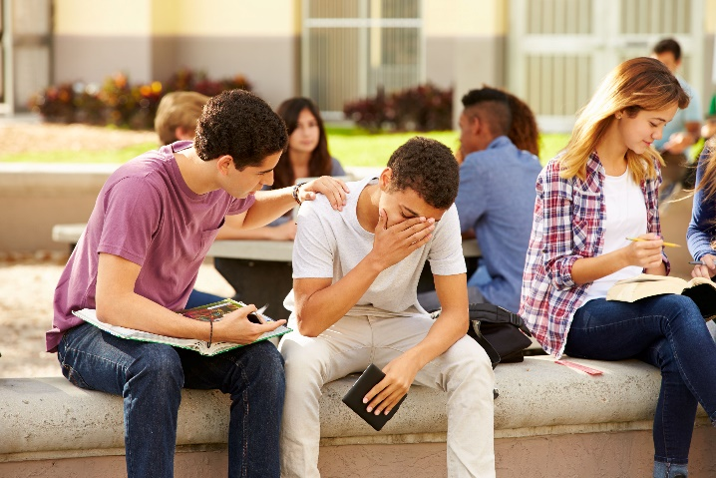
Strategies for forming healthy relationships
Healthy relationships should benefit both people.
Unbalanced, unhealthy, negative relationships harm one (or both) people.

Slide 9
How can you build healthy, valuable relationships?
Be cautiously optimistic.
Create healthy boundaries.
Use good social skills.
Practise clear communication.

Slide 10
How can you build healthy, valuable relationships?
Resolve conflict well.
Be tolerant.
Show integrity.
Be responsible.
Show reciprocation.
Have a positive attitude.

Slide 11
Click above to play this video.

Slide 12
Learning activity 4.2
Module 4
Test your knowledge of this section – and evaluate one of your important relationships – by completing Learning activity 4.2 in your Student’s Book.

Slide 13
Emotions
Unit 4.2

Slide 14
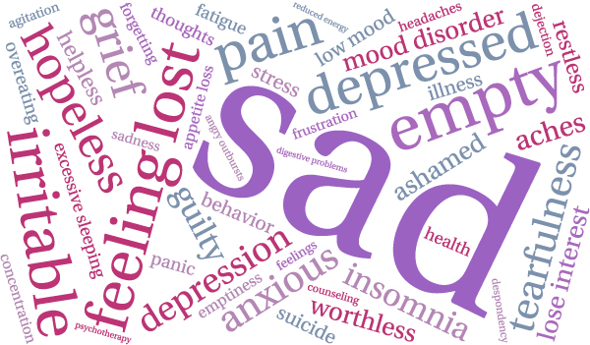
What are emotions?
Strong feelings, such as happiness, sadness or fear.
Emotions need to be controlled & expressed appropriately.

Slide 15
Appropriate ways to express emotions
Refer to Tables 4.1 & 4.2 in your Student’s Book to see how to express yourself in different relationships.

Slide 16
Learning activity 4.3
Module 4
Test your knowledge of this section – and evaluate one of your important relationships – by completing Learning activity 4.3 in your Student’s Book.

Slide 17
Deal with emotions constructively
Some emotions are overwhelming, such as:
Disappointment.
Anger.
Sadness.
You need to practise self-control.

Slide 18
Deal with emotions constructively
Strategies to remain calm include:
Don’t complain without real reason.
Talk to the right people.
Pause & take three to five deep breaths.
Try not to talk or act when you’re overcome with anger.

Slide 19
Deal with emotions constructively
Seek professional help if your anger or sadness doesn’t go away.
Get enough sleep, exercise & good nutrition.
Practise having a positive outlook.
Smile more.

Slide 20
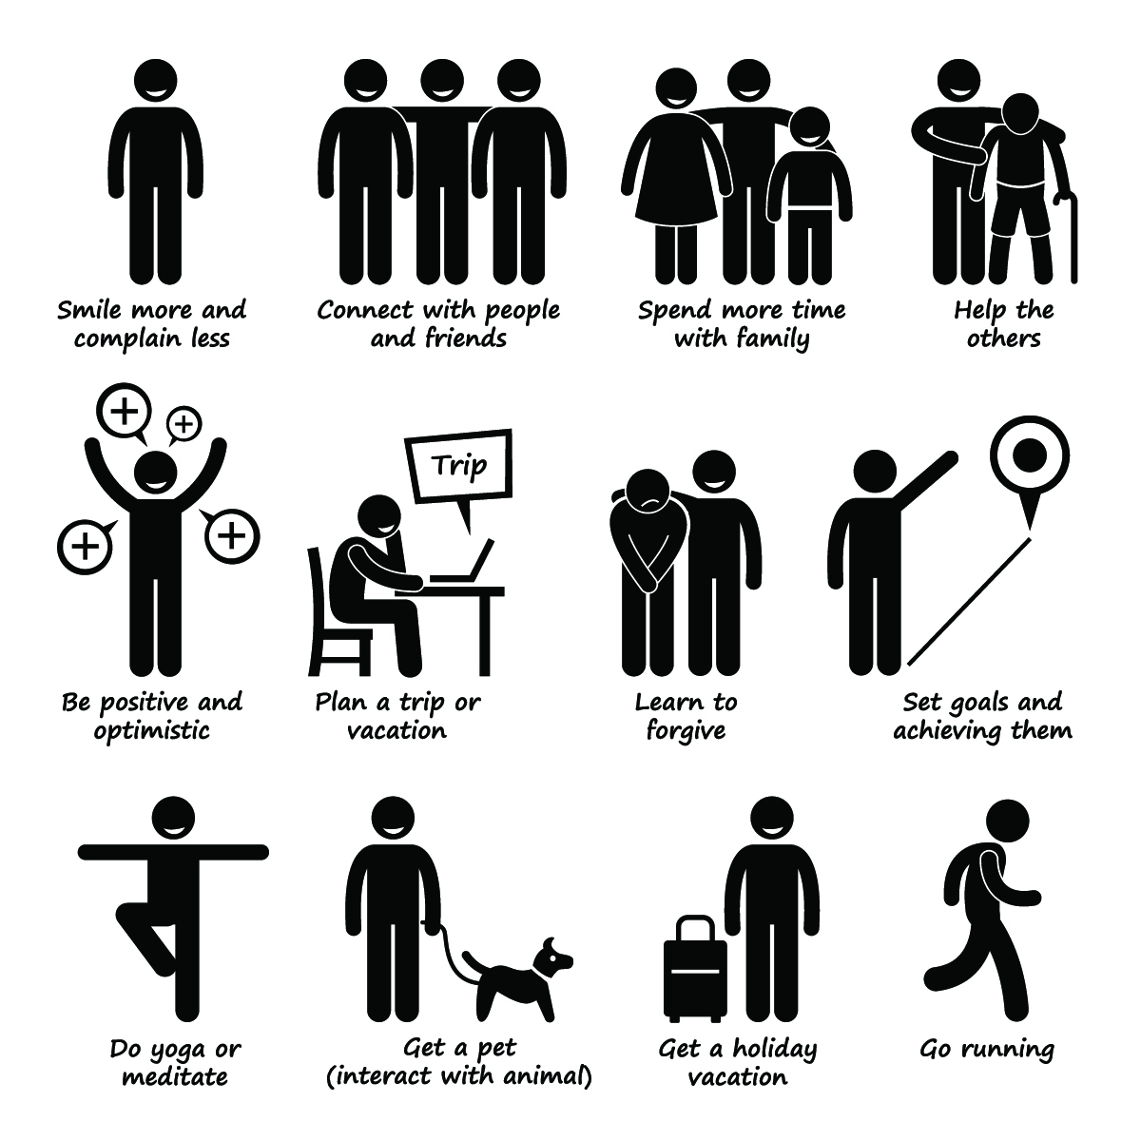
Figure 4.12: Examples of ways to cultivate happiness

Slide 21
Learning activity 4.4
Module 4
Test your knowledge of this section – and your strategies for dealing with emotions – by completing Learning activity 4.4 in your Student’s Book.

Slide 22
Negative peer pressure & bullying
Unit 4.3

Slide 23
What are peers?
Peers are a group of people with one or more of the following:
Same age.
Same social standing.
Shared interest(s).

Slide 24
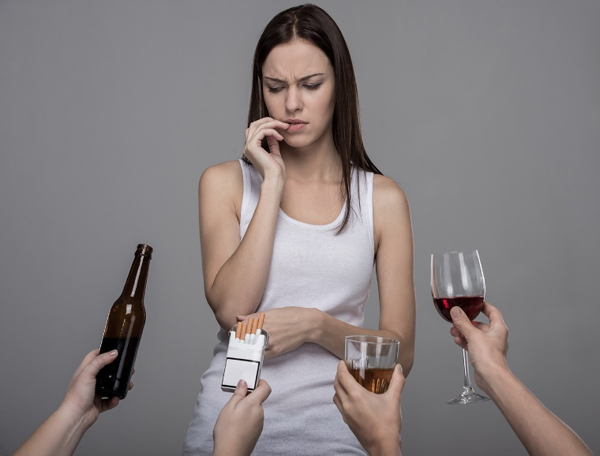
What is peer pressure?
It is when someone:
Is influenced by peers.
Does things to feel liked or accepted by the group.
Peer pressure can be positive or negative.
Figure 4.13: Examples of peer pressure – what else can you think of?

Slide 25
What is bullying?
Bullying is a form of abuse.
Bullies:
Humiliate their victims.
Intimidate others.
Abuse their victims physically & emotionally.
Cause worry & fear.
Damage or take others’ possessions.
Bullying is always negative.

Slide 26
How to resist negative peer pressure & bullying
Understand how bullies think & work.
Don’t feel pressurised into feeling shame.
Avoid facing the bully alone.
Take action.
Be your own person.

Slide 27
Click above to play this video.

Slide 28
Learning activity 4.5
Module 4
Test your knowledge of this unit by completing Learning activity 4.5 in your Student’s Book.

Slide 29
Challenges of being a college student
Unit 4.4

Slide 30
Coping with challenges at college
A challenge is a situation that needs commitment, effort & perseverance.
To cope with challenges at college
(& in life):
Be resilient.
Stay positive.

Slide 31
Coping with challenges at college
Use decision-making skills.
Handle your independence well.
Learn to cope with change.
Set your own boundaries.
Look after yourself & your possessions.

Slide 32
Learning activity 4.6
Module 4
Test your knowledge of this unit – and see how well you are coping at college –
by completing Learning activity 4.6 in your Student’s Book.

Slide 33
Module 4
Test your knowledge of this module by completing the Summative assessment of Module 4 in your Student’s Book.

