Slide 1
Life Orientation: Life Skills
NQF 2

Slide 2
Plan & manage your time in terms of activities & responsibilities
Module 3

Slide 3
Think about it…
Time just flies … or do we have some control over it?
Does delaying things actually have a snowball effect?
What are the principles that will help us use our time in the best way?

Slide 4
Time management
Unit 3.1

Slide 5
What is time management?
Handling, directing, organising, coordinating & controlling your time.
Using techniques, skills & tools to plan your time & meet your goals.
Failure to prioritise results in poor time management…

Slide 6
What are the principles of time management?
Prioritising things every day.
Planning ahead.
Not wasting time.
Being proactive.
Performing well.

Slide 7
How can you perform well?
Be organised.
Remain focused.
Follow a routine.
Refuse politely.
Monitor your progress.
Be on time.
Figure 3.4: Identify things that easily distract you & think about how you can manage this

Slide 8
Click above to play this video.

Slide 9
Learning activity 3.1
Module 3
Test your knowledge of this unit – and evaluate your time management habits – by completing Learning activity 3.1 in your Student’s Book.

Slide 10
Punctuality, due dates & procrastination
Unit 3.2

Slide 11
What is punctuality?
Being on time by:
Planning your time.
Planning for unexpected delays.
Arriving early for class, work or appointments.
Meeting deadlines.

Slide 12
What is a due date?
The latest date to do something.
Also called:
Cut-off date.
Final date.
Deadline.

Slide 13
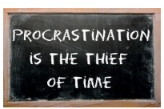
What is procrastination?
Delaying or putting off doing something that should be done now.
Procrastination can become a habit!
Figure 3.7: Delaying the completion of a task will add stress and make you feel pressured

Slide 14
Why are punctuality and due dates important?
Tasks need to be completed by certain dates.
Everyone involved needs to do their part to meet the schedule.
Being late or missing deadlines inconveniences others.

Slide 15
Figure 3.9: When you, your work or your payment is late, you portray certain characteristics
Seem to have poor self-discipline
Might be unreliable & cannot really be trusted
Seem to be unprofessional
Don’t consider the appointment or activity important
Being late shows that you:
Are unfocussed because you lost track of time
Don’t respect other people or their time, schedule or commitments
Don’t care about the stress it causes you or the other parties
Didn’t consider the ripple effect of your lateness on the plans or work of others

Slide 16
When you procrastinate, you:
Lose track of the urgency of a task.
Feel anxious & stressed.
Lack focus.
Neglect other commitments.
Need to put in more effort.
Inconvenience yourself & others.
Give yourself a bad reputation.
Harm your self-image.

Slide 17
Learning activity 3.2
Module 3
Test your knowledge of this unit by completing Learning activity 3.2 in your Student’s Book.

Slide 18
Timewasters
Unit 3.3

Slide 19
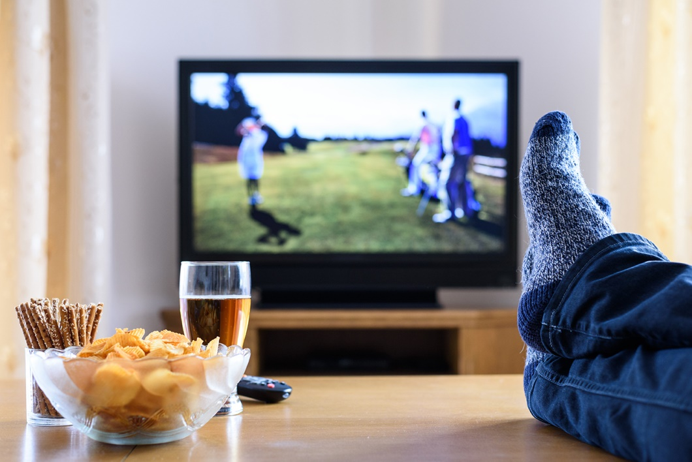
What are timewasters?
Anything that stops you from using your time in the best way!
Figure 3.12: Watching TV may help you to relax, but it can be a timewaster if you don’t plan your time wisely

Slide 20
Table 3.1: Examples of common timewasters
What are timewasters?
External source of time wastage | Internal source of time wastage
Interruptions (e.g. incoming phone calls & messages) | Sleeping late
Distractions around you (e.g. noise) | Having no plan of action for the day
Unexpected visitors | Failing to prioritise activities
Unexpected changes in circumstances | Lacking focus
People who change their mind or let you down | Failing to delegate tasks to others or to ask for assistance
Being given extra tasks at short notice | Spending too much time talking to friends in person or on the phone (e.g. via Skype, emails, texting or instant messaging)

Slide 21
Table 3.1: Examples of common timewasters
What are timewasters?
External source of time wastage | Internal source of time wastage
Long queues (e.g. at tellers or in waiting rooms) | Spending too much time on traditional media (e.g. magazines, newspapers, TV, movies)
Delays (e.g. in delivery times, getting feedback, being assisted) | Spending too much time on the digital and social media (e.g. the Internet, YouTube, blogs, Twitter, Facebook, Instagram)
People who are late for appointments | Visiting a person or place for longer than you planned to
Bureaucratic red tape, lengthy instructions | Being indecisive, or making the wrong choices

Slide 22
Table 3.1: Examples of common timewasters
What are timewasters?
External source of time wastage | Internal source of time wastage
Meetings that serve no real purpose | Not listening carefully to instructions
Breakdowns (e.g. cars, equipment, machinery) | Underestimating how long an activity will take
Traffic jams | Being ignorant of what to do
Power failures | Redoing a task over & over to get it perfect
Crises (e.g. health, economic, nature) | Being stressed or tired

Slide 23
Stop wasting your time!
Try to prioritise & plan.
Keep things simple.
Have regular wake-up & bedtimes.
Do urgent tasks first.
Use productive time wisely.
Remember to focus.
Avoid distractions.
Set boundaries.
Don’t take on too much.
Keep your space tidy.

Slide 24
Click above to play this video.

Slide 25
Learning activity 3.3
Module 3
Test your knowledge of this unit – and timewasters in your life – by completing Learning activity 3.3 in your Student’s Book.

Slide 26
Time management tools
Unit 3.4

Slide 27
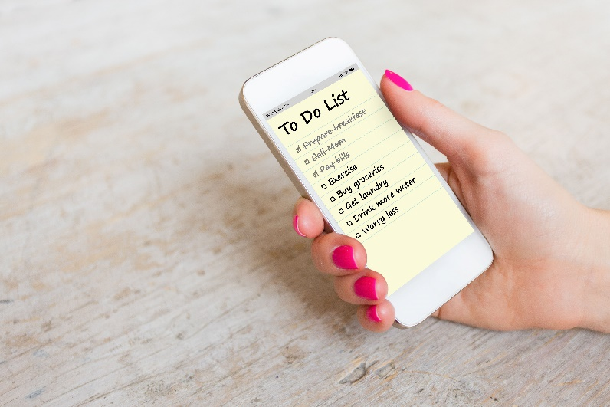
What is a time management tool?
Something to help you manage your time better, such as to-do lists, project tracking software & apps.
Time management helps you plan for
short-, medium- & long-term goals.

Slide 28
Examples of time management tools
Time logs (logbooks) – used to track
your daily activities.
Table 3.2: Example of a time log
Time | What I did | How long it took me
06:12 | Made the bed, showered & got dressed | 34 minutes
06:46 | Ate breakfast and made sandwiches for my lunch pack | 15 minutes
07:01 | Listened to the news over the radio, & then to the talk show | 57 minutes
07:58 | Packed my bag and rushed to the bus stop | 3 minutes

Slide 29
Time management tools
Task lists – table with notes of activities
& events throughout the year.
Table 3.3: Dividing tasks into a task list
 | Weekly events | Monthly events | Half-yearly events | Annual events
Description | All weekly tasks and chores appear in the first column. | List all your monthly activities in the second column. | All your half-yearly activities go in the third column. | Write annual events in the fourth column.

Slide 30
Time management tools
Task lists – table with notes of activities
& events throughout the year.
Table 3.3: Dividing tasks into a task list
 | Weekly events | Monthly events | Half-yearly events | Annual events
Examples | Lectures, laundry, sport, choir practice, cleaning my room | Monthly class tests, budgeting, shopping, haircuts, savings club meetings | Mid-year exams, holidays, projects, practicals | Birthdays, competitions, final exams, anniversaries

Slide 31
Time management tools
Monthly & annual calendars – show every day & fill in any important dates, deadlines, appointments & holidays.
Figure 3.17: Some desk calendars stand up, while others lie flat and can consist of a large sheet for each month – the main thing is to keep the calendar where you can see it every day

Slide 32
Time management tools
Daily planning –
include everything from your calendar & a detailed to-do list.
Weekly planning –
include activities, meetings, deadlines, chores & a rest day.
Project planning –
break down tasks into subtasks & include dates on your calendar.

Slide 33
Learning activity 3.4
Module 3
Test your knowledge of this section – and your own planning – by completing Learning activity 3.4 in your Student’s Book.

Slide 34
Time management tools for planning
Excel pie charts & templates.
Outlook calendar & reminders.
Other software.
Refer to Examples 3.8 & 3.9 in your Student’s Book.

Slide 35
Learning activity 3.5
Module 3
Test your knowledge of this section by completing Learning activity 3.5 in your Student’s Book.

Slide 36
Module 3
Test your knowledge of this module by completing the Summative assessment of Module 3 in your Student’s Book.

