Slide 1
Life Orientation: Life Skills
NQF 2

Slide 2
Set realistic goals for your personal development, studies & career
Module 2

Slide 3
Think about it…
Why is it important to change my ambitions & dreams into goals?
How do I decide which goals are the most important for now?
What is the connection between goals & success?

Slide 4
Setting & prioritising goals
Unit 2.1

Slide 5
What is a goal?
Something that you want to achieve in the future.
Goals can be:
Short-term (within a few weeks/months).
Medium-term (within one or two years).
Long-term (within three or more years).

Slide 6
What are SMART goals?
Specific (clear).
Measurable (steps to reach).
Achievable (possible).
Realistic (relevant to you).
Time-bound (by dates).
Figure 2.1: SMART gets even smarter! Your goals should be ethical & you should record your progress, successes & any failures or setbacks

Slide 7
Table 2.1: Qualities of SMART goals
What are SMART goals?
Qualities | Description | Examples
Specific | The goal should be clear, precise and detailed: What do you want to accomplish? | A broad goal is: “I want to become fit.” Cebo’s specific goal is: “I will enter a 10 km road race this year and finish it comfortably.”
Measurable | You should be able to measure your progress: What steps must you take to achieve the goal? Which criteria must the goal meet along the way? | A measurable goal for Cebo is: “I will follow a training programme that will take me from a beginner runner to a 10 km contestant in just 25 weeks.”

Slide 8
Table 2.1 (continued): Qualities of SMART goals
What are SMART goals?
Qualities | Description | Examples
Achievable | The goal should be possible to reach, otherwise you will be disappointed. However, the goal shouldn’t be too easy either. | The training programme alternates walking with running for the first 16 weeks. Cebo needs to train for half an hour, five days a week. He decides that this is a manageable routine. He will run after classes and study in the evenings.

Slide 9
Table 2.1 (continued): Qualities of SMART goals
What are SMART goals?
Quality | Description | Example
Realistic | The goal should be relevant to your interests, abilities and values. Does the goal have real relevance to who you are? Will it really matter if you achieve this goal? | Cebo doesn’t like contact sports and prefers the freedom of the outdoors. He also feels no need to be in competition with others and wants to run just for the pleasure of being fit.

Slide 10
Table 2.1 (continued): Qualities of SMART goals
What are SMART goals?
Quality | Description | Example
Time-bound | The goal should be time-based. When do you want to achieve your goal? What are the dates for the different steps leading up to the final date? | Cebo has chosen a road race in his area in six months’ time. This will give him sufficient time to be well prepared for his first 10 km run.

Slide 11
Click above to play this video.

Slide 12
Learning activity 2.1
Module 2
Test your knowledge of this section by completing Learning activity 2.1 in your Student’s Book.

Slide 13
How can you prioritise your goals?
Decide the importance of each goal.
Divide into short-, medium- &
long-term goals.
Does your goal have long-lasting benefits?
Which goal energises you the most?

Slide 14
Learning activity 2.2
Module 2
Test your knowledge of this section – and your own goals – by completing Learning activity 2.2 in your Student’s Book.

Slide 15
Perseverance
Unit 2.2

Slide 16
What is perseverance?
Carrying on with a task until it is completed.
Not being distracted, discouraged or giving up.
Showing determination, dedication, strength & patience.

Slide 17
Examples of perseverance
Refer to Case studies 2.1 and 2.2 in your Student’s Book.
Think about other examples of perseverance.
How do you finish a race? One stride at a time. How do you acquire a skill? One practice session at a time. How do you get fit? One exercise after another. The secret is to start, and then to persevere.

Slide 18
Learning activity 2.3
Module 2
Test your knowledge of this unit by completing Learning activity 2.3 in your Student’s Book.

Slide 19
Factors that impact positively on the achievement of goals
Unit 2.3

Slide 20
Table 2.2: Qualities we choose for ourselves
Qualities we choose for ourselves
Qualities | Description
Attitudes | This is how you choose to think, feel and behave. Your attitude makes you respond either positively or negatively to circumstances, ideas and other people.
Values | These are the principles or standards that you hold as important and that guide your decisions and actions. At a deeper level, your values reflect what you think is morally right or wrong.
Skills | These are the ability to do something very well. Such expertise is developed through gaining knowledge, training and practice.

Slide 21
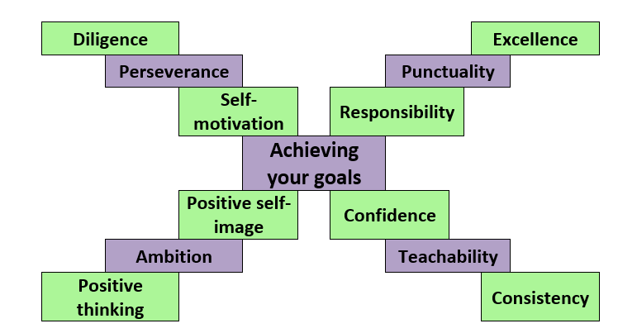
Positive factors affecting your goals
Figure 2.12: A diagram showing some of the attitudes, values & skills that have a positive impact on our goals

Slide 22
Learning activity 2.4
Module 2
Test your knowledge of this unit – and think about how positive influences help you – by completing Learning activity 2.4 in your Student’s Book.

Slide 23
Factors that impact negatively on the achievement of goals
Unit 2.4

Slide 24
Negative factors affecting your goals
Absenteeism.
Late-coming.
Laziness.
Unplanned pregnancy.
Poverty.
Taking care of minors.
Peer pressure.
Making harmful choices.
Self-sabotage.
Lack of perseverance.

Slide 25
How can you deal with negative factors?
Table 2.5: Examples of ways to deal with negative factors affecting the
achievement of goals
Negative influences | Examples of ways to overcome these obstacles
Absenteeism | Resist the temptation to skip classes or training sessions, as it will set you back in terms of understanding and practice. Arrange to meet a fellow student before each class, so that you can inspire each other to attend.
Late-coming | Use an alarm or reminders on your phone or computer, or a digital alarm clock. Ask a friend to call or text you an hour before an appointment so that you can organise yourself to be on time.
Laziness | Plan your day the previous evening, get up early the next day and keep a positive attitude. The more you keep moving, the more you will be energised in body and mind.

Slide 26
How can you deal with negative factors?
Table 2.5: Examples of ways to deal with negative factors affecting the
achievement of goals
Negative influences | Examples of ways to overcome these obstacles
Unplanned pregnancy | Think ahead about family planning and discuss the timing of pregnancies with your partner. Plan pregnancies around your goals as a couple and as individuals. Take measures to prevent unplanned pregnancies.
Poverty | Don’t allow your mind and heart to be defeated by your circumstances. Use opportunities to sharpen your talents and skills. You will reach your goals if you are diligent, honest and trustworthy, and keep a positive attitude.
Taking care of minors | Call on neighbours, friends and family to assist you with daily tasks in looking after younger family members or children. Find out about organisations in your community that can help you.

Slide 27
How can you deal with negative factors?
Table 2.5: Examples of ways to deal with negative factors affecting the
achievement of goals
Negative influences | Examples of ways to overcome these obstacles
Peer pressure | Try to spend time with people who have the same interests or goals as you. Encourage one another in reaching each step. Avoid people who mock you, or tempt you to go along with things that you know are harmful.
Making harmful choices | Stay away from situations where you may be tempted or pressurised into making a choice that you know isn’t good for you. Use the small choices in your everyday life to practise making the right choices. This will develop your self-discipline.
Self-sabotage | Think thoughts and say things that affirm your self-esteem and strengthen your determination and courage to reach your goal. Write down your list of affirmations and read them out loud to yourself every day.

Slide 28
How can you deal with negative factors?
Table 2.5: Examples of ways to deal with negative factors affecting the
achievement of goals
Negative influences | Examples of ways to overcome these obstacles
Lack of perseverance | Practise persevering and sticking to your decisions and schedules in all situations. For example, complete homework assignments and housework before you reward yourself with something nice. Recommit yourself daily to achieving your goals.

Slide 29
Click above to play this video.

Slide 30
Learning activity 2.5
Module 2
Test your knowledge of this unit – and factors that have prevented you from reaching your goals – by completing Learning activity 2.5 in your Student’s Book.

Slide 31
Module 2
Test your knowledge of this module by completing the Summative assessment of Module 2 in your Student’s Book.

