Slide 1
Life Orientation: Life Skills
NQF 2

Slide 2
Volunteer in a community project
Module 13

Slide 3
Think about it…
Why should people volunteer to help in a community?
Are you born with teamwork & leadership skills, or can these be developed?
Why is it good not to be paid for everything you do for others?

Slide 4
Volunteering in the community
Unit 13.1

Slide 5
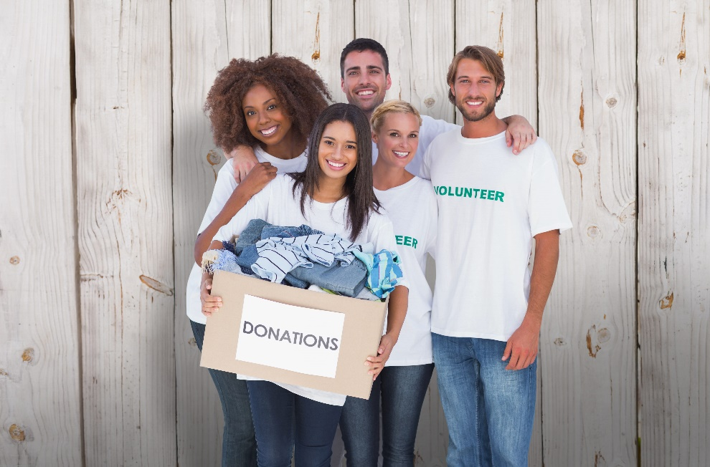
What is a volunteer?
Someone who:
Helps others
Isn’t paid
Isn’t forced to help
Wants to make a difference.
Figure 13.1: Volunteers can be any age and can work in projects that suit their personalities

Slide 6
The need for & importance of community volunteering
Table 13.1: Benefits that volunteers bring to a community
Benefits | Description
Workload | They can immediately reduce someone’s workload in terms of manual labour, administration, organisation & service delivery.
Energy | They bring interest, enthusiasm, energy, skills & talents into the project.
Goodwill | They spread goodwill, such as kindness, friendliness, helpfulness, generosity & caring.
Ideas | Because they are more objective, they may produce new ideas, good advice & fresh solutions.
Links | They form a link between benefactors and beneficiaries, & may bring with them new service providers.

Slide 7
The need for & importance of community volunteering
Table 13.1: Benefits that volunteers bring to a community
Benefits | Description
Programme development | They help to develop programmes, improve existing ones, or get programmes started up again.
Involvement | Their presence encourages others to become involved in the betterment of the community.
Feedback | Because they are objective and aren’t paid, they can more easily give constructive feedback & assessment.
Community spirit | The project strengthens bonds within a community & may revive community spirit.
Funds | They may help to raise funds for the project.

Slide 8
Learning activity 13.1
Module 13
Test your knowledge of this section – and evaluate your strengths for volunteering – by completing Learning activity 13.1 in your Student’s Book.

Slide 9
Volunteer community projects
Community project = plan to improve lives, conditions and/or the environment of a specific community
Community needs to be informed & involved.
Figure 13.2: Volunteers don’t have to belong to a specific community in order to do good there

Slide 10
Volunteer community projects
Refer to Table 13.2 in your Student’s Book to see examples of projects where people can volunteer.

Slide 11
Learning activity 13.2
Module 13
Test your knowledge of this section – and start thinking about an appropriate volunteer project – by completing Learning activity 13.2 in your Student’s Book.

Slide 12
Teamwork & leadership skills
Unit 13.2

Slide 13
Teams & leaders
Team = group working together to achieve a goal.
Leader = coordinator, decision-maker, implementer.

Slide 14
Leadership skills
Take ownership of the project
Get your plans approved
Assign responsibilities
Give training.

Slide 15
Leadership skills
Earn respect, stay impartial & be sensitive
Be available & supportive, & handle discipline well
Give constructive feedback.

Slide 16
Click here to play this video.

Slide 17
Learning activity 13.3
Module 13
Test your knowledge of this unit – and finalise your community volunteer project – by completing Learning activity 13.3 in your Student’s Book.

Slide 18
Portfolio task 5
Module 13
Complete Portfolio task 5 in your Student’s Book. This is a formal project.

