Slide 1
Life Orientation: Life Skills
NQF 2

Slide 2
Explain human rights & responsibilities
Module 11

Slide 3
Think about it…
Can someone demand a right while ignoring its limitations & responsibilities?
What are the characteristics of a respectable role model?
Does a setup like that of a place of education have environmental concerns of its own?

Slide 4
Human rights & responsibilities
Unit 11.1

Slide 5
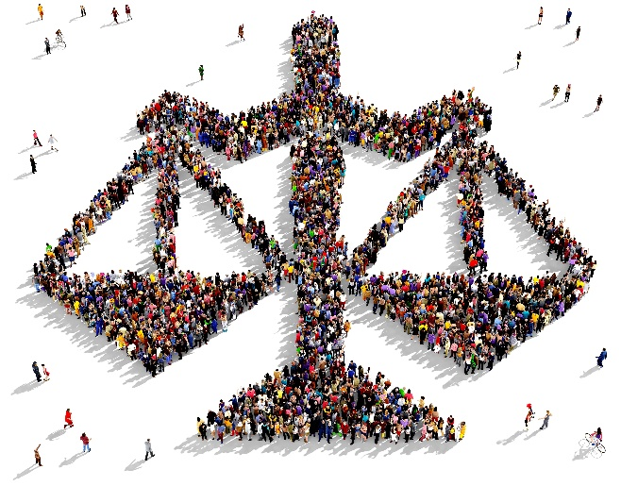
What are human rights?
Things all people are entitled to morally & legally.
Also called freedoms.
Basic, universal & fundamental.
Apply to all people, regardless of differences.

Slide 6
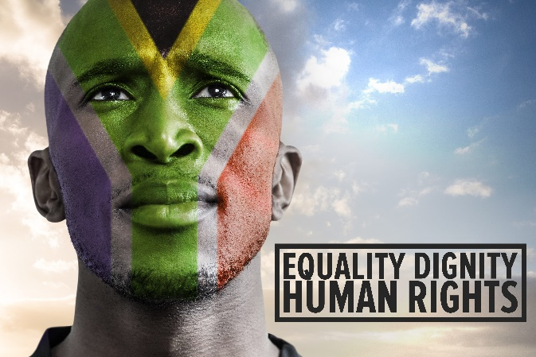
Human rights in South Africa
Constitution since 1997
Chapter 2 of Constitution = Bill of Rights
Bill of Rights protects:
Human dignity, equality & freedom
Various rights, including children’s rights.
No person should be discriminated against.

Slide 7
Summary of human rights
Refer to Table 11.1 in your Student’s Book to see a summary of human rights as specified in the South African Bill of Rights (with examples).

Slide 8
Rights have corresponding responsibilities
Refer to Example 11.1 in your Student’s Book for more about enjoying rights with responsibilities.

Slide 9
Learning activity 11.1
Module 11
Test your knowledge of this unit by completing Learning activity 11.1 in your Student’s Book.

Slide 10
Good citizenship
Unit 11.2

Slide 11
What is a citizen?
A person who is a subject of a state (also: a national).
South African citizens:
Born in SA to at least one parent with SA citizenship
Adopted by a SA citizen
Born elsewhere but lived in SA for many years.
Have successfully applied for citizenship.

Slide 12
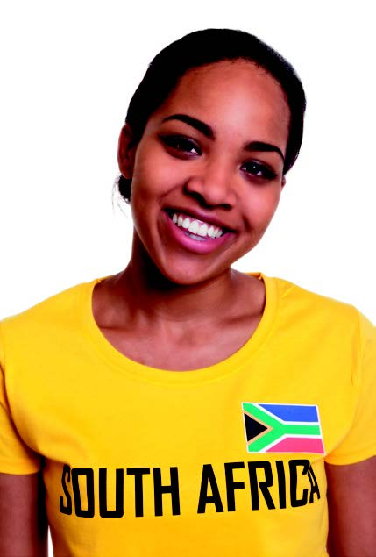
Qualities of good citizens
Don’t abuse their rights or freedoms
Respect others’ rights
Practise the responsibilities that come with their rights.

Slide 13
Examples of attributes of good citizens
Refer to Table 11.2 in your Student’s Book to see examples of qualities of good South Africans, in the context of the South African Bill of Rights.

Slide 14
Please insert the Civics SA video here.
Click above to play this video.

Slide 15
The previous video is courtesy of Civics Academy.
‘Civics Academy is an independent, not-for-profit online education initiative in South Africa. We offer free video and audio content aiming to inform and to strengthen democratic values and responsible citizenship. Civics Academy covers educational content related to democracy, governance, elections, political parties, the justice system, the Constitution, economics, civil society, human rights and the environment. All our content is purely educational, carefully peer reviewed by prominent experts and regularly updated. Please visit our website to view all of our educational content.’ www.civicsacademy.co.za

Slide 16
Learning activity 11.2
Module 11
Test your knowledge of this unit by completing Learning activity 11.2 in your Student’s Book.

Slide 17
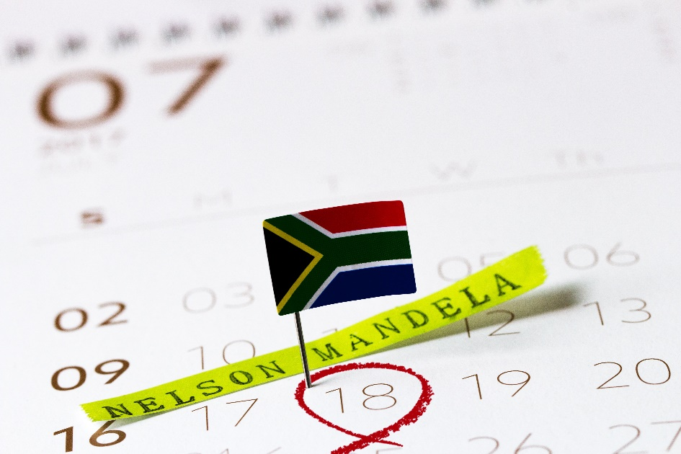
What are role models?
People who:
Do good things
Behave in a lawful way
Help make society better
Set a good example.

Slide 18
Role models of good SA citizens
May be awarded national orders (see Table 11.3)
Inspiring public figures, e.g. involved in:
Child care/healthcare
Business
Politics
Sport/entertainment
Animal/environmental work
Charity/social/emergency work.
Pillars in our homes & communities.

Slide 19
Learning activity 11.3
Module 11
Test your knowledge of this unit by completing Learning activity 11.3 in your Student’s Book.

Slide 20
Protecting the environment at college
Unit 11.3

Slide 21
What is an environment?
Settings & conditions of a living organism.
Two types:
Physical (natural and/or built).
Social (groups in society).

Slide 22
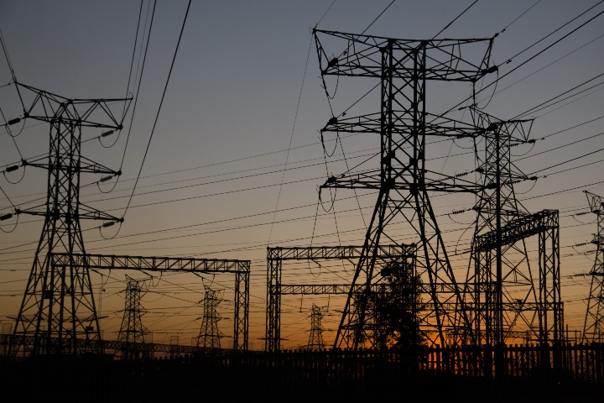
Protect the college environment
Human-made features:
Buildings
Roads
Electricity
Bins
Natural features:
Elements (e.g. air, water)
Inhabitants (e.g. plants, animals)
Ecological systems
Biodiversity (variety of life forms in an area).

Slide 23
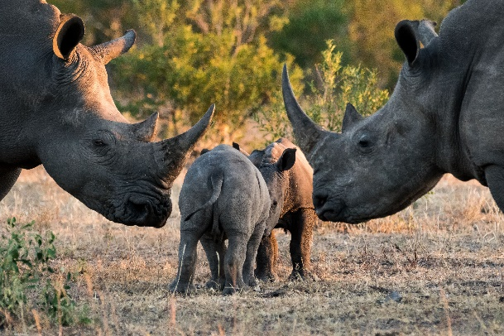
Goals to protect your college environment
1. Reduce water use.
2. Use land & soil sustainably.
3. Reduce the use of fossil fuels.
4. Use renewable & clean energy.
5. Look after endangered species.
6. Prevent pollution.
7. Protect biodiversity.
8. Look after plants & animals.
9. Look after existing structures.
10. Create new green structures.

Slide 24
Learning activity 11.4
Module 11
Test your knowledge of this unit – and implement five actions to protect your environment – by completing Learning activity 11.4 in your Student’s Book.

Slide 25
Module 11
Test your knowledge of this module by completing the Summative assessment of Module 11 in your Student’s Book.

