Slide 1
Life Orientation: Life Skills
NQF 2

Slide 2
Explain fire safety measures
Module 10

Slide 3
Think about it…
What normal conditions in a house or building can lead up to a fire risk?
What first-aid principles apply to burn victims in particular?
Why is arson a hate crime?

Slide 4
Fire risks & prevention
Unit 10.1

Slide 5
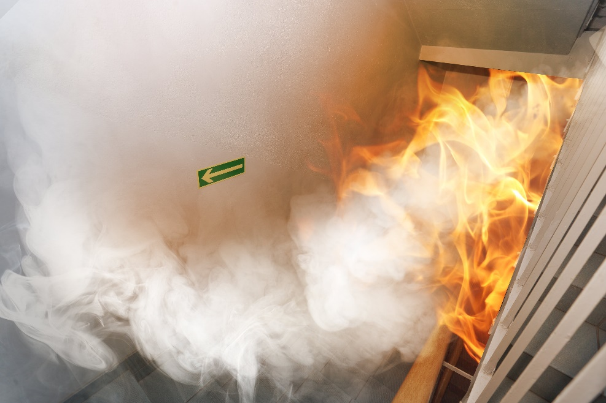
What is a fire risk?
Any situation, activity or material that increases the chance of an unwanted fire
Anything that makes an existing fire worse or uncontrollable.
Figure 10.1: Even just inhaling the smoke from a fire is dangerous and can be deadly, especially in an enclosed area

Slide 6
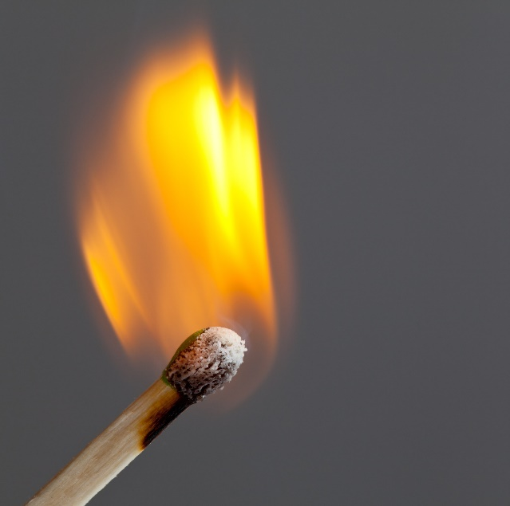
A fire needs:
Fuel (anything that can burn)
Oxygen
Something to start (ignite) it.

Slide 7
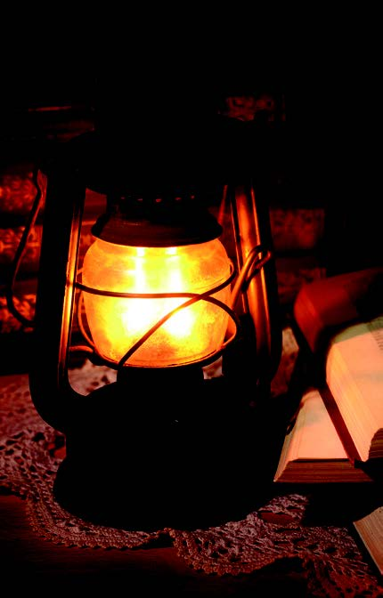
Kinds of fire risks
Heat sources, e.g.:
Controlled fire that becomes out of control
Dropped cigarettes & ash that are still burning
Stove, lamp or candle
Incorrect use of an electrical appliance.
Figure 10.2: Keep paraffin lamps on a flat surface and also far away from any combustible materials such as paper and fabric (especially curtains)

Slide 8
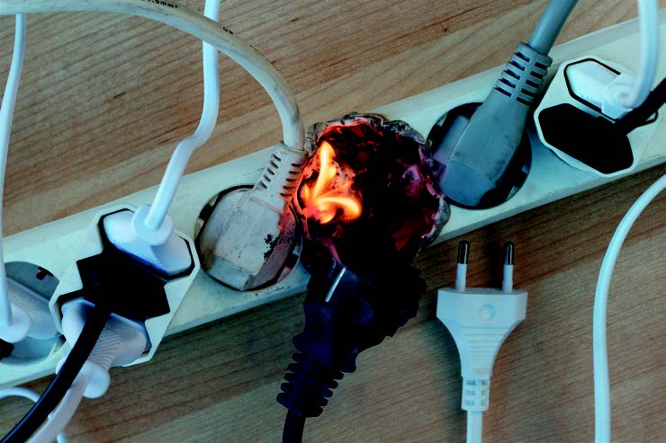
Kinds of fire risks
Electrical sources, such as:
Faulty appliances
Worn-out electrical cords
Old wiring
Unearthed connections
Illegal electricity connections
Figure 10.4: This overloaded extension cord has drawn more power (wattage) than the cord can handle, causing it to overheat and a plug to catch fire

Slide 9
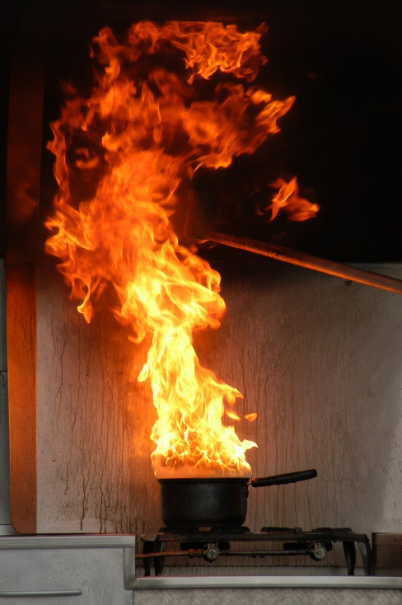
Kinds of fire risks
Fuel sources, for example:
Anything that burns easily, such as newspaper, carpets & curtains
Cooking oil
Chemicals at work
Flammable liquids, such as paraffin, petrol or paint
Explosives.
Figure 10.5: Fire in a pot (e.g. with cooking oil) can be controlled by quickly putting the lid on the pot

Slide 10
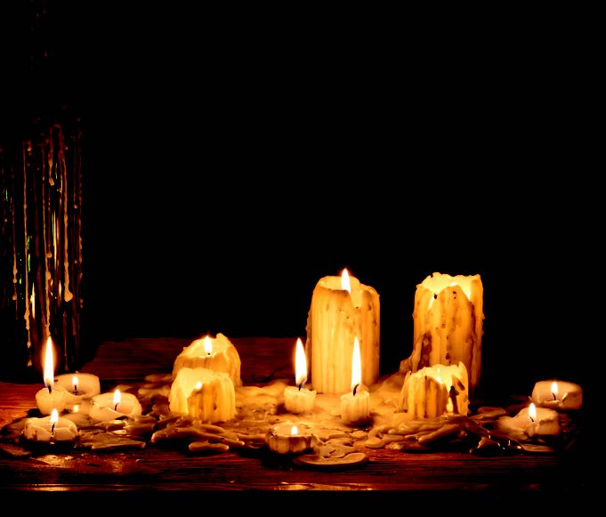
Preventing fire risks
Leave a building responsibly
Take care of the present & think ahead
Store things safely.
Figure 10.6: Never leave a burning candle unattended; also never stand it on wood, plastic or cardboard

Slide 11
Click above to play this video.

Slide 12
Learning activity 10.1
Module 10
Test your knowledge of this unit by completing Learning activity 10.1 in your Student’s Book.

Slide 13
Fire emergencies
Unit 10.2

Slide 14
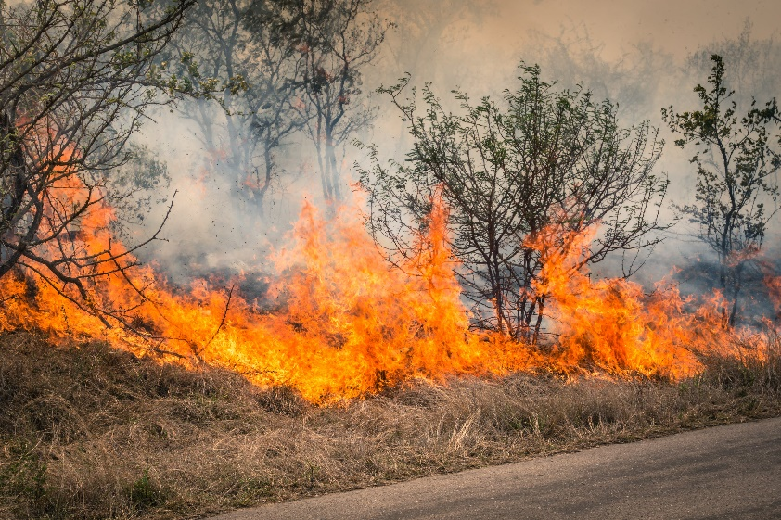
What is a fire emergency?
Emergency = life-threatening situation or damage to property
Fire emergency = risk of fire spreading & harming people, buildings & the environment.

Slide 15
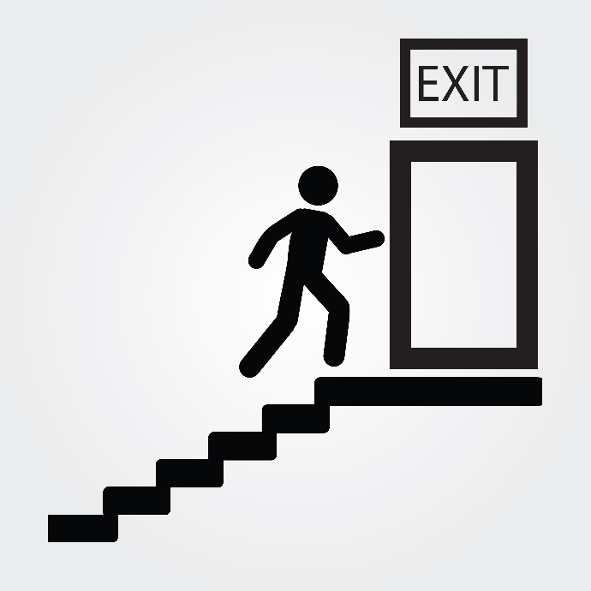
What to do in a fire emergency
Confirm the fire
Deal with the fire
Raise the alarm
Alert others
Notify the fire brigade
Evacuate.

Slide 16
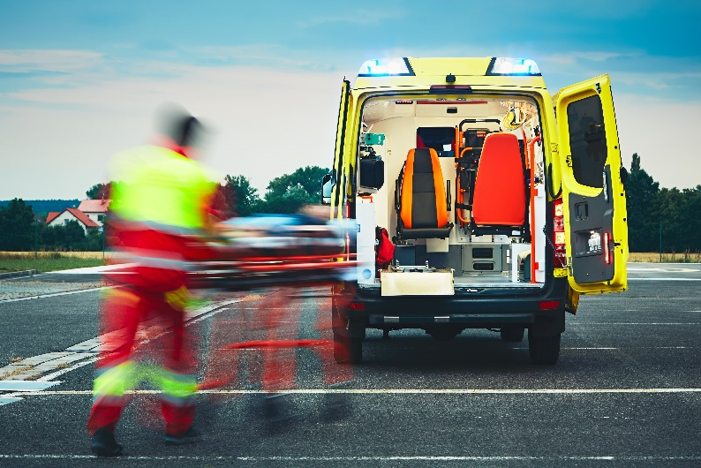
What to do in a fire emergency (continued)
Assemble
Assist emergency services
Face the media (if necessary)
Report back.

Slide 17
When evacuating:
If you can leave the building:
Follow the evacuation plan
Last person out must close (not lock) doors
Don’t use the lift
Don’t push others
Go down the stairs carefully.

Slide 18
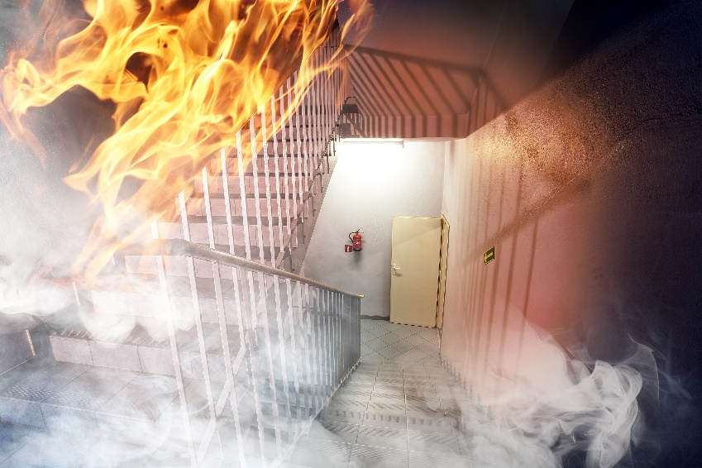
When evacuating:
If you are in a smoke-filled room:
Place a (damp) cloth over your nose & mouth
Crawl on the floor
Don’t enter areas filled with smoke.

Slide 19
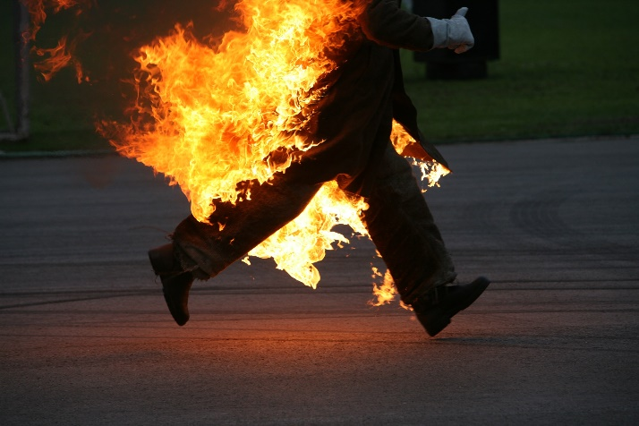
When evacuating:
If your clothing catches fire:
Stop, drop & roll!
If someone else’s clothing catches fire:
Tell them to drop to the floor & to cover their face with their hands
Throw a blanket/carpet over them & roll them around.

Slide 20
When evacuating:
If a door is closed:
Don’t touch the handle!
Touch the door – if it’s hot, the room may be on fire. If it’s not hot, open it slowly, go through, & close it behind you.

Slide 21
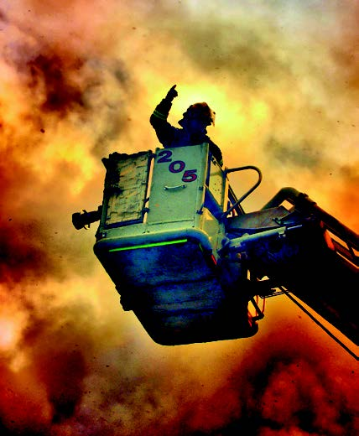
When evacuating:
If you are trapped in a room:
Put a jacket/towel under the door to stop smoke
Stand at a window & call for help; break the window (using a chair) if it won’t open.
Figure 10.15: Modern fire trucks usually have long ladders or crane-type platforms, so you don’t need to jump from a height

Slide 22
Click above to play this video.

Slide 23
Learning activity 10.2
Module 10
Test your knowledge of this unit by completing Learning activity 10.2 in your Student’s Book.

Slide 24
First aid for burn victims
Unit 10.2

Slide 25
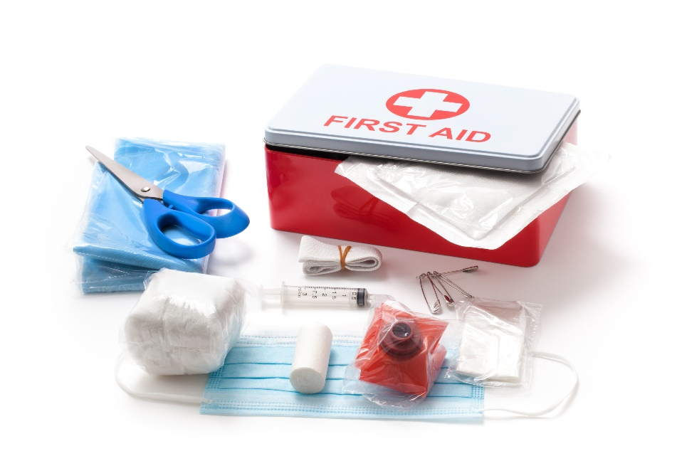
What is first aid?
First aid = first assistance/care for an ill or injured person until professional medical treatment is provided
Aim of first aid = to stabilise victims.

Slide 26
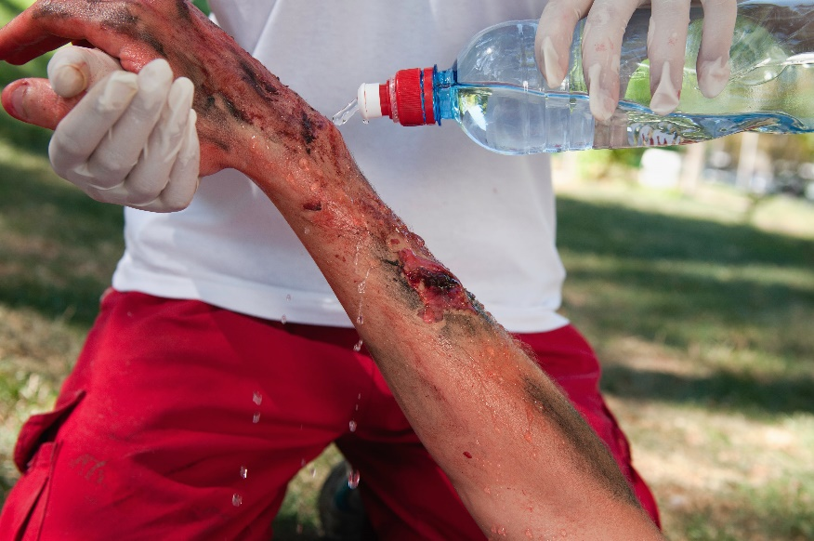
Basic first aid for burn victims
Burns from:
Fire
Sun
Hot liquids, steam, chemicals, electricity or radiation
Hot objects.

Slide 27
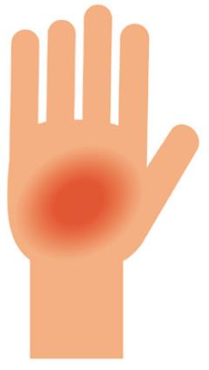
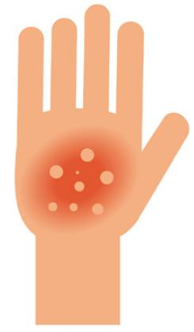
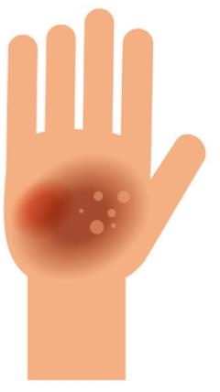
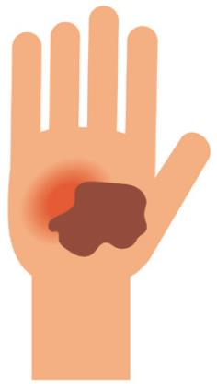
Degree of burns
Minor: less serious (1st degree)
Medium: more serious (2nd degree)
Major: most serious (3rd & 4th degree).
Figure 10.18: Degrees of burn wounds

Slide 28
First aid for minor & medium burns
Table 10.1: Assisting victims with minor and medium burns
Steps | Description
1. | Clean the wound with cool or lukewarm running water.
2. | • Use cool water or wet towels, but not ice, to bring the temperature of the skin tissue down and to prevent swelling. • Continue to do this for 10 to 30 minutes, until the skin feels cool. • Do not apply butter, cooking oil or mayonnaise, as substances such as these will keep the heat trapped in the skin tissue.
3. | Help the victim to remove any jewellery such as rings, earrings, bracelets or necklaces if the fingers, arms or neck have been burnt.
4. | Wrap a piece of sterile gauze lightly around the wound. Don’t use cotton wool or fluffy material, as small bits may stick to the flesh.
5. | A doctor needs to assess whether the burn is deeper than it appears.
6. | An antibiotic ointment may be used to prevent infection. The victim may need a mild painkiller, like aspirin or paracetamol.

Slide 29
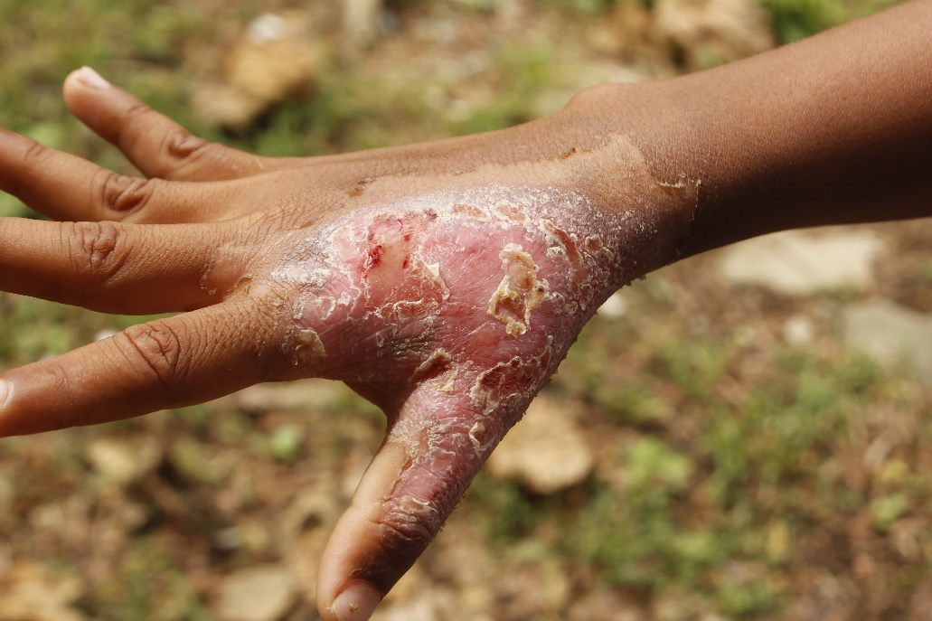
First aid for major burns
Very serious: affects skin, muscles, fat & bones
Need urgent medical treatment.

Slide 30
Table 10.2: Assisting victims with major burns
Steps | Description
1. | • Pull the victim away from the area that is burning, such as a room, tool shed or car, to a safe distance. • Beware of an explosion (e.g. from a burning car with leaking petrol).
2. | • Smother all flames on the victim. • Loosen tight clothing, but don’t remove pieces of burnt clothing that are stuck to the skin.
3. | Call the emergency services or an ambulance immediately.
4. | Observe the area of the fire, for example note whether any chemicals or manufactured materials may have caused the fire. These could give off dangerous vapours or smoke, endangering more lives.
5. | • Don’t use cold water to cool the victim. Hypothermia may result, where the body temperature drops too low. The person’s inner body temperature will have dropped already due to shock. • Don’t pour anything into the wounds.
6. | Gently raise the burnt body part above the level of the heart, if possible, for example by putting up the feet against a stone.

Slide 31
Table 10.2: Assisting victims with major burns
Steps | Description
7. | • Cover the victim with a jacket or blanket to keep him or her warm. • If possible, lightly wrap a clean, moist cloth (or bandage, sheet or towel) around the burnt areas. A clean, unused plastic bag or plastic cling film will also work. Don’t use dirty clothes or handkerchiefs, as this will put the victim at risk of infection.
8. | Keep the victim still and speak to him or her reassuringly. The victim may be in deep shock.
9. | • If the burns involve the mouth, nose, neck or face, the swelling that results may affect the victim’s ability to breathe. Make sure the victim is breathing steadily. • If the victim isn’t breathing, resuscitate him or her by starting CPR (see Sections 10.3.2 and 10.3.3 in your Student’s Book).
10. | The victim will have to receive a drip to replace the loss of body fluid, and possibly also injections. These will be administered by a doctor or paramedic.

Slide 32
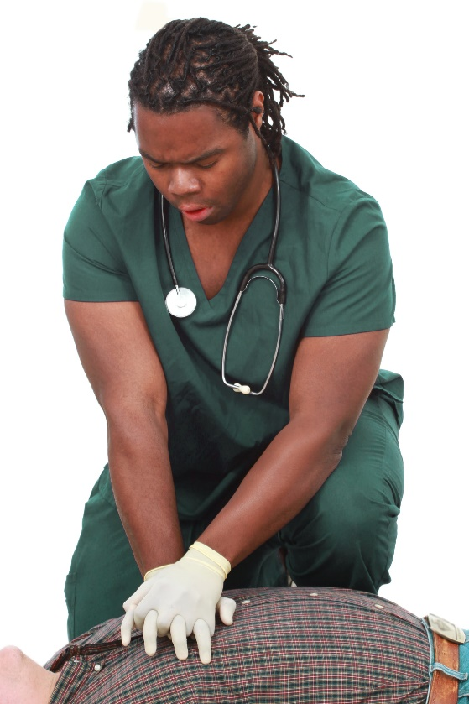
How to administer CPR
Turn patient onto their back
Check that their airway is clear
Place the heel of your hand on top of your other hand.
Figure 10.20: Do compressions on the breastbone between the nipples

Slide 33
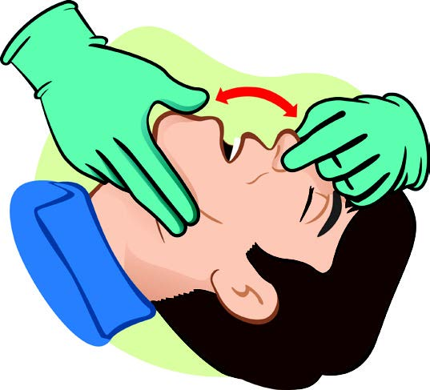
How to administer CPR
Adults & older children: 30 compressions (pressure) on chest (between nipples)
Young children: Press to a depth of 4 cm only
Babies: press with two fingers only
Gently tilt victim’s head back & pinch nose shut.
Figure 10.21: Make sure the airway is clear, then pinch the nose shut and tilt back the head

Slide 34
How to administer CPR
Completely cover the victim’s mouth with yours.
Blow hard enough for their chest to rise (only small breaths for a baby).
Give another two blows.
Continue to give 30 compressions & two deep breaths until help arrives.
Don’t give up! If necessary, swap with someone or ask them to help.

Slide 35
Click above to play this video.

Slide 36
Learning activity 10.3
Module 10
Test your knowledge of this unit – and practise CPR – by completing Learning activity 10.3 in your Student’s Book.

Slide 37
Module 10
Test your knowledge of this module by completing the Summative assessment of Module 10 in your Student’s Book.

