Slide 1
Life Orientation: Life Skills
NQF 2

Slide 2
Profile your strengths and abilities
Module 1

Slide 3
Think about it…
What is the difference between your self-confidence & your self-image?
What is self-esteem?
How can I become more self-motivated?

Slide 4
Benefits of confidence & a positive self-image
Unit 1.1

Slide 5
What is confidence?
Feeling self-assured, optimistic & enthusiastic.
Appreciating your abilities, skills & judgement.
Believing in yourself.
Being willing to learn new things.

Slide 6
What is self-esteem?
How you respect & value yourself.
Note: Your self-image is how you view yourself.
Your self-esteem & self-image can be strengthened.
Figure 1.2: Looking after your appearance may boost your confidence, but don’t base your
self-worth on your looks

Slide 7
Learning activity 1.1
Module 1
Find out more about your self-image by completing Learning activity 1.1 in your Student’s Book.

Slide 8
Learning activity 1.2
Module 1
Test your knowledge of this section by completing Learning activity 1.2 in your Student’s Book.

Slide 9
A personal SWOT analysis
Unit 1.2

Slide 10
What is a SWOT analysis?
A SWOT analysis evaluates internal and external environments.
It determines:
strengths
weaknesses
possible opportunities
threats to your success.
Figure 1.4: SWOT analysis

Slide 11
What are the benefits of a SWOT analysis?
Table 1.2: Benefits of a SWOT analysis
SWOT components | Description | Benefits
Strengths | Abilities, talents, skills, advantages, character, values, lessons you have learnt in life | If you know your strengths, you can focus on them & make the most of them.
Weaknesses | Limitations, faults, vulnerabilities, failings | If you are aware of your weaknesses, you can manage or reduce them.

Slide 12
What are the benefits of a SWOT analysis?
Table 1.2: Benefits of a SWOT analysis
SWOT components | Description | Benefits
Opportunities | Trends, developments, support, good chances | If you recognise and identify favourable opportunities, you can take advantage of these.
Threats | Obstacles, competition, risks, difficulties, dangers | If you are alert to possible threats, you can prepare for them or avoid them.

Slide 13
Click above to play this video.

Slide 14
Learning activity 1.3
Module 1
Test your knowledge of this section and your own strengths, weaknesses, opportunities and threats by completing Learning activity 1.3 in your Student’s Book.

Slide 15
Factors that detract from your self-esteem
Unit 1.3

Slide 16
Remember, self-esteem is about:
Your self-respect.
How you value yourself.
Your self-confidence.
Your self-image.

Slide 17
Factors that undermine self-esteem
THOUGHTS: negative or harsh thoughts about yourself or others; ideas of revenge; unreal fantasies
WORDS: gossip; harsh criticism; stereotyping; lies; words that are hurtful, humiliating or disrespectful
CIRCUMSTANCES: injustice; discrimination; few skills; events beyond your control (e.g. birthplace; family)
FEELINGS: feeling lonely, misunderstood, confused, depressed, threatened, inferior, insecure, worthless
VALUES: having no or poor morals to guide your decisions and actions; doing what you know is wrong
Factors that harm self-esteem
BELIEFS: negative beliefs about yourself; believing everything in the media; have no real spiritual beliefs
PHYSICAL: ill health; weak eyesight; poor hearing; bad skin; crooked teeth or toes; deformity; disability
RELATIONSHIPS: jealousy; envy; manipulation; friends who behave badly; distrust; unhealthy dependency
Figure 1.10: A diagram showing factors that negatively affect self-esteem

Slide 18
Ways to improve your self-esteem:
Be assertive.
Be positive.
Be mature.
Forgive and move on.
Resist fear.
Get in motion.
Don’t go completely solo.
Be kind to yourself.

Slide 19
Learning activity 1.4
Module 1
Test your knowledge of this section by completing Learning activity 1.4 in your Student’s Book.

Slide 20
Self-motivation
Unit 1.4

Slide 21
What is self-motivation?
Wanting to perform an activity.
Working to reach your goals.
Carrying on with an activity even when it is boring or difficult.

Slide 22
Why is self-motivation important?
Challenges give you energy.
You can stay committed to tasks.
You can rely on yourself (and others can rely on you).
You are principled.
You can make a success of goals and challenges.

Slide 23
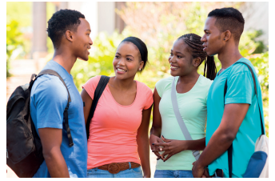
Examples of self-motivation
Figure 1.17: Find goals worth getting up early for
Figure 1.19: People with a good
self-confidence & self-image are often self-motivated as well

Slide 24
Click above to play this video.

Slide 25
Learning activity 1.5
Module 1
Find out more about your own self-motivation by completing Learning activity 1.5 in your Student’s Book.

Slide 26
How can you stay self-motivated?
Think ahead.
Set yourself targets.
Draw up a timetable.
Work hard.
Measure your progress.
Remain accountable to someone.
Reward yourself.

Slide 27
Learning activity 1.6
Module 1
Test your knowledge of this section by completing Learning activity 1.6 in your Student’s Book.

Slide 28
Job opportunities & careers
Unit 1.5

Slide 29
What is a career?
The occupation a person has for most of their working life.
People are usually trained in that line of work.
Most people try to progress in their profession.

Slide 30
Where can you find job opportunities?
Table 1.5A: Sources of job notices 1
What? | Where? | Placed by? | Examples
Classified ads & larger ads | Newspapers Weekly or monthly magazines | Employers Large companies Government departments | “Employment offered” “Jobs offered” “Vacancies”
 |  | Jobseekers (advertising their services) | “Employment wanted” “Jobs wanted”
Radio or television adverts | Radio Television | Media companies Radio stations TV stations | The SABC may advertise if it needs to fill a certain position.

Slide 31
Where can you find job opportunities?
Table 1.5A: Sources of job notices 1 (continued)
What? | Where? | Placed by? | Examples
Online adverts | Government department websites | Government departments | Tender Bulletin: www.gov.za/tenders Department of Labour: www.labour.gov.za/vacancies
 | Online publications | Government publications with details of vacancies | The Vuk’uzenzele newspaper at: www.vukuzenzele.gov.za Public Service Vacancy Circular – search online.
Examples

Slide 32
Where can you find job opportunities?
Table 1.5B: Sources of job notices (2)
What? | Where? | Placed by? | Examples
Online adverts | Employers’ websites | Large businesses, organisations & companies | A business may advertise open positions on its website.
 | Online job search websites | Several sites maintain listings of available jobs & also allow CVs to be uploaded. | www.careerjunction.co.za www.bestjobs.co.za www.indeed.co.za www.thejobsportal.co.za
 | Employment or recruitment agencies’ websites | Companies looking for a suitable person to fill a vacancy may contact an agency. Job seekers can leave their CV & details with an agency. | The agency places adverts, screens applicants & shortlists top candidates. The company conducts interviews with these candidates.
 | Professional networking websites | Some networking sites allow users to upload their CV & contact details. | http://za.linkedin.com

Slide 33
Where can you find job opportunities?
Table 1.5B: Sources of job notices (2 continued)
What? | Where? | Placed by? | Examples
Notices | Noticeboards | Employers may put up adverts in public places. Jobseekers can also put up a notice with their contact details. | Noticeboards outside a shop or community centre

Slide 34
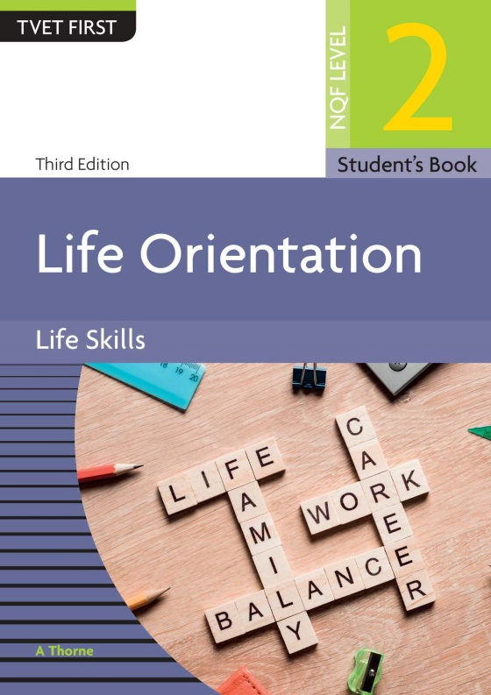
Analysing a formal job advert
Refer to Case study 1.1 in your Student’s Book to see an example of a formal job advert.

Slide 35
Where can you find more information about careers?
Advertisements (e.g. newspapers and noticeboards).
Websites and other media.
Career practitioners (including counsellors, tools and tests).
Human resources (HR) departments.

Slide 36
Learning activity 1.7
Module 1
Test your knowledge of this section – and prepare for your career – by completing Learning activity 1.7 in your Student’s Book.

Slide 37
Module 1
Test your knowledge of this module by completing the Summative assessment of Module 1 in your Student’s Book.

