Slide 1
English: First Additional Language
NQF 4

Slide 2
Visual material
Module 10

Slide 3
Overview
Visual material
Photographs
Depth of field
Caricatures
Infographics
Cartoons and comic strips

Slide 4

Visual material
Pre-viewing:
Know the type of visual text and its features before you view it.
Viewing:
View multimedia and visual texts critically in terms of format, layout, use of colour, meaning, message and purpose.
Post-viewing:
Respond critically to the text.

Slide 5
Visual material
Pre-viewing:
Know the type of visual text and its features before you view it.
Viewing:
View multimedia and visual texts critically in terms of format, layout, use of colour, meaning, message and purpose.
Post-viewing:
Respond critically to the text.

Slide 6
Visual material
Pre-viewing:
Know the type of visual text and its features before you view it.
Viewing:
View multimedia and visual texts critically in terms of format, layout, use of colour, meaning, message and purpose.
Post-viewing:
Respond critically to the text.

Slide 7

Learning activity 10.1
Module 10
Test your knowledge of this section by completing Learning activity 10.1 on page 132 of your Student’s Book.

Slide 8
Photographs
You know from your study of photographs in Level 3 that there is no set way to ‘read’ a photograph.
Your approach to reading photographs will change, depending upon the purpose or use of the photograph.

Slide 9
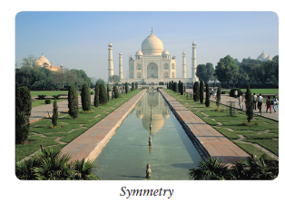
More about reading photographs
Symmetry
Something is symmetrical if the image is the balanced on either side of a central line. Symmetry in an image creates a sense of harmony and balance of proportion.
It creates a pleasing picture in a photograph, but sometimes the lack of balance can also suit a photographer’s purpose. This is called asymmetry.

Slide 10
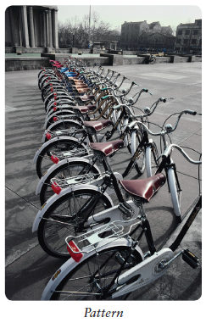
More about reading photographs
Pattern
A pattern is a repeated decorative design. Sometimes patterns are deliberate.
At other times, the pattern may be created by a natural effect, such as when clouds create a pattern in the sky.

Slide 11
More about reading photographs
The photographer can shoot from any angle, and create patterns.
As with symmetry, when those patterns are broken, the resulting photograph can also be interesting.

Slide 12
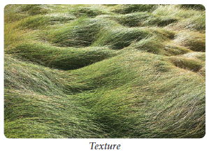
More about reading photographs
Texture
The texture is how we imagine an image would feel.
Texture becomes evident to the viewer when lighting and shadow are used to highlight objects.

Slide 13
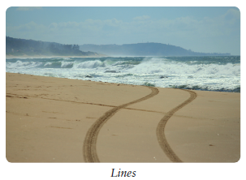
More about reading photographs
Line
Any lines that exist naturally in the picture will draw the viewer’s eyes to the end of the line.
Often the focal point of the picture is at the end of those lines.
The lines can be horizontal, vertical, diagonal, or they can join each other.

Slide 14
Learning activity 10.2
Module 10
Test your knowledge of this section by completing Learning activity 10.2 on page 134 of your Student’s Book.

Slide 15



Depth of field
Definition
Definition
Depth of field is the term used to describe the distance between the nearest and the furthest objects in an image. In a photograph or picture it describes what can be seen clearly and what is out of focus.

Slide 16


Depth of field
  Shallow focus: The depth of field is shallow to create a shallow focus plane (objects close up are in focus, others are blurred or the other way around).
English FAL NQF Level 2

Slide 17
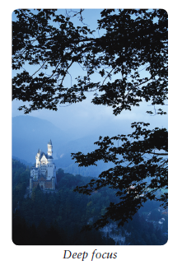
Depth of field
  Deep focus: This is a technique of photography that permits all distance planes to remain clearly in focus, from close-up range to infinity.
  This technique captures objects at close, medium and long ranges, at the same time. The objects in a deep focus shot are carefully arranged in a series of planes. By using this layering technique, the photographer can guide the viewer’s eye from one distance to another and another.
English FAL NQF Level 2

Slide 18
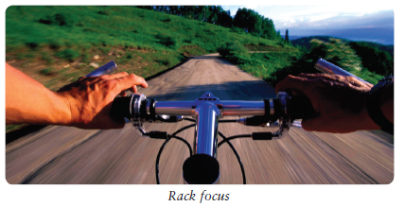
Depth of field
  Rack focus: The focus is shifted so that part of the picture becomes blurred and another part becomes sharp.
English FAL NQF Level 2

Slide 19
Learning activity 10.3
Module 10
Test your knowledge of this section by completing Learning activity 10.3 on page 135 of your Student’s Book.

Slide 20
Caricatures
A caricature is an illustration of a person or object in which the artist exaggerates some of the characteristics of that person or thing to create a humorous effect.

Slide 21
Caricatures
1
The distortion is deliberate and provides the humour in the caricature. The artist exaggerates the physical features of the person or object being caricatured.
2
This is to make sure that it is still clear who the subject is in the picture.
3
Caricatures can be funny, insulting or complimentary, and often the subjects are politicians or famous people.

Slide 22
Learning activity 10.4
Module 10
Test your knowledge of this section by completing Learning activity 10.4 on page 136 of your Student’s Book.

Slide 23
Learning activity 10.5
Module 10
Test your knowledge of this section by completing Learning activity 10.5 on page 136 of your Student’s Book.

Slide 24
Learning activity 10.6
Module 10
Test your knowledge of this section by completing Learning activity 10.6 on page 137 of your Student’s Book.

Slide 25
Infographics
They combine a number of facts in a visual form.
The reader makes sense of the text, images, colour and font rather than just reading the paragraphs.
Infographics must also have a flow of information for the reader to follow.
The information or data is represented by visual images on the chart, which are interpreted by the reader.
Infographics must also have a flow of information for the reader to follow.
The layout shows the relationship between the different elements on the infographic and allows the information to be accessed quickly and easily.
There are many different ways to create infographics, but the main principle is to avoid white backgrounds and not to include too much text.

Slide 26
Learning activity 10.7
Module 10
Test your knowledge of this section by completing Learning activity 10.7 on page 139 of your Student’s Book.

Slide 27
Learning activity 10.8
Module 10
Test your knowledge of this section by completing Learning activity 10.8 on page 140 of your Student’s Book.

Slide 28








Cartoon and comic strips
A
A
cartoon
comic strip
is usually one picture containing a few words or a caption, and the effect often comes from the drawing or picture.
is a series of pictures drawn inside boxes (called frames) that tell a story.
Attack!
That is a
scary spider.
A king scared of a spider?
A cartoon shows the opinion or point of view of the person who drew the cartoon.
Cartoons often make fun of people in government or important people in the news, or they draw attention to something that has happened recently.
The story is told mainly in pictures with some words.
The words are usually those spoken by the characters.
Comic strips can be printed in colour or in black and white.

Slide 29
Cartoon and comic strips
A king scared of a spider?
Cartoon
A cartoon is usually one picture containing a few words or a caption, and the effect often comes from the drawing or picture.

Slide 30
Cartoon and comic strips
Attack!
That is a
scary spider.
Comic strip
A comic strip is a series of pictures drawn inside boxes (called frames) that tell a story.

Slide 31
More about cartoons and comic strips
When discussing a comic strip or a cartoon:
  Comment on the position and size of the characters their facial expressions and gestures.
  Their body language.
  Their spoken words.
  Tines that show movement.
  Speech and thought bubbles (or the absence of speech bubbles).
  Comment on the font that is used in the spoken words, as well as the content of the words. After carefully studying a cartoon, you will need to be able to put each of these elements together and decide what they mean to the reader.
Notes:
Create a tree diagram with the heading as the starting point and an images of a cartoon character with a cross facial expression, body language and different fonts in a speech bubble.

Slide 32
Learning activity 10.9
Module 10
Test your knowledge of this section by completing Learning activity 10.9 on page 140 of your Student’s Book.

Slide 33
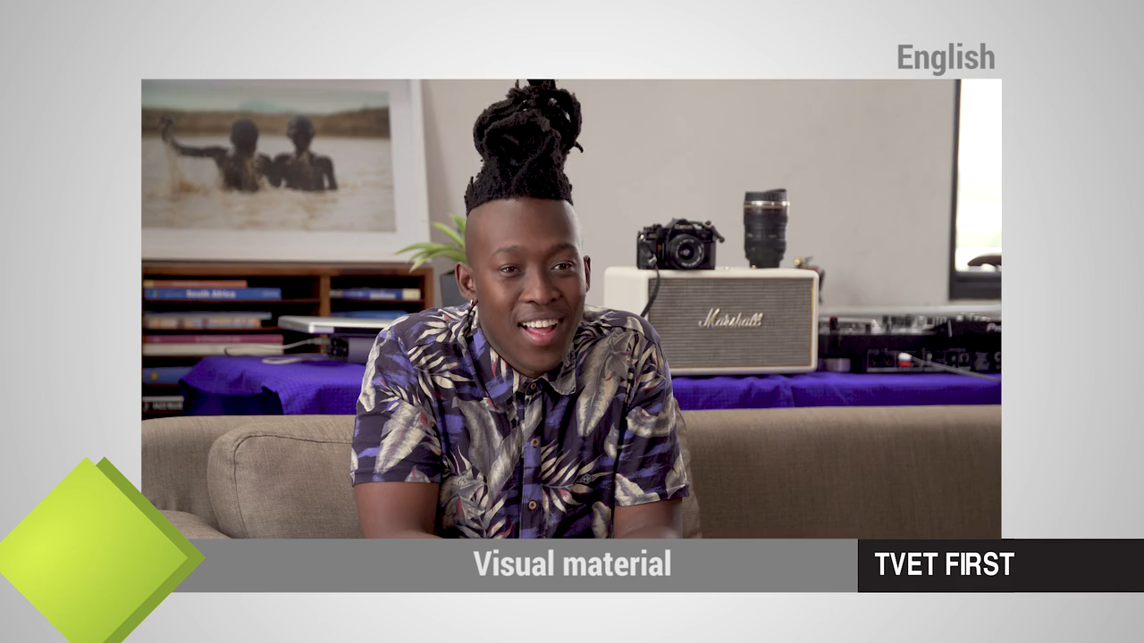

VIDEO: Visual material

Slide 34
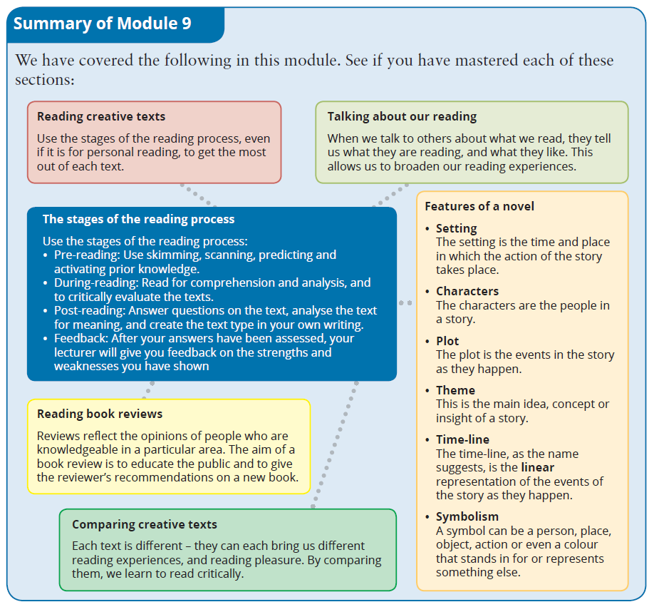
Summary of Module 10

Slide 35
Formative assessment
Module 10
Test your knowledge of Module 9 by completing the Formative assessment on page 141 of your Student’s Book.

