Slide 1
English: First Additional Language
NQF 4

Slide 2
Applying for a job
Module 1

Slide 3
Overview
Reading and creating a curriculum vitae (CV)
Reading and writing job advertisements
Reading and writing a letter of application/covering letter
Letters of appointment or rejection and acceptance and refusal
Letters of resignation

Slide 4
Reading and creating a curriculum vitae (CV)
Definition
A curriculum vitae (CV) is a detailed document that summarises information about your academic and professional training, your experience, and outlining the abilities that make you a suitable candidate for an advertised position.

Slide 5
Creating a curriculum vitae (CV)
Your CV should contain the following information:
Curriculum Vitae
Personal history
Name: Edgar Ndlovu
Date of Birth: 27 February 1989
Place of birth: Johannesburg, South Africa
Nationality South African
…….
Personal and identification information
Educational history
1995 - 2000: Naledi Primary School - Pimville, Soweto
2000 - 2003: Motawako High School - Pimville, Soweto
Education history
Other training
Professional qualifications
2003 - 2004: Soweto TVET College – TV Installation
Work experience
2004 - 2006: TV Installation – MK Satellite
2007 - Current: Team Foreman– MK Satellite
Employment history starting from the present
Interests
Interests
Football and singing
References
Mr M Hercules - MK Satellites 084 112 2334
Pastor V Tsope – Rosewood Community Church 083 776 6554
References

Slide 6
Creating a curriculum vitae (CV) continued ….
Keep your CV updated – each time your duties or job change, or you achieve some award or accolade, or your personal details change, edit your CV.
Pay careful attention to the layout and font of your CV. The rule is that it is better for your CV to be short.
Never lie or exaggerate your skills or experience. You will be found out in the end, and it will cost you your job.
Get someone to proofread your CV. Errors in the CV or covering letter are unforgiveable.

Slide 7
Learning activity 1.1
Module 1
Test your knowledge of this section by completing Learning activity 1.1 on page 3 of your Student’s Book.

Slide 8
Reading job advertisements
1
A classified advertisement is a small advertisement in a newspaper, magazine or leaflet to buy or sell something.
2
Classified advertisements use shortened forms of words, such as ‘salary neg’ for ‘salary negotiable’.
3
You can also find job advertisements online. Websites such as OLX, Taboola, Career Junction and Careers24, for example, have a feature where prospective job applicants can post their CVs and requirements online, and potential employers can find them there.

Slide 9
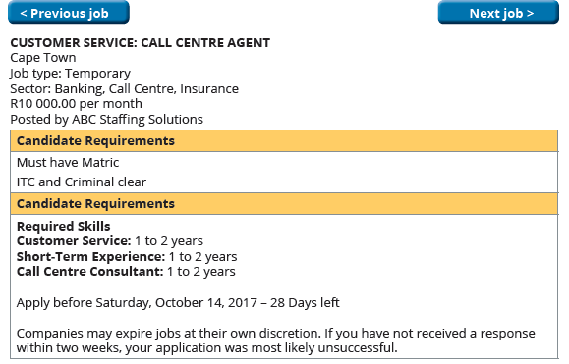
Job advertisements

Slide 10
Learning activity 1.2
Module 1
Test your knowledge of this section by completing Learning activity 1.2 on page 6 of your Student’s Book.

Slide 11
Learning activity 1.3
Module 1
Test your knowledge of this section by completing Learning activity 1.3 on page 6 of your Student’s Book.

Slide 12
Writing a letter of application / covering letter
Write the letter to a person, not to the organisation. Find out the name and address of the person who will receive your job letter in the advertisement. Make sure you spell the person’s name correctly.

Slide 13
Writing a letter of application / covering letter
A letter of application has the layout and format of a business letter, and the style is formal.

Slide 14
Writing a letter of application / covering letter
The subject line should include the position or job for which you are applying: for example, APPLICATION FOR POSITION OF RECEPTIONIST.

Slide 15
Writing a letter of application / covering letter
The first paragraph of the letter is short and simply states that you want to apply for the job. Say where and when you saw the advertisement for the job.

Slide 16
Writing a letter of application / covering letter
In the second paragraph, say why you are applying for the job; why you are interested in this type of work; or why you want to work for the organisation.

Slide 17
Writing a letter of application / covering letter
In the next paragraph, briefly sum up your qualifications and experience.

Slide 18
Writing a letter of application / covering letter
Then indicate that you have included your CV and any written testimonials.

Slide 19
Writing a letter of application / covering letter
Thank the recipient of the letter for considering your application.

Slide 20
Writing a letter of application / covering letter
As you used the recipient’s name in the greeting, end with ‘Yours sincerely’.

Slide 21
Writing a letter of application / covering letter
Thank the recipient of the letter for considering your application.

Slide 22
Learning activity 1.4
Module 1
Test your knowledge of this section by completing Learning activity 1.4 on page 9 of your Student’s Book.

Slide 23
Learning activity 1.5
Module 1
Test your knowledge of this section by completing Learning activity 1.5 on page 11 of your Student’s Book.

Slide 24
Letters of appointment
1
Congratulations on being accepted for the job and a confirmation of the position
2
The date and time when the job starts
3
The details of your responsibilities
4
The details of your salary and other benefits such as medical aid and pension
5
Where you should go on the first day and who you should report to
6
Details of any training that will be given
7
Welcome to the organisation and good wishes

Slide 25
Letters of resignation
When you want to resign from a position or a company, write a letter of resignation to your immediate manager. In the letter, explain why you are leaving.
The tone of the letter should be polite; this is not the moment to mention any problems you have had with the organisation or your co-workers.
Give the date when you will leave, making sure that you give the correct notice period according to the rules of the organisation.
Thank the organisation for what you have learnt during your time there.
1
2
3
4

Slide 26
Letters of rejection
If your application is not successful, you will receive a short letter that might encourage you to apply for another position in the organisation in the future.

Slide 27
Letters of acceptance and refusal
You must reply to a letter of appointment. If you accept the position, you should indicate that you are glad to accept the position. Confirm the date and time when you will start work. Thank the organisation for the offer.
Letters of acceptance
OR
If you are unable to accept the job offer, write a short letter to thank the organisation for offering you the position. Explain why you cannot accept it.
Letters of refusal

Slide 28
Learning activity 1.6
Module 1
Test your knowledge of this section by completing Learning activity 1.6 on page 12 of your Student’s Book.

Slide 29
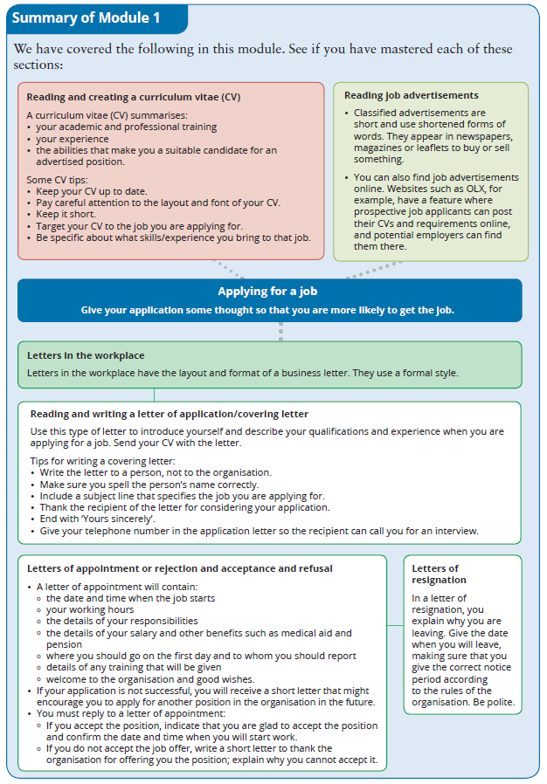
Summary of Module 1

Slide 30
Formative assessment
Module 1
Test your knowledge of Module 1 by completing the Formative assessment on page 14 of your Student’s Book

