Slide 1
English: First Additional Language
NQF 3

Slide 2
Reading and creating multimedia texts, flyers, pamphlets and brochures
Module 7

Slide 3
Overview
Multimedia texts
Creating a multimedia text
Creating a flyer
Creating a pamphlet
Creating a brochure
Phrases and clauses
Active and passive voice
Conditionals

Slide 4
Multimedia texts
The term ‘multimedia’ covers types of texts that integrate different forms of information.
These may include spoken or written texts, still, animated or moving images; they may be produced on paper or electronic screens and may include sound and interactivity.
Multimedia texts have more than one content form so that meaning is communicated in a number of ways.

Slide 5
Multimedia texts
Examples include a webpage with a video and sound effects, or a visual book with textual and visual images.
These texts can be on paper or digital.
Hypertext
text with hyperlinks

Slide 6
Multimedia texts
Hyperlink
in computing, a hyperlink, or simply a link, is a reference to data that the reader can follow by clicking, tapping or hovering; a hyperlink points to a whole document or to a specific element within a document

Slide 7
Print-based vs multimedia texts
Differences between reading of print-based and multimedia texts
Reading print-based texts | Reading multimedia texts
Words: The words ‘tell’. The words create the text’s register, vocabulary, grammar, headings, chapters, paragraphs and sentence structure. | Visual images: The images ‘show’. This includes layout, size, shape, colour, line, angle, position, perspective, screen, frames, icons, links and hyperlinks.
Verbal style: Register, tone, intonation, humour and word play are developed through the use of words. We see the text’s formatting, layout, font, and punctuation – these help to create the text’s meaning. | Visual style: The style of the text is created by the choice of medium, graphics, animation, frames, menu board and hypertext.
Verbal imagery: Includes description, images, symbolism, poetic devices with words and sound patterns. | Visual imagery: Includes the use of colour, icons, symbols and repetition.
Readers mostly follow what the creator has decided should be followed. | Reader has more choice and opportunity to interact.

Slide 8
Learning activity 7.1
Module 7
Test your knowledge of this section by completing Learning activity 7.1 on page 114 of your Student’s Book.

Slide 9
Flyers
Flyers, or leaflets, are used by people for small-scale marketing.
Flyers use large typefaces, capital letters and bold type.
Flyers are also used to announce shop openings or events. They can contain product information and be given out at trade shows and events.
The message of a flyer may leave the reader feeling like he or she is missing out on a good deal if the product or service is not bought immediately.

Slide 10
Examples of flyers

Slide 11
Examples of flyers

Slide 12
Examples of flyers

Slide 13
Learning activity 7.2
Module 7
Test your knowledge of this section by completing Learning activity 7.2 on page 116 of your Student’s Book.

Slide 14
Pamphlets
Pamphlets may consist of a few pages that are folded in half and bound at the crease to make a simple book
Pictures or diagrams are often included in pamphlets.
Pamphlets are used to educate, inform, persuade or entertain your intended audience.

Slide 15
Learning activity 7.3
Module 7
Test your knowledge of this section by completing Learning activity 7.3 on page 117 of your Student’s Book.

Slide 16
Brochures
Brochures are similar to pamphlets but are more upmarket in their design.
Brochures are folded a number of times, so the copy (the words) and the visual material may appear on four or six pages.
Brochures are meant to be kept and referred to again and again.
Brochures are often printed on glossy paper and are often in full colour.

Slide 17
Example of brochures

Slide 18
Learning activity 7.4
Module 7
Test your knowledge of this section by completing Learning activity 7.4 on page 119 of your Student’s Book.

Slide 19
Phrases and clauses
Phrases
Groups of words without a finite verb
Clauses
Groups of words that have a finite verb
A clause that can stand alone.
Can you think of an example for each of these definitions?

Slide 20
More about phrases and clauses
Verbs tell you about the subject.
To find the subject of a verb, ask who or what is performing the action of the verb.
=

Slide 21
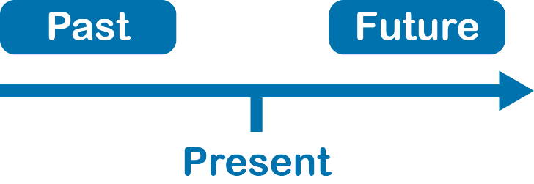
More about phrases and clauses
Verbs have
tense
number
and
Present tense
Past tense
Future tense
Singular
Plural

Slide 22
More about phrases and clauses
Subordinate Clause
A clause that cannot make sense on its own. It needs a main clause to help it make sense.
Subordinate clauses are introduced by conjunctions, such as when, why, before, after, because.
Can you think of examples of subordinate clauses?

Slide 23
Learning activity 7.5
Module 7
Test your knowledge of this section by completing Learning activity 7.5 on page 122 of your Student’s Book.

Slide 24
Learning activity 7.6
Module 7
Test your knowledge of this section by completing Learning activity 7.6 on page 123 of your Student’s Book.

Slide 25
Active and passive voice
In the
In the
active voice
passive voice,
the subject of the sentence performs the action. The subject of the sentence is doing the action to the object.
something is done to the subject. It does not do the action itself. Sometimes, in passive voice sentences, the original subject falls away.
Can you think of examples of these definitions?

Slide 26
Active and passive voice
Active voice
Passive voice
subject
action
action
A dog
A dog attacked my boss.
attacked
My boss was attacked by a dog.
was attacked
a dog
subject

Slide 27
Learning activity 7.7
Module 7
Test your knowledge of this section by completing Learning activity 7.7 on page 124 of your Student’s Book.

Slide 28
Learning activity 7.8
Module 7
Test your knowledge of this section by completing Learning activity 7.8 on page 124 of your Student’s Book.

Slide 29
Conditionals
Use the conditional to say that if one thing happens, then another may result from the first happening.
The conditional shows that a second action may occur on condition that a first action does.
Conditionals are useful when you are trying to persuade someone to buy something, or to make use of a service.
The conditional can be used in the past, present or future tense.

Slide 30
Conditionals
The zero conditional is used when the result of the condition is always true. Scientific facts are zero conditionals. This condition will always have the same result.
The first conditional refers to the future, and implies that there is a very real possibility that the second action will happen, if the first action does.
The second conditional also refers to the future, but there is not a real possibility that this condition will happen.
The third conditional refers to the past, and an imaginary condition in the past that did not happen.
1
2
3
0

Slide 31
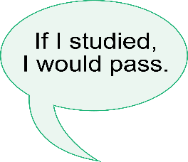
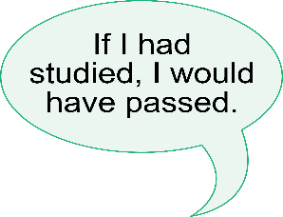
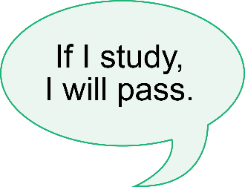
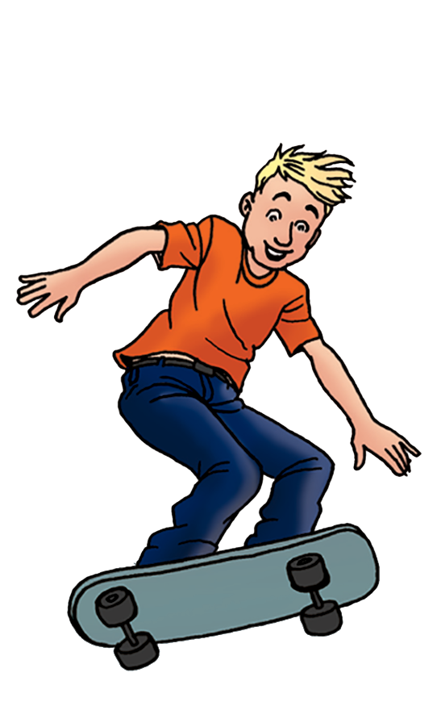
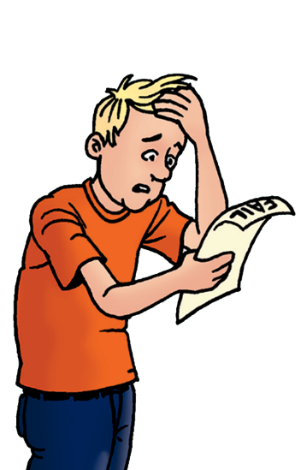
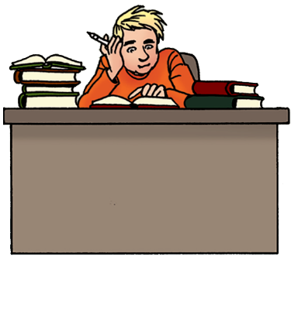
Conditionals
First conditional
Second conditional
Third conditional

Slide 32
Learning activity 7.9
Module 7
Test your knowledge of this section by completing Learning activity 7.9 on page 126 of your Student’s Book.

Slide 33
Learning activity 7.10
Module 7
Test your knowledge of this section by completing Learning activity 7.10 on page 126 of your Student’s Book.

Slide 34
Summary of Module 7

Slide 35
Formative assessment
Module 7
Test your knowledge of Module 7 by completing the Formative assessment on page 127 of your Student’s Book.

