Slide 1
English: First Additional Language
NQF 3

Slide 2
Reading and responding to visual texts
Module 6

Slide 3
Overview
Reading visual material
Infographics
Flyers
Cartoons and comic strips
Reading internet texts
Modal verbs
Summary writing
Memo
Email
Telephone conversations

Slide 4
Reading visual material
Pre-reading
Skimming, scanning, predicting and activating background knowledge
During reading
Examining the meaning and usage of words, language structures and conventions, and the purpose of the texts
Post-reading
Answering questions on the text and analysing the text for meaning
The reading process

Slide 5
Learning activity 6.1
Module 6
Refer to Module 3 for revision on conducting discussions.
Test your knowledge of this section by completing Learning activity 6.1 on page 95 of your Student’s Book.

Slide 6
Learning activity 6.2
Module 6
Refer to Module 1 for revision notes on the summary.
Test your knowledge of this section by completing Learning activity 6.2 on page 96 of your Student’s Book.

Slide 7
Learning activity 6.3
Module 6
Refer to Module 5 for revision notes on telephone conversations.
Test your knowledge of this section by completing Learning activity 6.3 on page 96 of your Student’s Book.

Slide 8
Learning activity 6.4
Module 6
Refer to Module 1 and 2 for revision notes on answering questions.
Test your knowledge of this section by completing Learning activity 6.4 on page 96 of your Student’s Book.

Slide 9
Reading infographics
Definition
An infographic is a visual image such as a chart or diagram that is used to represent information or data.
Infographics have become more popular with the development of social media and the internet.
Formatting is the way text is organised on the page.

Slide 10
Formatting
Formatting
Fonts, font sizes, bold, italics
Size of text
Type of font
Bullets
Columns
Symbols
Headings and titles

Slide 11
Formatting

Slide 12
Learning activity 6.5
Module 6
Test your knowledge of this section by completing Learning activity 6.5 on page 98 of your Student’s Book.

Slide 13
Learning activity 6.6
Module 6
Refer to Module 5 for revision notes on memos.
Test your knowledge of this section by completing Learning activity 6.6 on page 99 of your Student’s Book.

Slide 14
Learning activity 6.7
Module 6
Refer to Module 5 for revision notes on memos.
Test your knowledge of this section by completing Learning activity 6.7 on page 99 of your Student’s Book.

Slide 15
Reading creative visual texts
When you look at visual material, study it in any way that occurs to you.
There is no order to follow for this process, but make sure that you examine all areas of the text.
Writers often use formatting to give clues about the content of the text.
Notes:
Cogs to appear one by one and rotate.

Slide 16
Reading visual material
Bullets
Summarises important points or they capture the essential bits of information.

Slide 17
Reading visual material
WAR IS PEACE
Figures of speech
Writers may use clever figures of speech to capture the reader’s attention in the headings and titles.

Slide 18
Reading visual material
I AM A NORMAL
HEADING
I AM A BOLD
HEADING
Bold text
Bold text helps the reader focus on those words. Bold text should be used sparingly because it loses its effect if too much of the text is in bold.

Slide 19
Reading visual material
Visuals
We receive information in many forms, including pictures, diagrams, word webs, graphs, sketches, illustrations, charts, timelines, photographs, tables, flow charts, maps and mind maps.

Slide 20
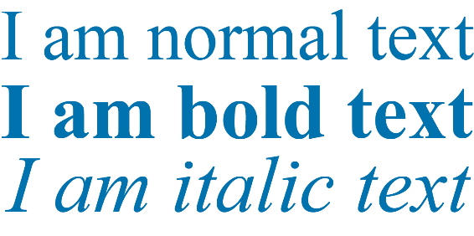
Reading visual material
Formatting
Writers may use many methods to catch and keep the reader’s attention. These include using different fonts, sizes of fonts, bolding text, and italicising words.

Slide 21
Reading visual material
No Parking
Symbols
Symbols are quickly understood by the reader. A symbol contains significant amounts of information that the reader can decode.

Slide 22
Cartoons and comic strips
A
cartoon
A
comic strip
is usually one picture containing a few words or a caption, and the effect often comes from the drawing or picture.
is a series of pictures drawn inside boxes (called frames) that tell a story.
A cartoon shows the opinion or point of view of the person who drew the cartoon.
Cartoons often make fun of people in government or important people in the news, or they draw attention to something that has happened recently.
The story is told mainly in pictures with some words.
The words are usually those spoken by the characters.
Comic strips can be printed in colour or in black and white.

Slide 23
Cartoon analysis
When you read and view cartoons and comic strips, you must be able to comment on the following:
The position and size of the characters.
The characters’ gestures and facial expressions, such as sneers and smiles.
The characters’ body language, such as clenched fists or sloping shoulders.
The spoken words: look at the font that is used in the spoken words, as well as the content of the words.

Slide 24
Learning activity 6.8
Module 6
Test your knowledge of this section by completing Learning activity 6.8 on page 100 of your Student’s Book.

Slide 25
Reading internet texts
Photograph Analysis
Begin reading a photograph by looking at the things in the photograph. What people, places, and things are included in the photograph?
Consider whether there are any activities captured. If so, how do the people or activities use the objects in the photograph?
Consider whether there are any activities captured. If so, how do the people or activities use the objects in the photograph?
There’s nothing fixed about how to read photographs.
1
2
3
4

Slide 26
Learning activity 6.9
Module 6
Test your knowledge of this section by completing Learning activity 6.9 on page 105 of your Student’s Book.

Slide 27
Learning activity 6.10
Module 6
Test your knowledge of this section by completing Learning activity 6.10 on page 105 of your Student’s Book.

Slide 28
Modal verbs
You know that
verbs
are action words or they express a state of being.

Slide 29
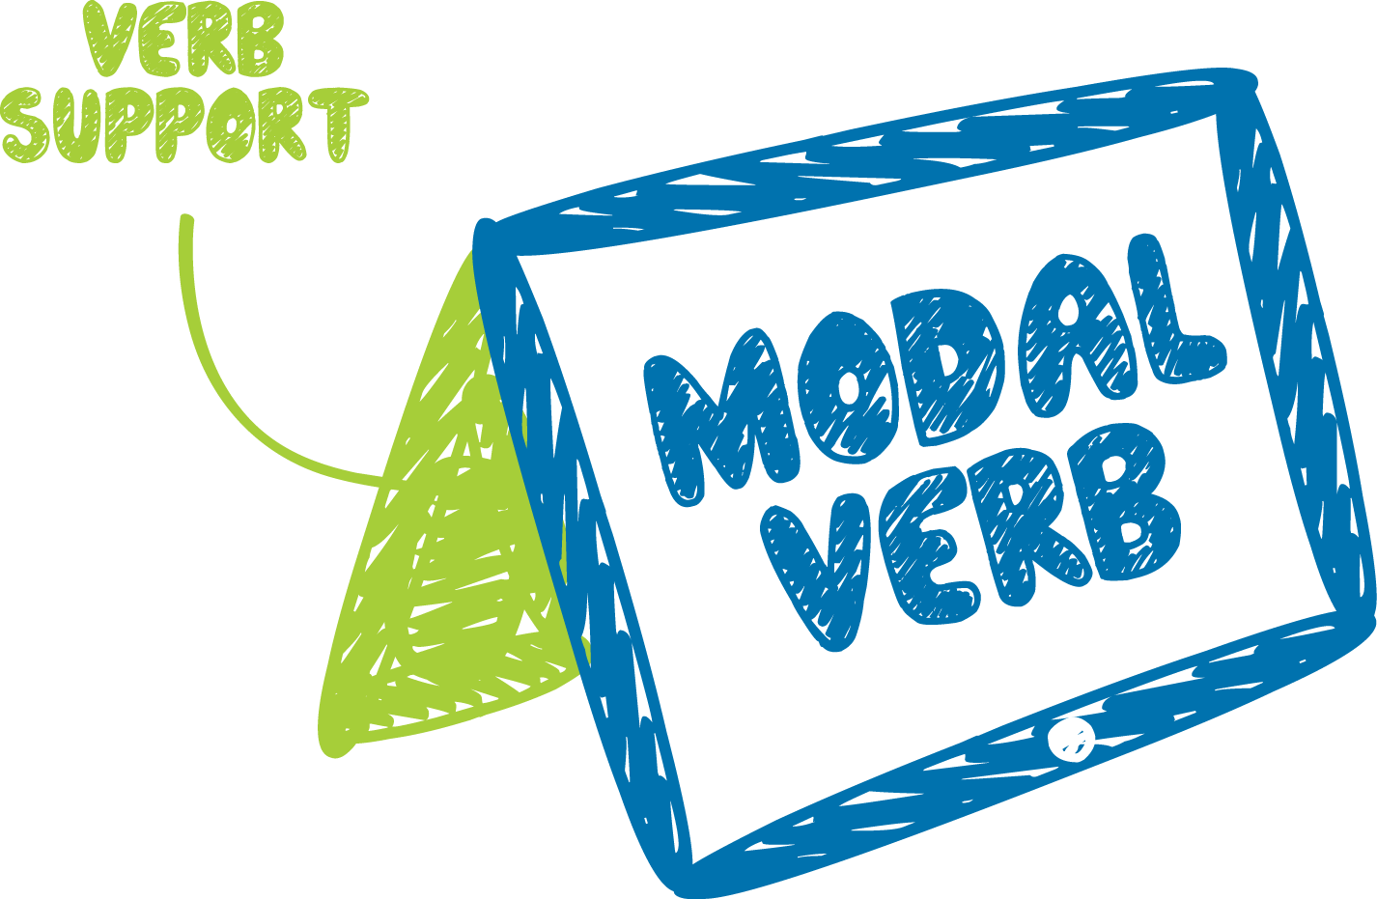
Modal verbs
Modal verbs
are like auxiliary verbs as they cannot stand on their own – they have to be used with another verb.

Slide 30
More on modal verbs
Modal verbs include:
can, could
may, might, must
will
shall, should
ought to

Slide 31
Still more on modal verbs
Modal verbs can be used for:
making requests
giving advice
expressing necessity or a requirement
making a suggestion
showing probability
showing ability and possibility
showing desire
offering
showing preference
Class Activity
Can you give an example of each, using modal verbs?

Slide 32
Learning activity 6.11
Module 6
Test your knowledge of this section by completing Learning activity 6.11 on page 108 of your Student’s Book.

Slide 33
Learning activity 6.12
Module 6
Test your knowledge of this section by completing Learning activity 6.12 on page 110 of your Student’s Book.

Slide 34
Summary of Module 6

Slide 35
Formative assessment
Module 6
Test your knowledge of Module 6 by completing the Formative assessment on page 111 of your Student’s Book.

