Slide 1
English: First Additional Language
NQF 2

Slide 2
Visual texts
Module 8

Slide 3
Overview
Symbols
Signs
Sign language
Schedules
Comic strips and cartoons
Examination instruction words: Differentiate
Abbreviations
Proofreading

Slide 4
Visual Texts
Visual texts use pictures or graphics to send a message.
Symbols
Sign Language
Signs
Schedules

Slide 5
Symbols
A symbol is a mark or a sign that represents a specific idea.
Heart
Recycle
Bluetooth
Effective symbols are universally understood.
Notes:
Display this sign while you are discussing the information provided on page 118 of the Student’s Book.

Slide 6
Symbols (continued)
Symbols are culturally or group specific.
Symbols evoke strong feelings.
Colours can have symbolic meanings.
Some more examples of symbols:
Raindrop
Flag
Fire hydrant

Slide 7
Learning activity 8.1
Module 8
Test your knowledge of this section by completing Learning activity 8.1 on page 118 of the Student’s Book.

Slide 8
Signs
A sign is a large, publicly displayed board that gives specific information by using words, pictures or symbols or all three.
Information
Stop
No smoking
Notes:
Display this slide while you are discussing the information provided on pages 118 and 119 of the Student’s Book.

Slide 9
Purpose of signs
To warn
To inform

Slide 10
Purpose, message and meaning of signs
Signs that inform:
Signs that warn:
Direction and place signs
Prohibition signs
Mandatory signs
Hazard signs
Emergency information signs

Slide 11
Learning activity 8.2
Module 8
Test your knowledge of this section by completing Learning activity 8.2 on page 120 of the Student’s Book.

Slide 12
Features of signs
Format or layout
Font
Size
Colour
Shape
The use of abbreviations

Slide 13
Learning activities 8.3 and 8.4
Module 8
Test your knowledge of this section by completing Learning activities 8.3 and 8.4 on page 122 of the Student’s Book.

Slide 14
Language pillars of effective signs
Pillar 1
Spelling
Pillar 2
Punctuation
Pillar 3
Choosing the
right word

Slide 15
Learning activities 8.5 and 8.6
Module 8
Test your knowledge of this section by completing Learning activities 8.5 and 8.6 on page 123 of the Student’s Book.

Slide 16
Use the writing process when designing your sign:
Design the first draft
of the sign. Use appropriate format, layout, size, font and use of colour. Edit and proofread. Make necessary changes.
Plan: brainstorm, draw a
mind-map,
organise the information according to the features of an effective sign.
1
2
Present a final draft of the sign to your partner.
4
Submit
your final
sign for assessment.
3
5
Incorporate feedback.

Slide 17
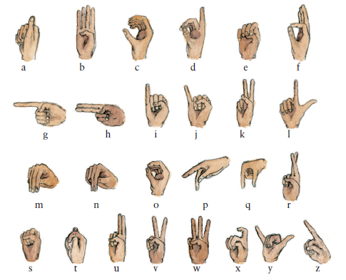
Sign Language

Slide 18
Learning activity 8.7
Module 8
Test your knowledge of this section by completing Learning activity 8.7 on page 125 of the Student’s Book.

Slide 19
Schedules
A schedule is a list of times when tasks or events or actions will take place.
Day | Time | Activity
Monday | 13:00 | Library duty
Tuesday | 13:00 | Choir
Wednesday | 13:00 | Extra IT
Thursday | 13:00 | SRC
Friday | 13:00 | Weekend!

Slide 20
Learning activities 8.8 and 8.9
Module 8
Test your knowledge of this section by completing Learning activity 8.8 and 8.9 on page 125 of the Student’s Book.

Slide 21
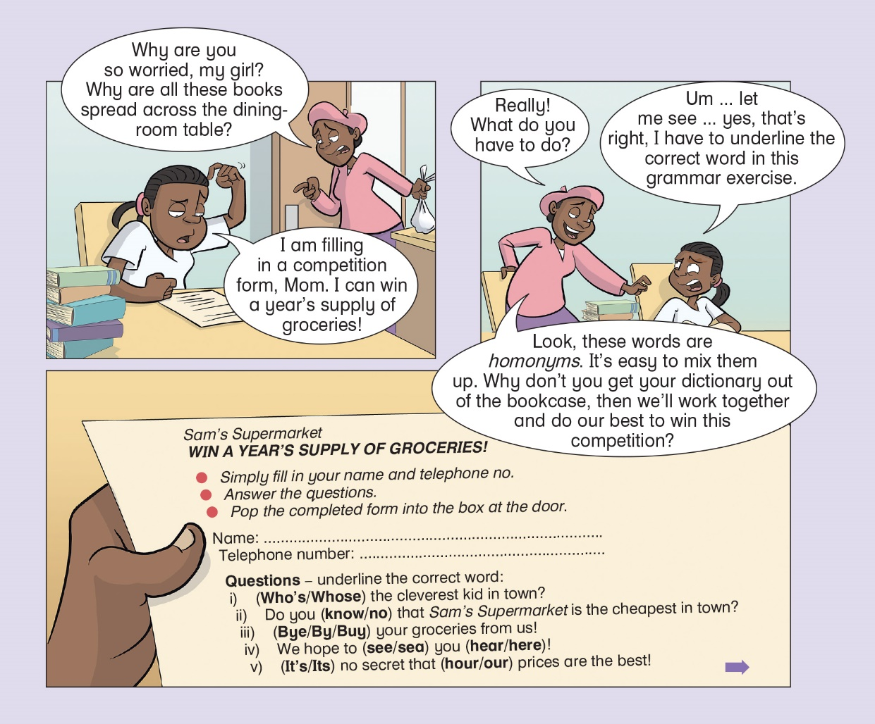
Comic strips and cartoons
Drawings and words work together to tell a story or inform.

Slide 22
Understanding cartoons and comic strips
That is a
scary spider.
Attack!
Divided into frames
Speech bubbles show what a character is saying
Non-verbal clues tell us how a character is feeling or what he or she is thinking
Thought bubbles show what a character is thinking

Slide 23
Learning activity 8.10
Module 8
Test your knowledge of this section by completing Learning activity 8.10 on page 128 of the Student’s Book.

Slide 24
Learning activity 8.11
Module 8
Test your knowledge of this section by completing Learning activity 8.11 on page 130 of the Student’s Book.

Slide 25
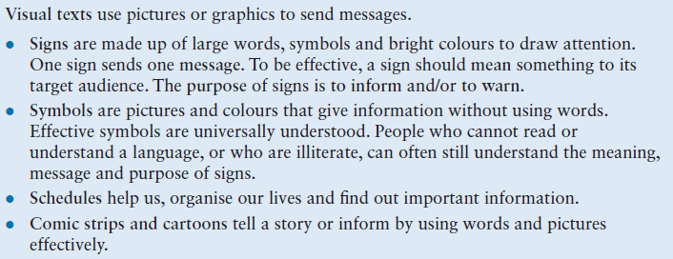
Summary of Module 8

Slide 26
Formative assessment
Module 8
Test your knowledge of Module 8 by completing the Formative assessment on page 131 of your Student’s Book.

