Slide 1
English: First Additional Language
NQF 2

Slide 2
Write for social purposes
Module 6

Slide 3
Overview
Simple, compound and complex sentences
The writing process
Descriptive writing
Blogs
Invitations
Emails
Facebook, Twitter and text messages

Slide 4
Simple sentences
Alisha sings a song.
One idea
One finite verb (can stand on its own, has a subject, number and tense)

Slide 5
Compound sentences
Alisha sings a song and
dances a choreographed
routine on the stage.
Two or more finite verbs (sings and dances), may be two simple sentences,
Joined by a conjunction (and).

Slide 6
Complex sentences
Alisha sings a song while the
band plays after the
dancers leave the stage.
One main clause (contains a finite verb)
One or more subordinating clauses which add information
Joined by conjunctions (while, after)

Slide 7
Learning activities 6.1 and 6.2
Module 6
Test your knowledge of this section by completing Learning activities 6.1 and 6.2 on pages 80 and 81 of your Student’s Book.

Slide 8
The writing process
WRITING
PRE-WRITING
DURING WRITING
POST-WRITING
FEEDBACK
Plan and organise information
Write first draft
Use appropriate style, structure and correct grammar
Edit first draft
Write and proofread until final draft is written
Submit final draft
Use feedback to improve later written work
Submit final draft
Use feedback to improve later written work

Slide 9
The writing process
Class activity
Give one word for the following:
the stage of the writing process when you plan
the stage of the writing process when you write your first draft
the stage of the writing process when you correct and improve your first draft
the stage of the writing process when you submit your writing for assessment and get feedback on your performance

Slide 10
Learning activity 6.3
Module 6
Test your knowledge of this section by completing Learning activity 6.3 on page 82 of your Student’s Book.

Slide 11
Descriptive writing
The writing appeals to your senses and you can picture what you read.
Use descriptive adjectives and adverbs.
Use strong verbs.
Use different types of sentences.
Use punctuation so that it adds to the description.
Follow the writing process.

Slide 12
Learning activity 6.4
Module 6
Test your knowledge of this section by completing Learning activity 6.4 on page 84 of your Student’s Book.

Slide 13
Blogs
Web log, an on-line social medium
The purpose of blogs is to connect with others who have a common interest, in order to inform, educate or entertain.
Blogs have specific features.

Slide 14
Learning activities 6.5 and 6.6
Module 6
Test your knowledge of this section by completing Learning activities 6.5 and 6.6 on pages 86 and 88 of your Student’s Book.

Slide 15
Invitations
Printed and posted, or through on-line platforms such as email and Facebook (or both).
The purpose of invitations is to invite someone to an event.
Invitations have specific features.

Slide 16
Learning activity 6.7
Module 6
Test your knowledge of this section by completing Learning activity 6.7 on page 90 of your Student’s Book.

Slide 17
Emails
Electronic, on-line mail
The purpose of an email is:
to connect and communicate with others, and
to transfer information (visual or textual) which is attached to the email.
Emails have specific features.

Slide 18
Learning activities 6.8 and 6.9
Module 6
Test your knowledge of this section by completing Learning activities 6.8 and 6.9 on pages 91 and 92 of your Student’s Book.

Slide 19
More on social media
To connect, to inform, to persuade, to advertise, to do business, to humour, to express views, to obtain people’s personal data and preferences , to mobilise, to pass on information (visual and textual)
Facebook
Twitter
Text messages

Slide 20
Learning activities 6.10 to 6.13
Module 6
Test your knowledge of this section by completing Learning activities 6.10 to 6.13 from page 94 to page 97 of your Student’s Book.

Slide 21
VIDEO: Writing for social purposes

Slide 22
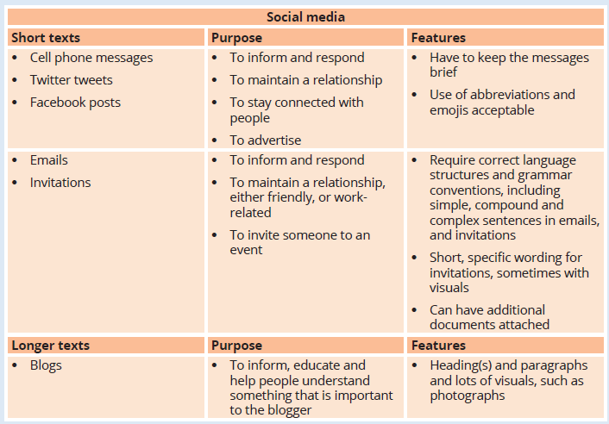
Summary of Module 6

Slide 23
Formative assessment
Module 6
Test your knowledge of Module 6 by completing the Formative assessment on page 98 of your Student’s Book.

