Slide 1
English: First Additional Language
NQF 2

Slide 2
Listen and speak to interact with others
Module 5

Slide 3
Overview
Conversations, discussions and dialogues
Listening and speaking in groups
Non-verbal communication
Strategies
Pairs
Small groups
Large groups
Online

Slide 4
Overview (continued)
Connotative and denotative meaning
Idioms
Proverbs
Adjectives
Adverbs

Slide 5
Listen and speak to interact with others: Conversations
The sky? No seriously, there is so much going on in my life right now…

Slide 6
Listen and speak to interact with others: Conversations
Conversation
Mostly informal
Verbal: words and language
Non-verbal: body language and use of voice
Purpose: to interact informally

Slide 7
Listen and speak to interact with others: Discussions
We need to
discuss the
agenda
for tomorrow.
Let us discuss it now.

Slide 8
Listen and speak to interact with others: Discussions
Discussion
Mostly formal
Verbal: words and language
Non-verbal: body language and use of voice
Purpose: to interact on a more serious issue, formally

Slide 9
Listen and speak to interact with others: Dialogues
Dialogue
Informal or formal
Verbal: words and language
Non-verbal: body language and use of voice

Slide 10
Listen and speak to interact with others: Dialogues
Purpose: for two or more people or groups of people to talk to each other to solve a problem.

Slide 11
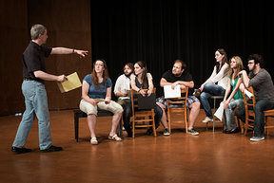
Listen and speak to interact with others: Dialogues
Purpose: for characters in a play or in a book to talk to each other,
in order to entertain and inform the audience or readers.

Slide 12
Learning activity 5.1
Module 5
Test your knowledge of this section by completing Learning activity 5.1 on page 65 of your Student’s Book.

Slide 13
Non-verbal communication
Use of voice
tone
pitch
volume
tempo
rhythm
projection
Body language
posture
facial expressions
eye-contact
gestures

Slide 14
Strategies for listening and speaking in groups
Participate (listen and speak)
Initiate and respond
Awareness of your own and other speakers’ verbal and non-verbal communication
Reflect interest and attention
Appropriate use of language

Slide 15
Learning activities 5.2, 5.3 and 5.4
Module 5
Test your knowledge of these sections by completing Learning activities 5.2, 5.3 and 5.4 on pages 67 and 68 of your Student’s Book.

Slide 16
Did you know that you can interact with others by speaking and listening online?

Slide 17
Learning activities 5.5 and 5.6
Module 5
Test your knowledge of these sections by completing Learning activities 5.5 and 5.6 on pages 69 and 70 of your Student’s Book.

Slide 18
Denotative and connotative meaning of words
 | Denotative | Connotative
Definition | the meaning that the dictionary gives for a word | the way a word makes you feel or the things that a word reminds you of. Words can have a positive or a negative connotation
Home | A building, a residence | A warm, safe, loving place to be (positive connotation)
Father and mother | Parents | Loving, protective, strong, mom and dad (positive connotation)
Woman | Female | Can be seen as, or called a chick or babe (may have a negative connotation)
Drug addict | A person who takes harmful drugs and cannot stop taking them | When called a druggie, there is a negative connotation

Slide 19
The connotative and figurative use of words: Idioms and proverbs
 | Denotative (literal) | Connotative (figurative)
 | sheep: farm animal | the black sheep of the family: someone who brings disgrace to the family
 | iron: an appliance used to iron the creases out of clothes | strike while the iron is hot: act when you have the opportunity
 | bridge: road constructed over a river in order to cross the river safely | cross the bridge when you come to it: do not worry about a situation until you are faced with it
 | ice: frozen water | break the ice: be the first one to begin something
 | bed: a piece of furniture that you sleep on consisting of a mattress and a base | get out of bed on the wrong side: be in a bad mood

Slide 20
More idioms and proverbs
Imagine what it would look like if you drew the following:
I will give you a piece of my mind
Meaning:
I will argue with you and tell you how I feel

Slide 21
More idioms and proverbs
Imagine what it would look like if you drew the following:
Two heads are better than one
Meaning:
Two people are more likely to solve a problem than one person

Slide 22
More idioms and proverbs
Imagine what it would look like if you drew the following:
To lose your heart to someone
Meaning:
To be in love

Slide 23
More idioms and proverbs
Imagine what it would look like if you drew the following:
To come out of your shell
Meaning:
To become more confident and more lively

Slide 24
Learning activity 5.7
Module 5
Test your knowledge of this section by completing Learning activity 5.7 on page 71 of your Student’s Book.

Slide 25
Adjectives
Describe nouns and pronouns
Make writing more interesting and descriptive
Can be compared (degrees of comparison)
a big (bigger, biggest) elephant
a spectacular (more spectacular, most spectacular) view
he is brave (braver, bravest)
she is courageous (more courageous, most courageous)

Slide 26
Adjectives in pictures
Water
(deep, deeper, deepest; dangerous, more dangerous, most dangerous)
Girl
(excited, more excited, most excited)
Dolphin
(fast, faster, fastest)
(adaptable, more adaptable, most adaptable)

Slide 27
Learning activity 5.8
Module 5
Test your knowledge of this section by completing Learning activity 5.8 on page 74 of your Student’s Book.

Slide 28
Adverbs
Tell you more about a verb
She reads books enthusiastically every day,
at home and at college. At the moment
she is reading extremely attentively.

Slide 29
Adverbs
Tell you more about a verb
She reads books every day,
at home and at college. At the moment
she is reading extremely attentively.
enthusiastically
Adverb of manner
(How?)

Slide 30
Adverbs
Tell you more about a verb
every day
She reads books enthusiastically ,
at home and at college. At the moment
she is reading extremely attentively.
Adverb of frequency
(How often?)

Slide 31
Adverbs
Tell you more about a verb
She reads books enthusiastically every day,
at and at . At the moment
she is reading extremely attentively.
home
college
Adverb of place
(Where?)

Slide 32
Adverbs
Tell you more about a verb
She reads books enthusiastically every day,
at home and at college. she
is reading extremely attentively.
At the moment
Adverb of time
(When?)

Slide 33
Adverbs
Tell you more about a verb
She reads books enthusiastically every day,
at home and at college. At the moment
she is reading attentively.
extremely
Adverb of degree
(How much?)

Slide 34
Adverbs
Tell you more about a verb
She reads books enthusiastically every day,
at home and at college. At the moment
she is reading extremely .
attentively
Adverb of manner
(How?)

Slide 35
Adverbs in pictures
The athlete runs fast (faster, fastest). He runs rhythmically (more rhythmically, most rhythmically).
He practises regularly and saves much (more, most) time by living close to the track.

Slide 36
Adverbs in pictures

Slide 37
Learning activity 5.9
Module 5
Test your knowledge of this section by completing Learning activity 5.9 on page 75 of your Student’s Book.

Slide 38
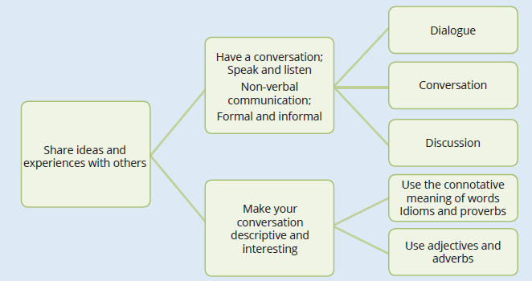
Summary of Module 5

Slide 39
Formative assessment
Module 5
Test your knowledge of Module 5 by completing the Formative assessment on page 77 of your Student’s Book.

