Slide 1
English: First Additional Language
NQF 2

Slide 2
Listen for information
Module 3

Slide 3
Overview
The listening process
Taking notes
Mind maps
Timelines
Verbs
Questions

Slide 4
The listening process: Use your EARS!
E
liminate distractions and barriers.
ngage with what you hear.
A
ttention! Pay careful attention.
R
ecord. Take notes.
emember. Taking notes helps you
remember what you hear.
S
ummarise what you hear.
horten the information, extracting only the main ideas. Use symbols, abbreviations and acronyms to help you.

Slide 5
The listening process
1
Pre-listening
2
During listening
3
Post-listening

Slide 6
Learning activity 3.1
Module 3
Test your knowledge of this section by completing Learning activity 3.1 on page 30 of your Student’s Book.

Slide 7
Taking notes

Slide 8
Taking notes
Taking notes
An important skill for life-long learning and working.
Illustrates the ability to listen attentively, and to be able to extract and record main ideas.
Useful formats and methods
Mind maps
Timelines
Lists
Tables
Tree diagrams
Spidergrams
Organograms
Flow charts

Slide 9
Use a tree diagram to take notes

Slide 10
Mind mapping

Slide 11
Learning activity 3.2
Module 3
Test your knowledge of this section by completing Learning activity 3.2 on page 32 of your Student’s Book.

Slide 12
Draw a timeline

Slide 13
Learning activity 3.3
Module 3
Test your knowledge of this section by completing Learning activity 3.3 on page 33 of your Student’s Book.

Slide 14
Taking notes
Instruction | Note-taking method
Define, state, summarise, list | Numbered or bulleted list
Compare, contrast, comment on, criticise, prove, substantiate, justify, evaluate, review | Table
Trace, outline, relate | Timeline
Illustrate, show, describe, discuss | Tree diagram, organisational chart, spidergram or flow chart
Analyse, interpret, determine, motivate | Mindmap

Slide 15
Learning activity 3.4
Module 3
Test your knowledge of this section by completing Learning activity 3.4 on page 33 of your Student’s Book.

Slide 16
Listening comprehension
Questions | YES/NO
1. Do I have what I need to do this listening activity?
2. Can I predict what the passage is about, based on the lecturer’s pre-listening comments and questions?
3. Have I read through the questions or instructions?
4. Have I decided what note-taking method to use?
5. Can I block out all distractions and listen attentively?

Slide 17
Learning activity 3.5
Module 3
Test your knowledge of this section by completing Learning activity 3.5 on page 34 of your Student’s Book.

Slide 18
Verbs
How do you show, in a sentence, that someone does something?
You use a verb: laugh, shake, build

Slide 19
More on verbs
The part of speech in a sentence that shows action.
Sentence
Finite verb
The engineer
designs
bridges.
Subject
Object

Slide 20
More on verbs
Verbs have:
Tense (present perfect tense)
Number (singular)
Auxiliary verbs are helping verbs:
Sentence
The engineer
has
designed bridges.
auxiliary verb

Slide 21
Learning activity 3.6
Module 3
Test your knowledge of this section by completing Learning activity 3.6 on page 37 of your Student’s Book.

Slide 22
Can you ask questions?
Sentence
The engineer designs bridges.
Questions:
Question word:
Who designs bridges? What does she design?
Start with auxiliary verb:
Does the engineer design bridges?
Add a question tag:
The engineer designs bridges, doesn’t she?
Remember!
Keep the tense the same and make sure the verb agrees with
the subject in terms of number (singular or plural).

Slide 23
Learning activity 3.7
Module 3
After viewing the video, test your knowledge of this section by completing Learning activity 3.7 on page 40 of your Student’s Book.

Slide 24
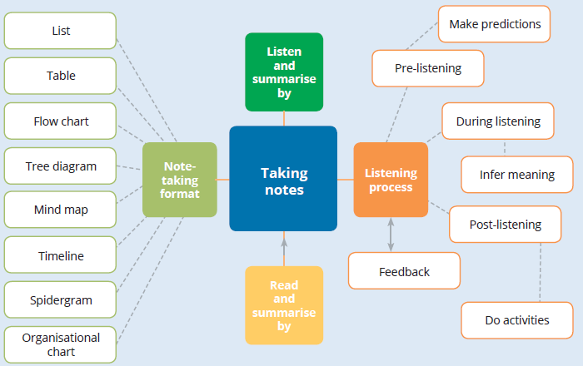
Summary of Module 3

Slide 25
Formative assessment
Module 3
Test your knowledge of Module 3 by completing the Formative assessment on page 41 of your Student’s Book.

