Slide 1
English: First Additional Language
NQF 2

Slide 2
Reading for information
Module 2

Slide 3
Overview
Information and reference texts
The reading process
Abbreviations and acronyms
Summarising
Parts of speech
Nouns
Articles
pronouns
Antonyms and synonyms

Slide 4
Information and reference texts
Use information and reference texts to find specific facts and information, from printed or electronic sources, for example:
dictionaries
encyclopaedias
textbooks
manuals
newspapers
magazines

Slide 5
Learning activity 2.1
Module 2
Test your knowledge of this section by completing Learning activity 2.1 on page 16 of your Student’s Book.

Slide 6
The reading process
1
Pre-reading
Skim, scan, predict
2
During reading
Intensive reading in order to understand
3
Post-reading
Respond to questions and instructions
Comprehension
Summary
Language in practice

Slide 7
Learning activities 2.2 and 2.3
Module 2
After viewing the video, test your knowledge of this section by completing Learning activities 2.2 and 2.3 on pages 17 and 19 of your Student’s Book.

Slide 8
Shortening words: abbreviations and acronyms
An
An
abbreviation
acronym
is a short form of a word or phrase.
is also an abbreviation in which the first letters of a group of words form a word.
abbr.
(abbreviation)
e.g.
(example)
no.
(number)
POTUS
(President of the United States)
SAPS
(South African Police Services)
UFO
(unidentified flying object)

Slide 9
Shortening texts: How to summarise information
Step 1
PRE-READ
Skim, scan, predict

Slide 10
Shortening texts: How to summarise information
break down into main ideas, exclude supporting details
Step 2
READ and ANALYSE

Slide 11
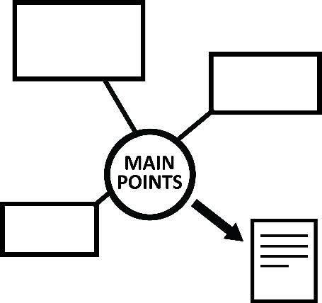
Shortening texts: How to summarise information
Step 3
SYNTHESISE
Put back together
in shortened format, rewrite main points, own words

Slide 12
Shortening texts: How to summarise information
Check work and submit final draft
Step 4
EVALUATE

Slide 13
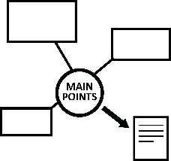
Shortening texts: How to summarise information
Step 1
PRE-READ
Step 2
READ and ANALYSE
Step 3
SYNTHESISE
Step 4
EVALUATE

Slide 14
Summary activity
Module 2
Test your knowledge of this section by completing the Summary activity on page 20 of your Student’s Book.

Slide 15
Parts of speech
Each word in a sentence has a specific function. Words
can function as:
Articles
Parts
of
Speech
Nouns
Pronouns
Later you will cover:
Verbs, Adjectives, Adverbs, Prepositions and Conjunctions

Slide 16
Nouns
2
Proper nouns
Wednesday, March
Common nouns
Pen
Abstract nouns
Determination
Collective nouns
A pack of cards

Slide 17
Nouns in a picture
Proper noun: Mount Kilimanjaro, Mount Everest
Common noun: mountain, mountaineer, snow
Abstract noun: courage, strength, perseverance
Collective noun: a range of mountains, a team of climbers

Slide 18
Learning activity 2.4
Module 2
Test your knowledge of this section by completing Learning activity 2.4 on page 22 of your Student’s Book.

Slide 19
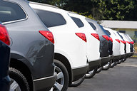
Articles
A word (a, an, the) used before a noun to show whether you are referring to something in particular, or a general example of something:
A car

Slide 20
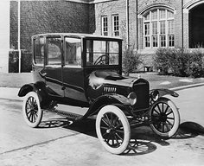
Articles
A word (a, an, the) used before a noun to show whether you are referring to something in particular, or a general example of something:
An old-fashioned car.

Slide 21
Articles
A word (a, an, the) used before a noun to show whether you are referring to something in particular, or a general example of something:
The car that Kylie bought.

Slide 22
Antonyms and synonyms
Word | Antonym (opposite) | Synonym (same)
big | small | huge
rich | poor | wealthy
happy | sad | joyful
adult | child | grownup
quick | slow | fast
depart (on holiday) | arrive | leave
hot (temperature) | cold | scorching
low (levels of water) | high | depleted
fix (a broken object) | break | repair
sound (that you hear) | silence | noise

Slide 23
Pronouns
Personal pronouns (me)
Possessive pronouns (mine)
Reflexive pronouns (myself)
Interrogative pronouns (Who?)
Demonstrative pronouns (those)
Relative pronouns (that)
Indefinite pronouns (anyone)

Slide 24
Learning activity 2.5
Module 2
Test your knowledge of this section by completing Learning activity 2.5 on page 25 of your Student’s Book.

Slide 25
Summary of Module 2
You can improve your ability to read and respond to information texts with real understanding, by following a reading process. This ability does not only apply to English First Additional Language, but across the curriculum. You actively engage your brain in these activities which then improves your chances of academic success.
Pre-reading skills: Skim, scan and predict.
During reading skills: Understand words. Use a dictionary, the context, your knowledge of prefixes and suffixes, and the origins of words to help you.
Post-reading skills: Apply your knowledge of language structures and grammar conventions to help you respond to instructions.
Use the feedback you receive to improve future performance.

Slide 26
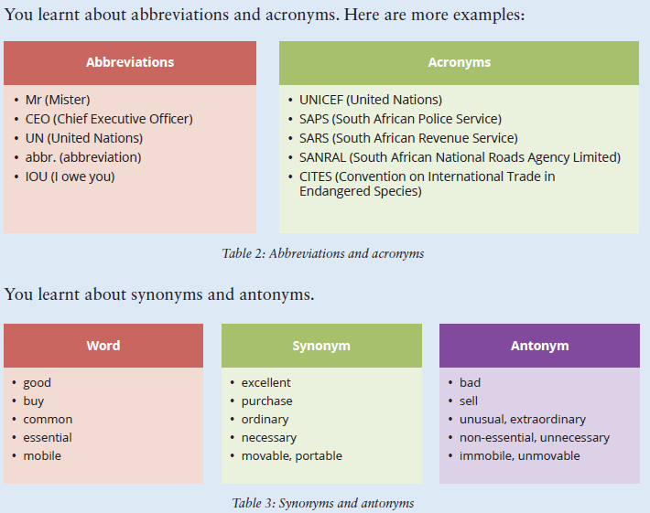
Summary continued…

Slide 27
Formative assessment
Module 2
Test your knowledge of Module 2 by completing the Formative assessment on page 27 of your Student’s Book.

