Slide 1
English: First Additional Language
NQF 2

Slide 2
Revision
Module 12

Slide 3
Overview
Communication
Theory
Reading and viewing
Writing
Language in practice
Speaking
Listening

Slide 4
Theory of communication
Principles
Elements
Barriers
Channels
Categories

Slide 5
Listening
Listen:
For information
In order to understand
In order to take notes
In order to learn
In order to respond appropriately

Slide 6
Speaking
Speak:
To convey or formally present information to others.
To clarify others’ understanding.
To initiate and sustain conversations and interact with others.
To express yourself.
Non-verbal communication (use of voice and body language) conveys information in addition to the words you use.

Slide 7
Reading
Read:
In order to acquire information and to be informed on a variety of matters.
For enjoyment.

Slide 8
Writing
Write:
To express yourself.
To convey information and knowledge in printed or electronic format.
When a written response is required from someone.

Slide 9
Language in practice
Use language and grammar conventions:
For expressive purposes
Express yourself clearly and correctly according to the requirements of the language you are using
For receptive purposes
To be able to receive information (through reading and listening), with understanding and in order to learn and remember.

Slide 10
Study method
Remember!
For EFAL, but also for all learning across the curriculum
Use what you have learnt about the reading process as a study method!
Remember that for many learners reading is the foundation of most learning.

Slide 11
The reading and learning process
1
Pre-reading = Pre-learning
2
During reading = During learning
3
Post-reading = Post-learning

Slide 12
Pre-learning
Let your brain know what you will be learning about (warm up and prepare your brain before you start to exercise it):
Skim through the section
Scan for specific information
Predict what you will be learning about

Slide 13
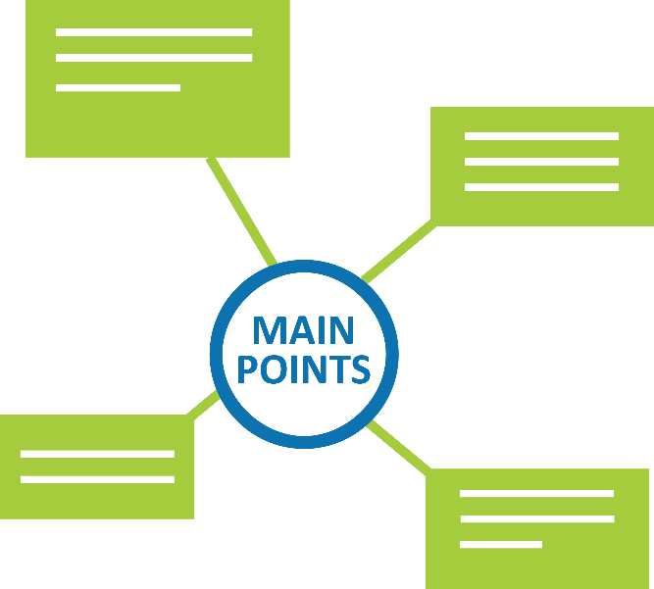
During learning
Read intensively and with understanding.
As you read, make a mind map of the topic and main ideas of the section of work you are learning.
Follow the procedure for mind mapping that you learnt this year.
To extract the main ideas while you read, turn the headings into questions.

Slide 14
During learning
Mnemonics refers to a learning aid, something that helps you remember information that you have to learn.
Use mnemonics to help
you remember information.

Slide 15
Examples of mnemonics
Use the first letter of each word in a list of words or information to make a word:
For example:
use the acronym BODMAS to help you remember the order of mathematical operations – Brackets; Order; Division; Multiplication; Addition; Subtraction

Slide 16
Examples of mnemonics
Use a word or association to help you remember the spelling of a difficult word:
For example:
there is a rat in separate,
Roy G Biv to remember the colours of the rainbow (red, orange, yellow, green, blue, indigo, violet)

Slide 17
Examples of mnemonics
Use music or visual representations.
For example:
Music: Remember how you learnt the ABC song to help you learn the alphabet?
Visual representations: Mind maps, tree diagrams or flow charts to help you remember.

Slide 18
During learning
Remember!
Reading through notes or a textbook without doing anything else does not equal learning.
Reading and mind mapping at the same time makes you an active learner.
Creating and revising thorough, well-designed mind maps ensures that what you learn is stored in your long-term memory.
Keep your mind maps neatly arranged in a file so that you can revise the information later.

Slide 19
Post-learning
There are two post-learning steps:
1
Immediately after completing a section
2
Before writing tests and exams

Slide 20
Post-learning
Immediately after completing your mind map of a section:
RECITE
That means visualising your mind map (being able to ‘see’ it and all the information it contains, in your head when your eyes are closed) and
Saying out loud what you learnt without referring to your notes or mind map

Slide 21
Post-learning
Later, before tests or exams on that particular section of work
REVISE
Go through your mind map again until you remember what you learnt
Visualise and recite the information out loud again

Slide 22
Now you are good to go.
Good luck!

