Slide 1
English: First Additional Language
NQF 2

Slide 2
Read and listen for enjoyment
Module 11

Slide 3
Overview
Short stories
Key features
Plot
Background
Setting
Theme
Characters

Slide 4
Overview (continued)
Express appreciation of story and story-telling techniques
Read and listen for enjoyment
Writing techniques and stylistic devices
Simile
Metaphor
Personification
Irony
Allusion

Slide 5

Words, words, words!
Literature
Fiction
Non-fiction
Notes:
Display this slide while discussing the information on page 162 of the Student’s Book.

Slide 6

Reading is good for you!
Fact 1
Reading makes you a better conversationalist.
Fact 2
The neighbours will not complain that you are reading loudly!
Fact 3
Knowledge by osmosis does not exist so you’d better read!
Fact 4
Books can save your life!
Fact 5
Dinosaurs didn’t read and they became extinct!

Slide 7


Characteristics of a good short story
Believable characters
Realistic setting and background
Universal theme

Slide 8
Key features of a short story
Plot
is a series of events
are the things that happen to the characters.
Background
describes the world a character lives in
could concentrate on a particular type of family, social position or culture
could be the historical, geographical or political situation in which a
character lives .
Setting
is the time and place in which the story happens
answers the question when and where the action takes place.
Characters
are the people in the story
a short story only has a few characters
characters come to life by what they say, do and think and by what other
characters say about them or think of them.
Theme
is the main idea, message or belief in the short story – some examples of common themes are: fear of
failure, forbidden love, jealousy, greed, the dangers of loneliness, childhood memories.
Diagram 1 : Key features of a short story

Slide 9
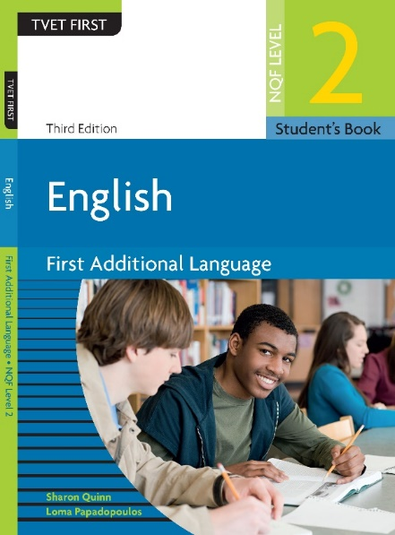
Learning activity 11.1
Module 11
See how well you understand this section. Complete Learning activity 11.1 on page 164 of the Student’s Book.

Slide 10
Structure of a short story
BEGINNING
Every story has a beginning. This is where the writer introduces the reader to the characters, the background and the setting. The writer hints at the big problem that the main character faces.
Diagram 2 : The structure of a short story

Slide 11
Structure of a short story
The middle of the story
explains the problem
facing the main
character
The problem the main character faces can take different forms. It could be an argument or disagreement between:
the main character and a family member, employer, friend or colleague
a powerful person or animal or the forces of nature threatening to harm the main character or characters
the main character and his or her own conscience, to decide on what would be the correct moral action or decision to take.
Diagram 2 : The structure of a short story

Slide 12
Structure of a short story
THE HIGH POINT OF THE STORY
This is where the danger, threat, shame or sadness that is facing the main character is at its worst. This is the darkest moment. At this point it looks as if the character will fail. Perhaps he, or someone close to him, will die. Or, maybe everyone will know his darkest secrets. After the high point, the story slowly begins to wind down. Here, the reader learns what the result is of the actions the main character has taken, or the decisions he or she has made. The writer leads the reader to the end of the story.
Diagram 2 : The structure of a short story

Slide 13
Structure of a short story
This is the final part of the story where any unfinished explanations are brought together and explained or answered.
ENDING
Diagram 2 : The structure of a short story

Slide 14
Structure of a short story
The middle of the story
explains the problem facing
the main character
THE HIGH POINT OF
THE STORY
The problem the main character faces can take different forms. It could be an argument or disagreement between:
the main character and a family member, employer, friend or colleague
a powerful person or animal or the forces of nature threatening to harm the main character or characters
the main character and his or her own conscience, to decide on what would be the correct moral action or decision to take.
This is where the danger, threat, shame or sadness that is facing the main character is at its worst. This is the darkest moment. At this point it looks as if the character will fail. Perhaps he, or someone close to him, will die. Or, maybe everyone will know his darkest secrets. After the high point, the story slowly begins to wind down. Here, the reader learns what the result is of the actions the main character has taken, or the decisions he or she has made. The writer leads the reader to the end of the story.
BEGINNING
ENDING
Every story has a beginning. This is where the writer introduces the reader to the characters, the background and the setting. The writer hints at the big problem that the main character faces.
This is the final part of the story where any unfinished explanations are brought together and explained or answered.
Diagram 2 : The structure of a short story

Slide 15
Learning activity 11.2
Module 11
See how well you understand this section. Complete Learning activity 11.2 on page 165 of the Student’s Book.

Slide 16
Writing Techniques and Stylistic Devices: Figures of speech
Simile
Metaphor
Personification
Irony
Allusion
Idioms and proverbs

Slide 17

Simile
A simile is a direct comparison that uses ‘like’ or ‘as’. The writer compares two things that are not the same to make the reader see these objects with fresh eyes.
The moon looks like a balloon tonight, it is so bright and so round.

Slide 18

Metaphor
A metaphor is an indirect comparison. It compares two things that are not the same but finds something between them that is similar.
When Lucy’s children are in trouble, she is a lion.

Slide 19

Personification
Personification is an indirect comparison where something that does not have life is given human qualities.
The wind was sobbing and moaning the whole night.

Slide 20

Irony
Irony says something but means the opposite to draw attention to or make fun of something.
“You are such a brave boy!” the girl teased as her boyfriend ran away from the large spider.

Slide 21

Allusion
Allusion is when a writer talks about someone or something famous or well-known and assumes that the reader knows who or what it is and can understand why he is referring to it.
He stood as still as Lot’s wife.
This is a biblical allusion in a simile.

Slide 22


Idioms and proverbs
Idioms and proverbs are examples of language used to create an effect because they have been used so often that they have become part of everyday speech.
‘To be in a tight corner’ means to be in serious trouble.
‘To bite the dust’ means to give up because you have failed.

Slide 23
Learning activity 11.3
Module 11
See how well you understand this section. Complete Learning activity 11.3 on page 166 of the Student’s Book.

Slide 24
Learning activity 11.4
Module 11
See how well you understand this section. Complete Learning activity 11.4 on page 167 of the Student’s Book.

Slide 25
Learning activity 11.5
Listen to and appreciate a short story
Module 11
See how well you understand this section. Complete Learning activity 11.5 on page 168 of the Student’s Book.

Slide 26
Learning activity 11.6
Read and appreciate a short story
Module 11
See how well you understand this section. Complete Learning activity 11.6 on page 170 of the Student’s Book.

Slide 27
Learning activity 11.7
Read and enjoy a short story
Module 11
See how well you understand this section. Complete Learning activity 11.7 on page 174 of the Student’s Book.

Slide 28
Learning activity 11.8
Literature assignment: Short story
Module 11
See how well you understand this section. Complete Learning activity 11.8 on page 178 of the Student’s Book.

Slide 29
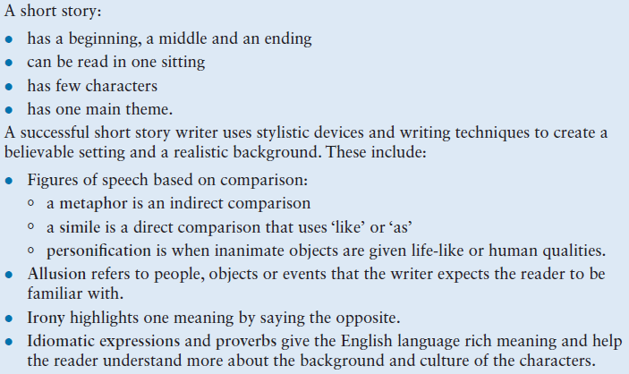
Summary of Module 11

Slide 30
Formative assessment
Module 11
Test your knowledge of Module 11 by completing the Formative assessment on page 180 of your Student’s Book.

