Slide 1
English: First Additional Language
NQF 2

Slide 2
Research activities: Reading, writing and speaking
Module 10
Notes:
l

Slide 3
Overview
Conduct research
Instruction words
Acknowledging sources and references
Research report
Prepared speech

Slide 4
The research process
Analyse the
research
topic or
instruction
Gather
information:
Read and
speak
Write up your results:
A research report
Present your
Findings:
Oral presentation
Analyse your
results
1
2
3
4
5

Slide 5
Conduct research
RESEARCH
PRE-RESEARCH
DURING RESEARCH
POST-RESEARCH
What? Who? When?
Where? How?
Observe, read, administer
questionnaires, take notes
Record and analyse findings
Write a research report
Feedback
Follow-ups
Publish findings

Slide 6
Learning activities 10.1, 10.3, 10.4 and 10.5
Module 10
Test your knowledge of these sections by completing Learning activities 10.1, 10.3, 10.4, 10.5 on pages 150, 152 and 153 of your Student’s Book.

Slide 7
What would you do? (if you were asked to do the following)
Analyse
Comment on
Describe
Discuss
Explain

Slide 8
Learning activity 10.2
Module 10
Test your knowledge of this section by completing Learning activity 10.2 on page 150 of your Student’s Book.

Slide 9
Acknowledging sources
Class Activity
Which source documents do these references come from?
Stern, T. Getaway Adventure Manual. Cape Town.
Taylor Brooklyn Publishers. 2014.
www.en.wikipedia.org Accessed 9 December 2017.
Mokotedi, B. Tourism boom. Pretoria News. 17 August 2017.
Serote M, Sejane, A. English for Post-Millenials.
Zandfontein. Zebra Publishers. 2017.
Khosa, P. Ask Amanda. YOU. July 22 2017.

Slide 10
Learning activity 10.6
Module 10
Test your knowledge of this section by completing Learning activity 10.6 on page 155 of your Student’s Book.

Slide 11
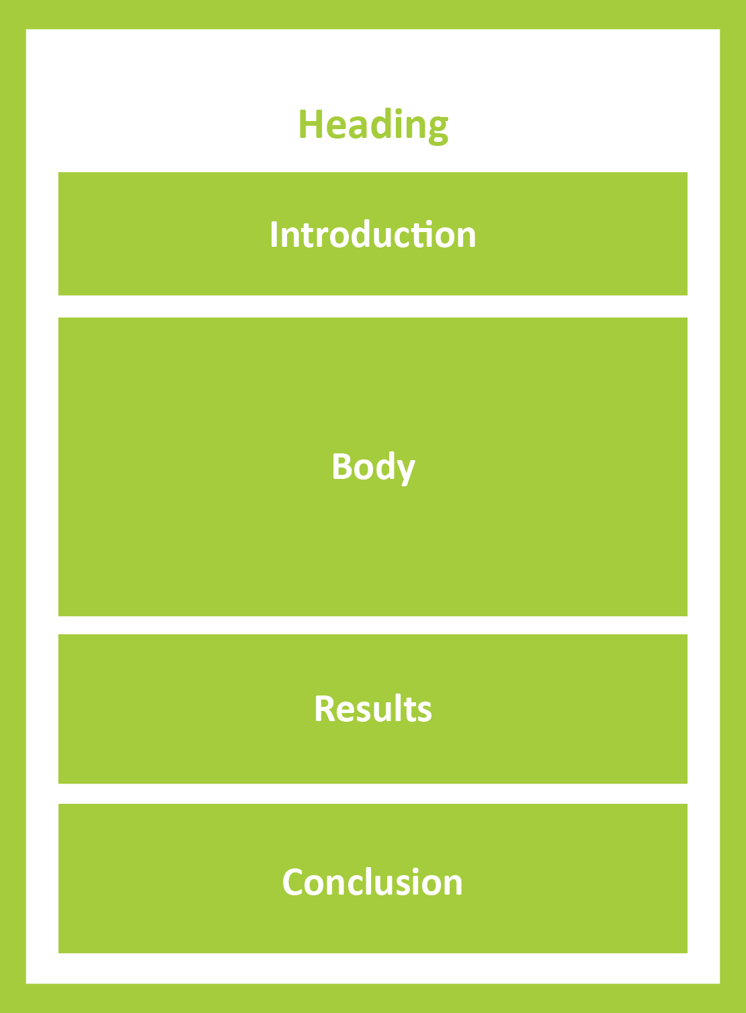
Research report
It all comes together in the research report:
The research report is well-written: content, format, language usage, appearance.

Slide 12
Learning Activities 10.7 and 10.8
Module 10
Test your knowledge of this section by completing Learning activities 10.7 and 10.8 on pages 156 and 157 of your Student’s Book.

Slide 13
Present your research findings: Prepared speech

Slide 14
Prepared speech
S
elf-confidence, reflected verbally and non-verbally
P
lanned, prepared, practised
E
ngage audience (introduction, conclusion, style, content
and body language)
E
xemplary use of language
C
onclusion: summarises and provides food for thought
H
elp: use audio and visual aids to help you

Slide 15
Audio-visual aids
Use visual and audio visual aids to improve and support your message.

Slide 16
Learning activity 10.9
Module 10
After viewing the video, test your knowledge of this section by completing Learning activity 10.9 on page 160 of your Student’s Book.

Slide 17
VIDEO: Research activities: reading, writing and speaking

Slide 18
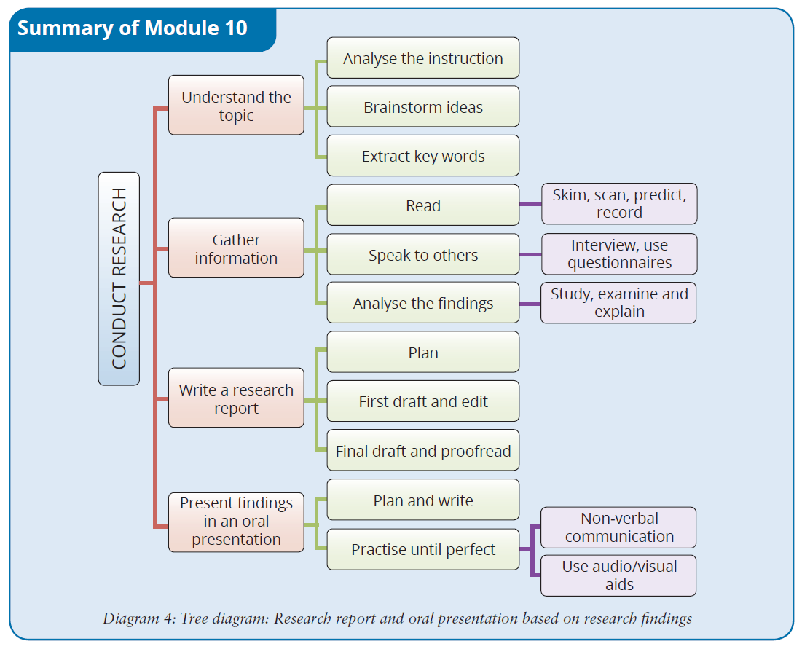
Summary of Module 10

Slide 19
Formative assessment
Module 10
Test your knowledge of Module 10 by completing the Formative assessment on page 161 of your Student’s Book.

