Slide 1
Mathematics
N3

Slide 2
Orientation
Module 1

Slide 3
Assessment activity 1.2

Slide 4
6. Simplify:

Slide 5
7. Simplify:

Slide 6
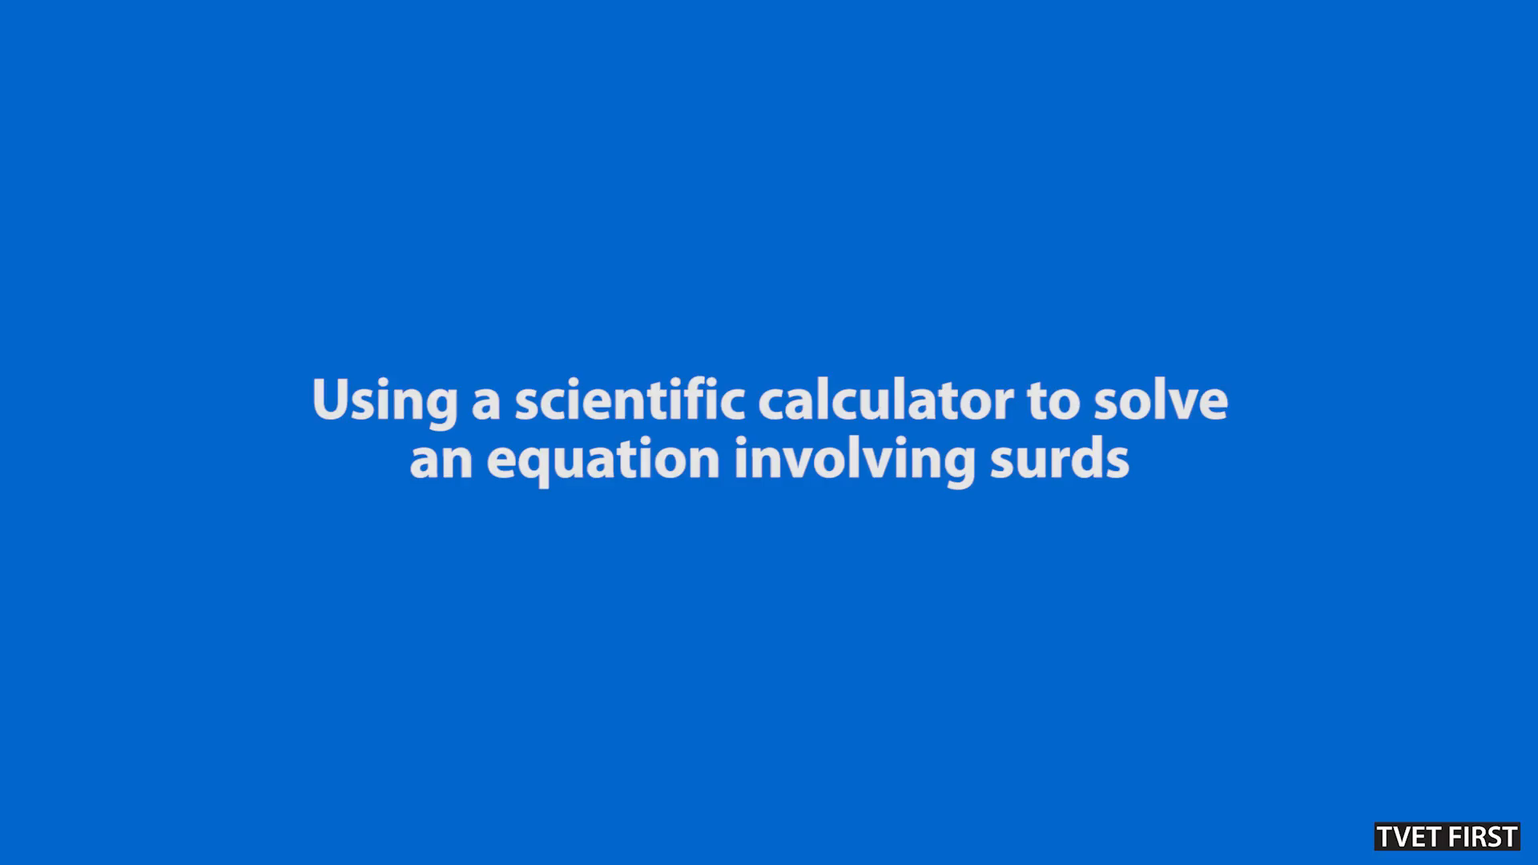

Slide 7
Assessment activity 1.3

Slide 8
8. Simplify:

Slide 9
8. (continued)

Slide 10
14. Simplify:

Slide 11
14. (continued)

Slide 12
15. Simplify:

