Slide 1
Mathematics
N2

Slide 2
Exponents and logarithms
Module 2

Slide 3
Module 2: Exponents and logarithms

Slide 4
1 . Simplify without using a calculator:

Slide 5
2. Simplify without using a calculator:

Slide 6
3. Simplify without using a calculator:

Slide 7
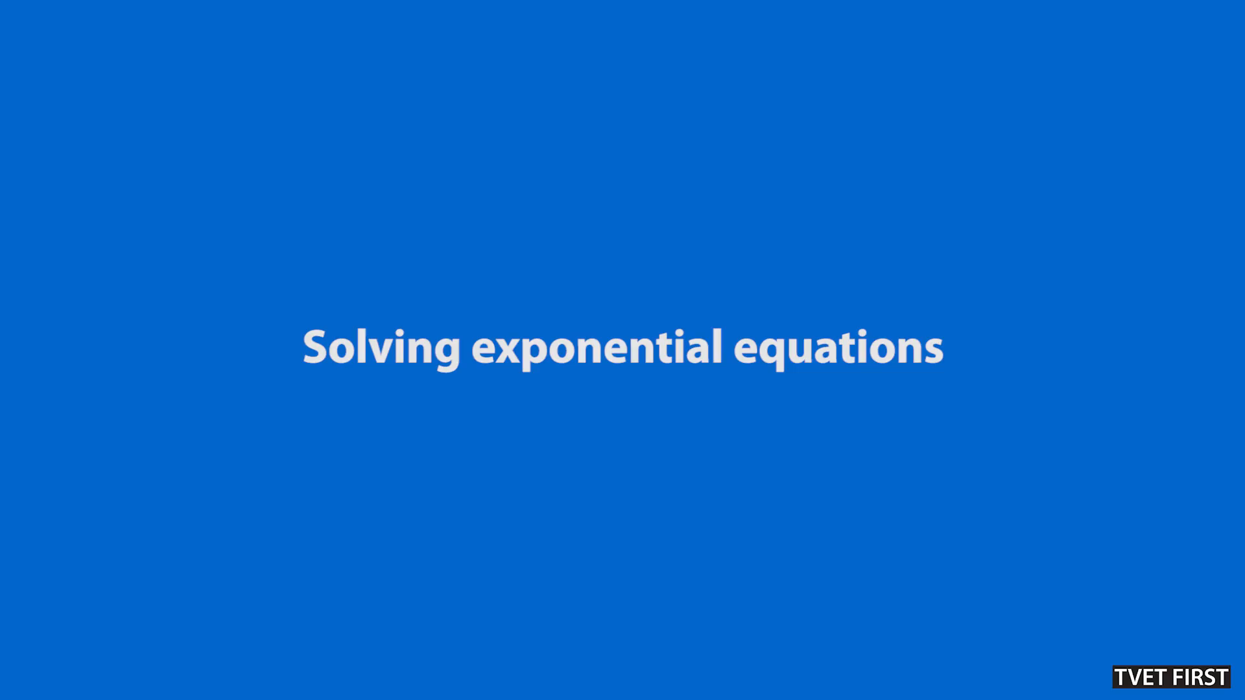
Video: exponential equations

Slide 8
4. Simplify without using a calculator:

Slide 9
5. Simplify without using a calculator:

Slide 10
5. (continued)

Slide 11
5. (continued)

Slide 12
6. Simplify without using a calculator:

Slide 13
6. (continued)

Slide 14
6. (continued)

Slide 15
7. Simplify without using a calculator:

Slide 16
8. Simplify without using a calculator:

Slide 17
9. Simplify without using a calculator:

Slide 18
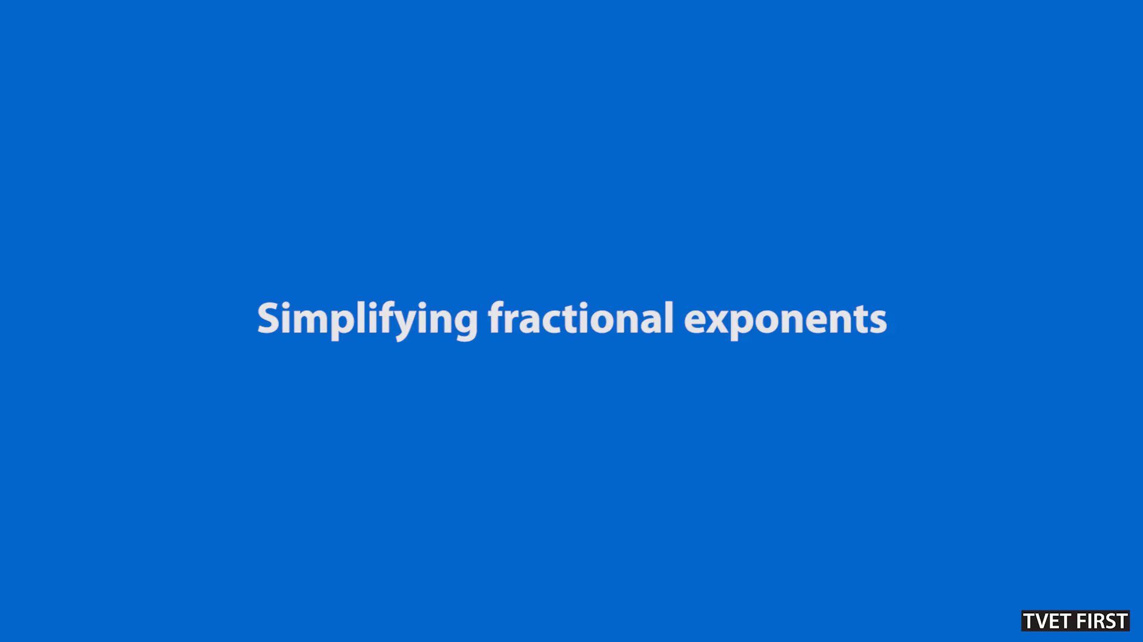
Video: fractional exponents

Slide 19
11. Solve for a:

Slide 20
12. Solve for a:

Slide 21
13. Solve for x:

Slide 22
13. (continued)

Slide 23
14. Solve for x:
[Divide both
sides by 4]

Slide 24
14 (continued)

Slide 25
15. Solve for x:

Slide 26
15. (continued)

Slide 27
15. (continued)

Slide 28
16. Write in exponential form:

Slide 29
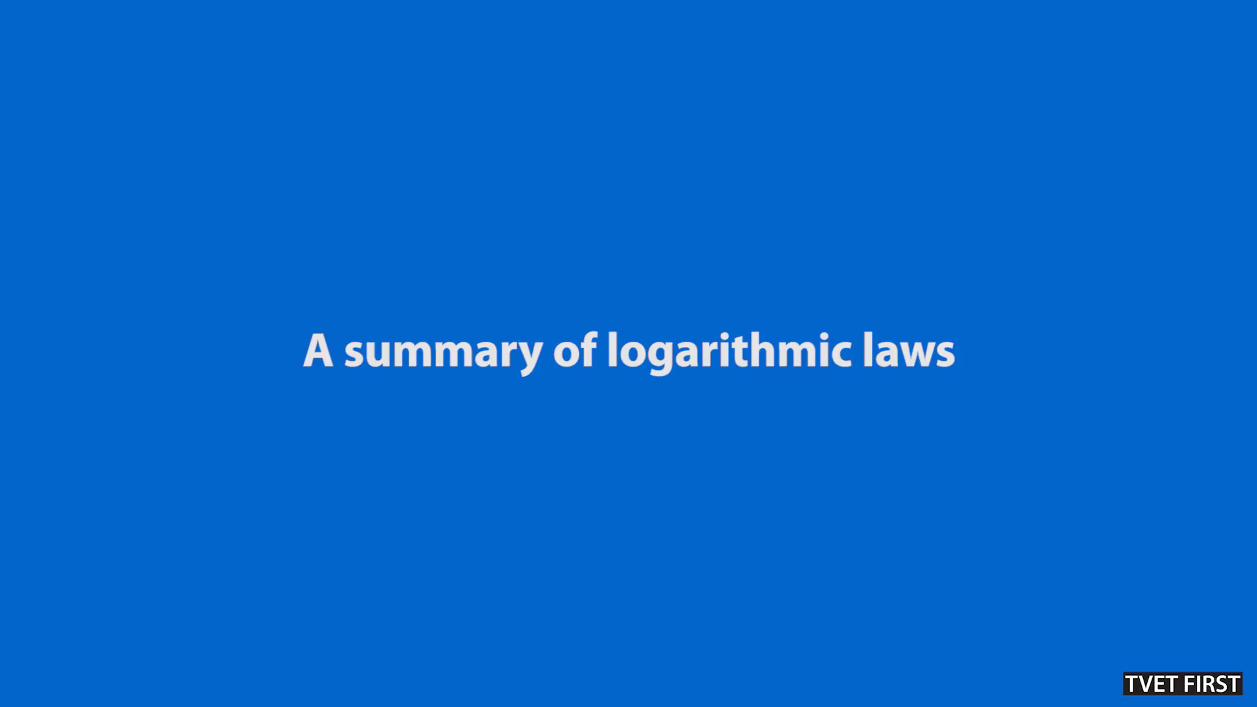
Video: logarithmic laws

Slide 30
17. Write in exponential form:

Slide 31
18. Write in logarithmic form:

Slide 32
19. Write in logarithmic form:

Slide 33
20. Solve for x:

Slide 34
21. Solve for x:

Slide 35
21. (continued)

Slide 36
22. Solve for x:

Slide 37
23. Solve for x:

Slide 38
23. (continued)

Slide 39
24. Solve for x:

Slide 40
24. (continued)

Slide 41
25. Simplify:

Slide 42
25. (continued)

Slide 43
26. Simplify:

Slide 44
27. Simplify:

Slide 45
27. (continued)

Slide 46
28. Change to .

Slide 47
28. (continued)

Slide 48
29. Change to .

Slide 49
30. Solve for x by using logarithms:
Note: Answers may vary slightly, depending on how many decimal places are used.

Slide 50
31. Solve for x by using logarithms:

Slide 51
32. Solve for x by using logarithms:

Slide 52
32. (continued)

Slide 53
33. Solve for x by using logarithms:

Slide 54
33. (continued)

Slide 55
34. Solve for x by using logarithms:

Slide 56
35. Solve for x by using logarithms:

Slide 57
35. (continued)

Slide 58
36. Simplify without the aid of a calculator:

Slide 59
37. Solve for x:

Slide 60
37. (continued)

Slide 61
38. Write x = 3 in exponential form.
Press [log][3] or [3][log] on your calculator.

Slide 62
39. Write x = 3 in logarithmic form.

Slide 63
40. Solve for x by using logarithms to the base e. Antilog given is also to base e.
Press [5] [e^{x}] to get antilog 5 to base e.

Slide 64
41. Solve for x by using logarithms to the base 10. Antilog given is also to base 10.
x = antilog 5 – antilog 4

Slide 65
42. Simplify without the aid of a calculator:

Slide 66
43. If , calculate x if all logarithms and antilogarithms are to the base 10.

Slide 67
43. Alternative solution

