Slide 1

TERMS AND CONDITIONS
These PowerPoint slides are a tool for lecturers, and as such:
YOU MAY add content to the slides, delete content from the slides, print out the slides, and save the slides onto your computer or server.
YOU MAY NOT resell, reproduce or redistribute the content in any form whatsoever, without prior written permission from the copyright holder.
© Troupant Publishers (Pty) Ltd, 2016
Selected images used under licence from Shutterstock.com

Slide 2
Mathematics
N1

Slide 3
Trigonometry
Module 8

Slide 4
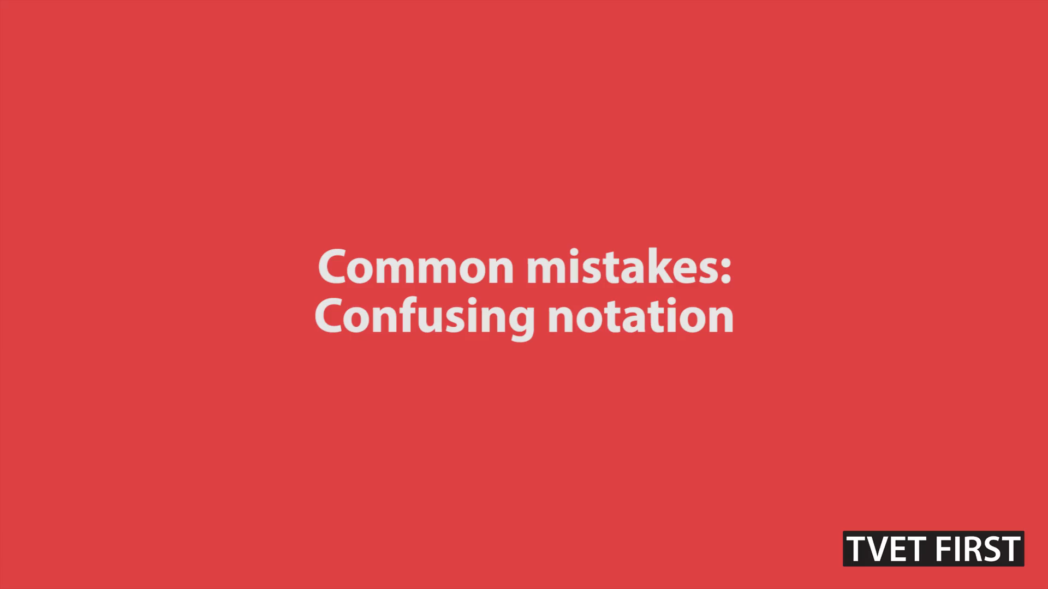
VIDEO: Common mistakes: Confusing notation

Slide 5
The three functions: sine, cosine and tangent
Unit 8.1

Slide 6
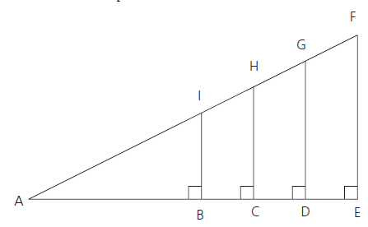
A right-angled triangle
Figure 8.2: Right-angled triangles

Slide 7
Trigonometric ratios

Slide 8
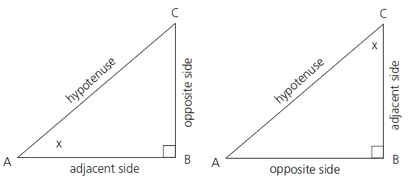
Trigonometric ratios
Figure 8.5: Two triangles ABC with different reference angles

Slide 9
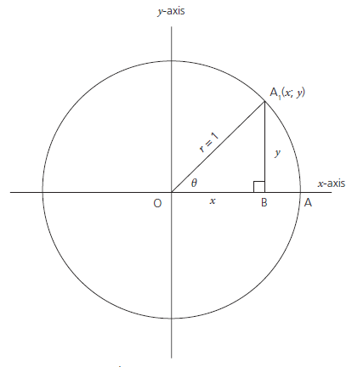
The unit circle
Figure 8.6: A unit circle

Slide 10
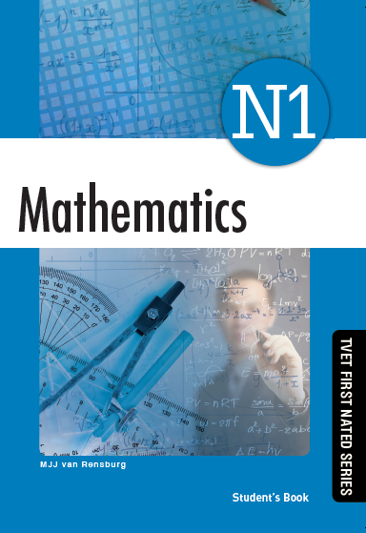
Complete
Assessment activity 8.1 on
page 139
of your
Student’s Book

Slide 11
Inverse trigonometric functions

Slide 12
Inverse trigonometric functions

Slide 13
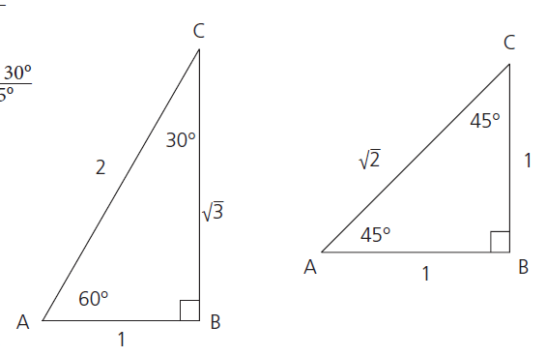
Special angles
Figure 8.11: 30°, 60° and 45° are special angles

Slide 14
Complete
Assessment activity 8.2 on
page 142
of your
Student’s Book

Slide 15
Solution of right-angled triangles
Unit 8.2

Slide 16
Complete
Assessment activity 8.3 on
page 143
of your
Student’s Book

Slide 17
Trigonometric graphs
Unit 8.3

Slide 18
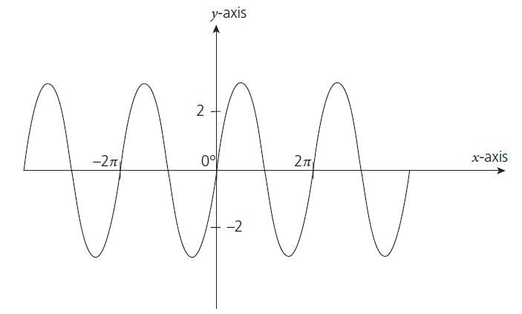
The sine graph
Figure 8.13: Sine graph

Slide 19
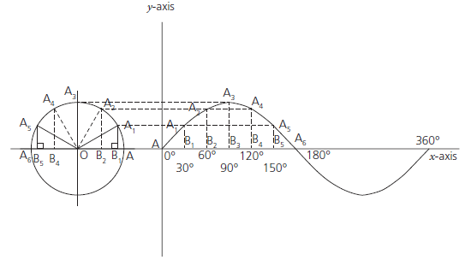
The sine graph
Figure 8.14: Plotting a sine graph

Slide 20
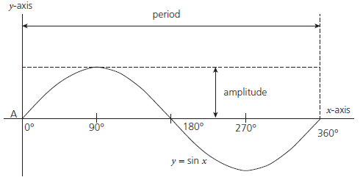
Period and amplitude
Figure 8.15: Amplitude and period of a sine graph

Slide 21
Complete
Assessment activity 8.4 on
page 146
of your
Student’s Book

Slide 22

VIDEO: Tips and tricks: Draw diagrams to help you visualise the problem

Slide 23
Summative activity
Module 8

Slide 25
Calculate:

Slide 26
Calculate:

Slide 27
Calculate:

Slide 28
Calculate:

Slide 29
Calculate:

Slide 30
Calculate:

Slide 31
2. Solve for x:

Slide 32
2. Solve for x:

Slide 33
2. Solve for x:

Slide 34
2. Solve for x:

Slide 35
2. Solve for x:

Slide 36
2. Solve for x:

Slide 37
3. Solve the following right-angled triangles by using trigonometry:

Slide 38
3a) (continued)

Slide 39
3a) (continued)

Slide 40
3. Solve the following right-angled triangles by using trigonometry:

Slide 41
3b) (continued)

Slide 42
3b) (continued)

Slide 43
4. If cos A = 0,7, calculate sin A + 2 tan A.

Slide 44
4. (continued)

Slide 45
4. (continued)

Slide 46
5. A right cone has a perpendicular height of
80 mm and a base diameter of 40 mm. Calculate
the magnitude of the vertex.

Slide 47
5. (continued)

