Slide 1
TERMS AND CONDITIONS
These PowerPoint slides are a tool for lecturers, and as such:
YOU MAY add content to the slides, delete content from the slides, print out the slides, and save the slides onto your computer or server.
YOU MAY NOT resell, reproduce or redistribute the content in any form whatsoever, without prior written permission from the copyright holder.
© Troupant Publishers (Pty) Ltd, 2016
Selected images used under licence from Shutterstock.com

Slide 2
Mathematics
N1

Slide 3
Triangles
Module 7

Slide 4
VIDEO: Tips and tricks: Use common sense as a check

Slide 5
Properties of triangles
Unit 7.1

Slide 6
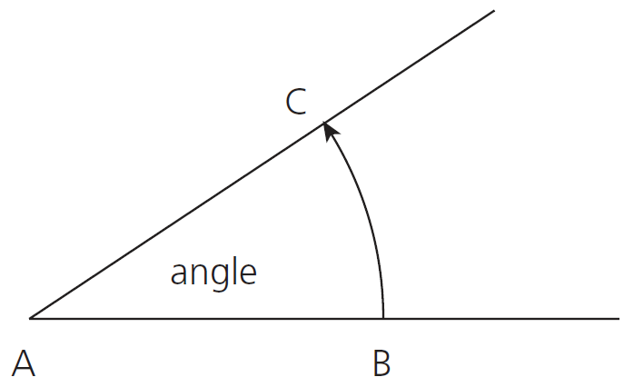
An angle
Figure 7.1: An angle

Slide 7
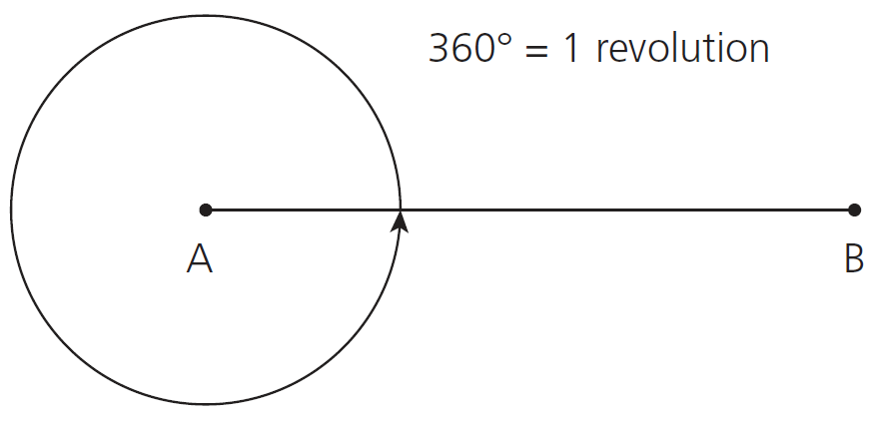
Revolution
Figure 7.2: One revolution

Slide 8
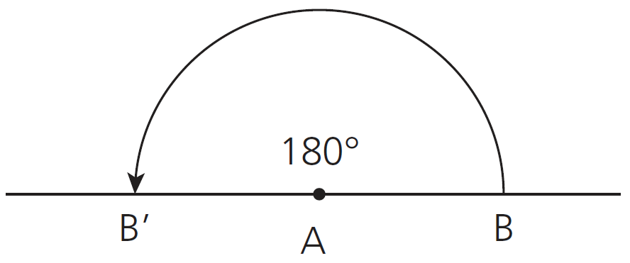
Straight angle
Figure 7.3: A straight angle

Slide 9
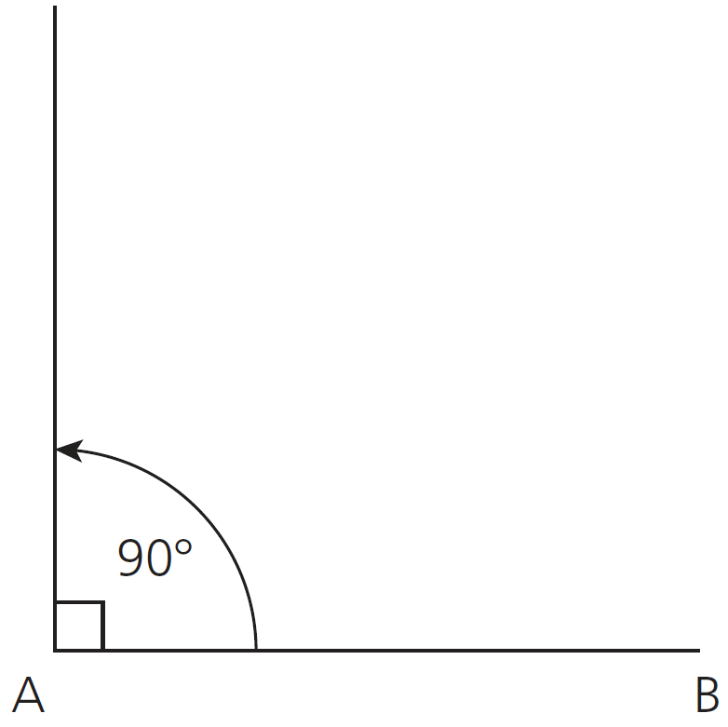
Right angle
Figure 7.4: A right angle

Slide 10
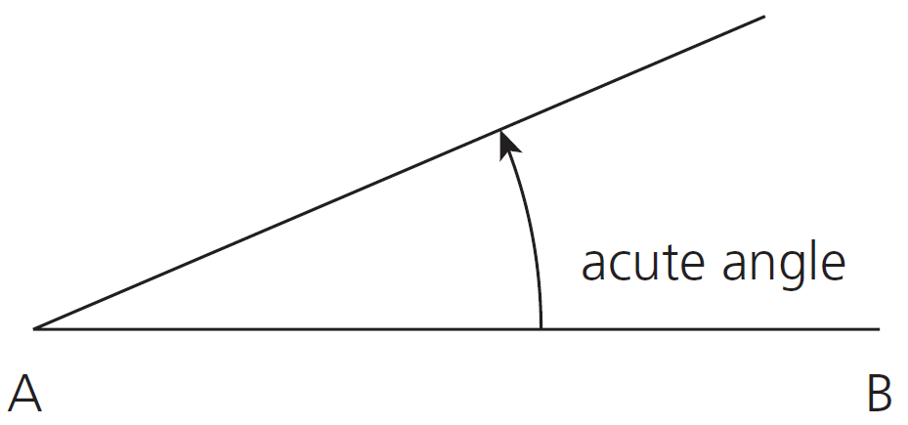
Acute angle
Figure 7.5: An acute angle

Slide 11
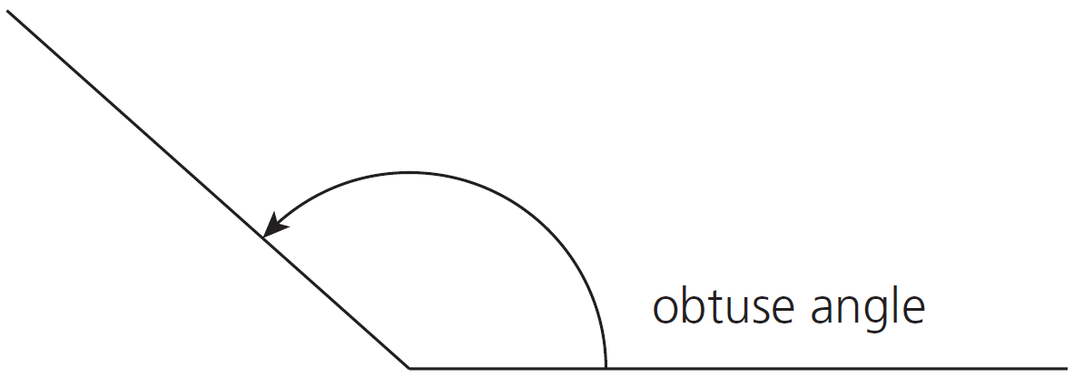
Obtuse angle
Figure 7.6: An obtuse angle

Slide 12
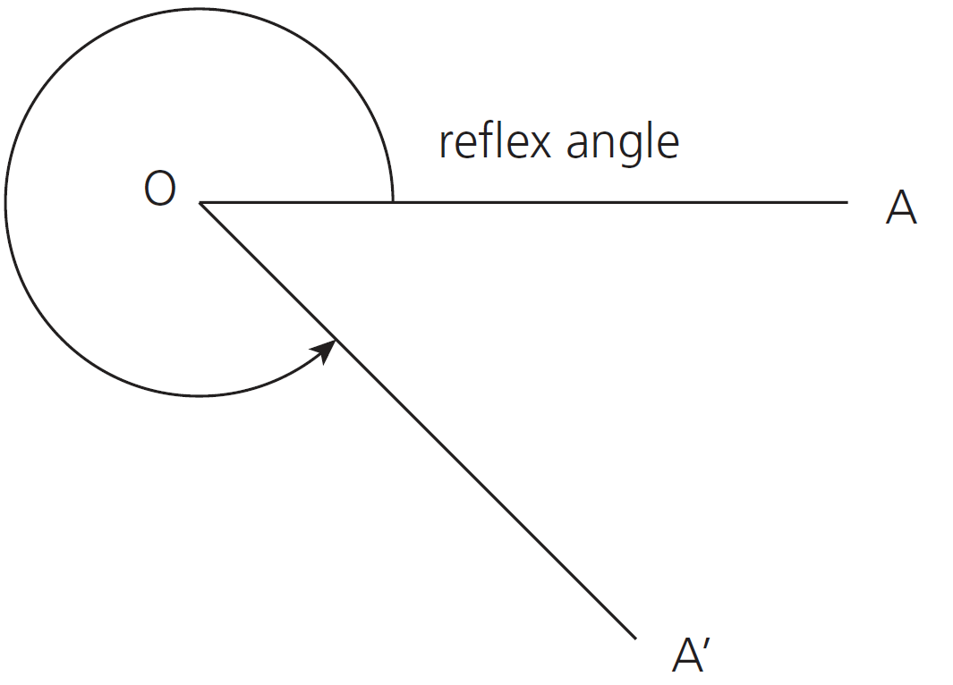
Reflex angle
Figure 7.7: A reflex angle

Slide 13
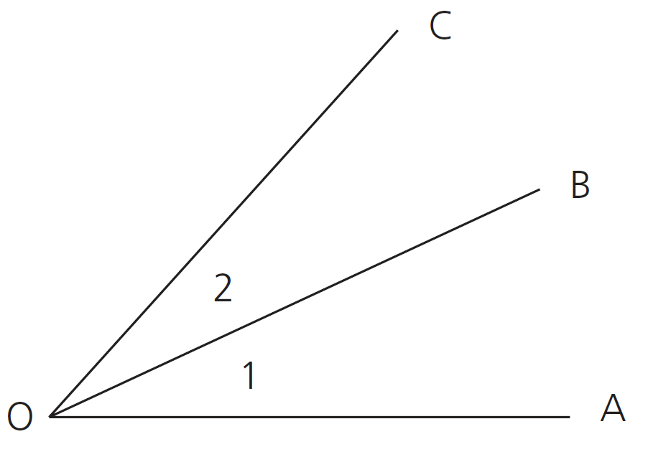
Adjacent angles
Figure 7.8: Adjacent angles

Slide 14
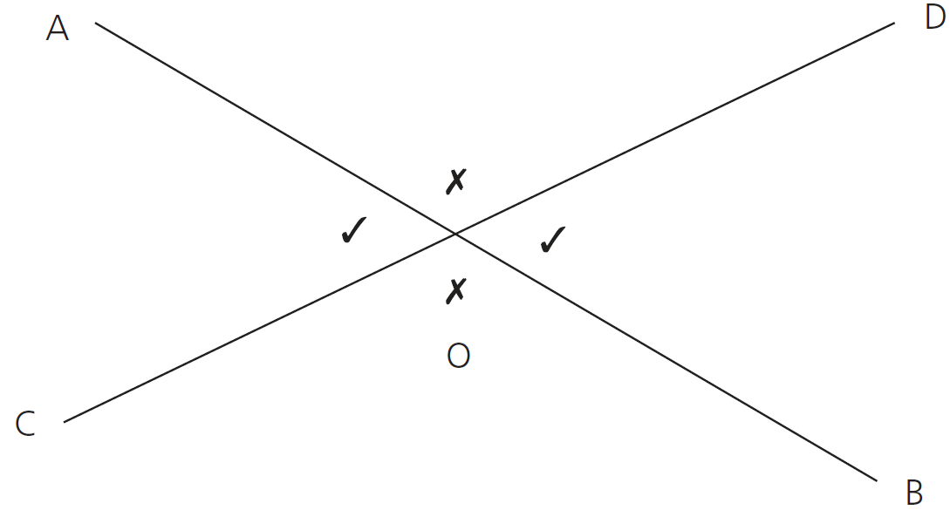
Opposite angles
Figure 7.9: Opposite angles

Slide 15
Complementary angles and supplementary angles
Complementary angles
Supplementary angles
1
3
4
2

Slide 16
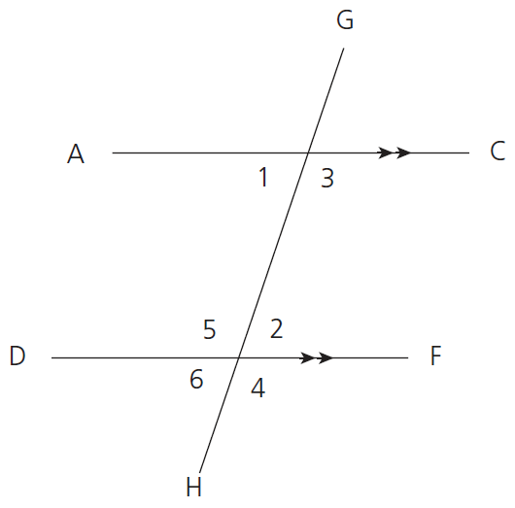
Alternate interior angles:
Corresponding angles:
Figure 7.10: Corresponding and alternate angles

Slide 17
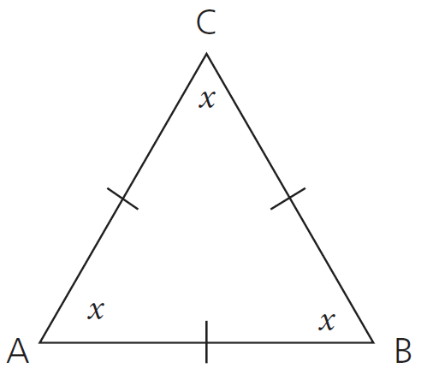
Types of triangles
Equilateral triangle
Figure 7.11: An equilateral triangle

Slide 18
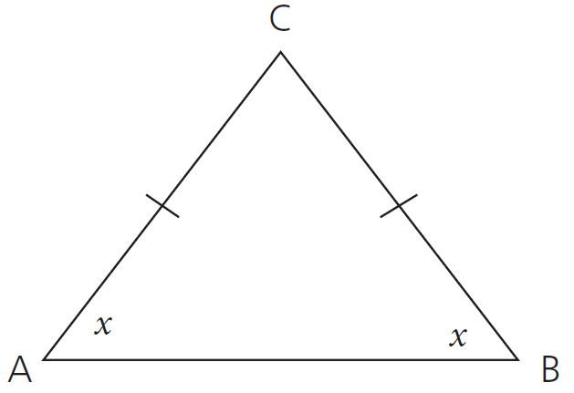
Isosceles triangle
Figure 7.12: An isosceles triangle

Slide 19
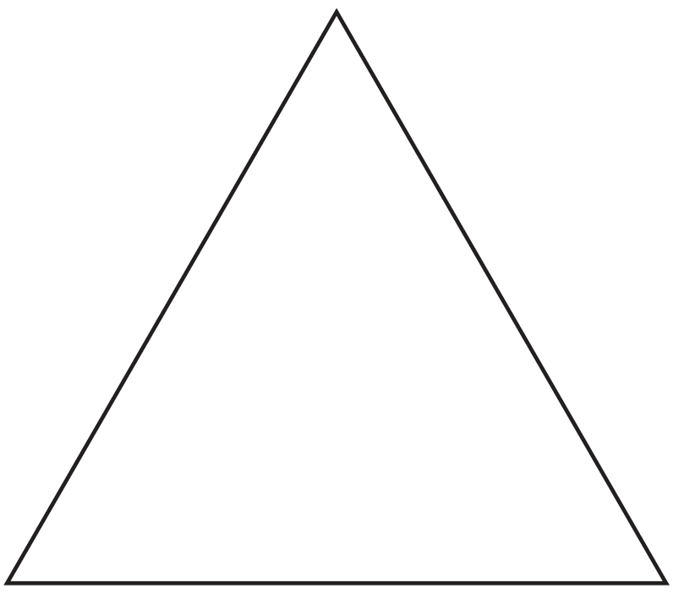
Acute-angled triangle
Figure 7.13: An acute-angled triangle

Slide 20
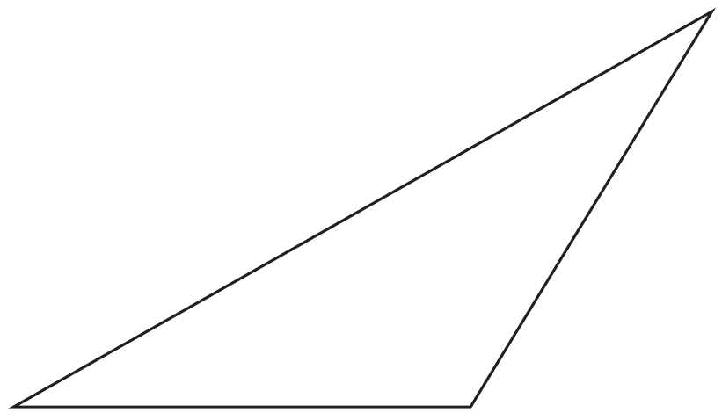
Obtuse-angled triangle
Figure 7.14: An obtuse-angled triangle

Slide 21
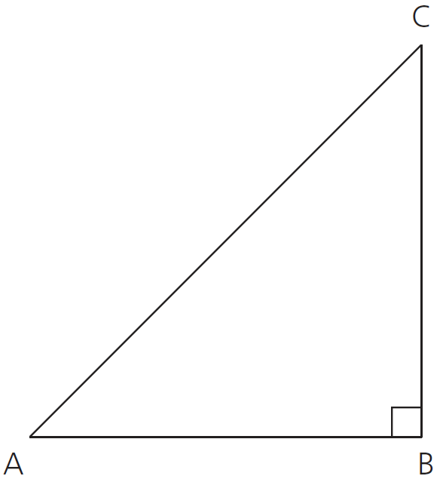
Right-angled triangle
Figure 7.15: A right-angled triangle

Slide 22
Scalene triangle
All the sides are different.

Slide 23
Complete Assessment activity 7.1 on page 104 of your Student’s Book

Slide 24
The sum of the interior angles of a triangle
Sum of interior angles of a triangle = 180°
Use this to find the value of a missing angle

Slide 25
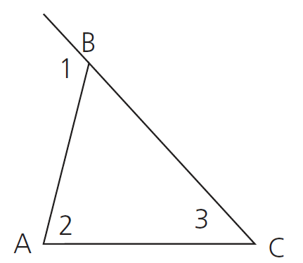
The exterior angle of a triangle
The exterior angle of a triangle is equal to the sum of the interior opposite angles

Slide 26
Complete Assessment activity 7.2 on page 108 of your Student’s Book

Slide 27
Congruency and similarity
Unit 7.2

Slide 28
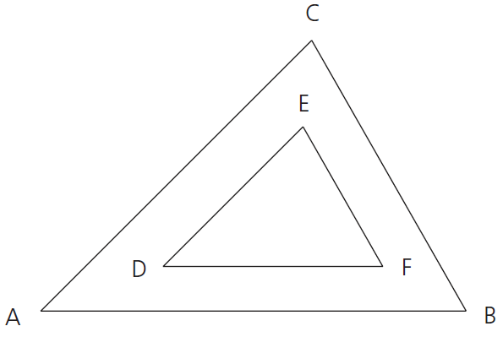
Similar triangles |||
Angles are the same
Sides are different
Figure 7.51: Similar triangles

Slide 29
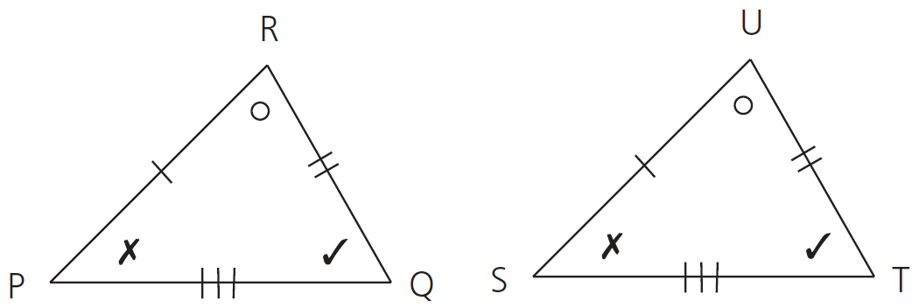
Congruent triangles
All angles and sides are the same
Figure 7.52: Congruent triangles

Slide 30
Conditions for congruency of triangles

Slide 31
1. Two sides and the included angle equal
Figure 7.53: Two triangles having two sides and the included angle equal

Slide 32
2. Three equal sides
Figure 7.54: Two triangles having three sides equal

Slide 33
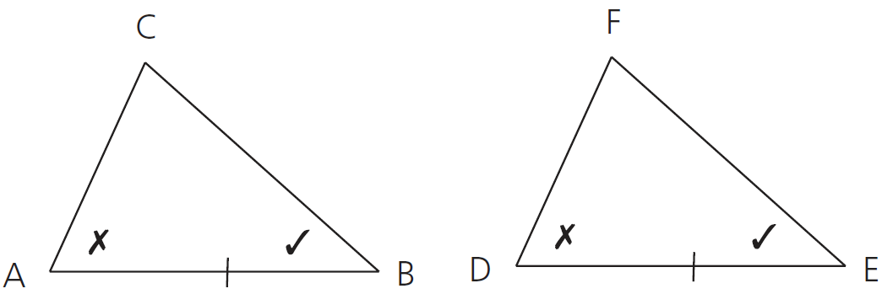
3. Two sides and the included angle equal
Figure 7.55: Two triangles having one side and one corresponding angle equal

Slide 34
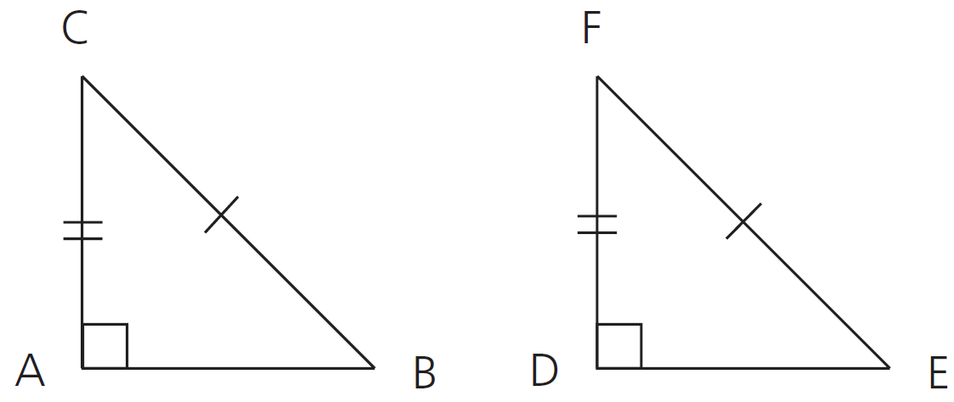
4. Right-angled triangles with the hypotenuse and one side equal
Figure 7.57: Two right-angled triangles having the hypotenuse and one side equal

Slide 35
Conditions for similarity of triangles
Corresponding angles are equal
Corresponding sides are in the same ratio

Slide 36
Complete Assessment activity 7.3 on page 118 of your Student’s Book

Slide 37
Pythagoras’ theorem
Unit 7.3

Slide 38
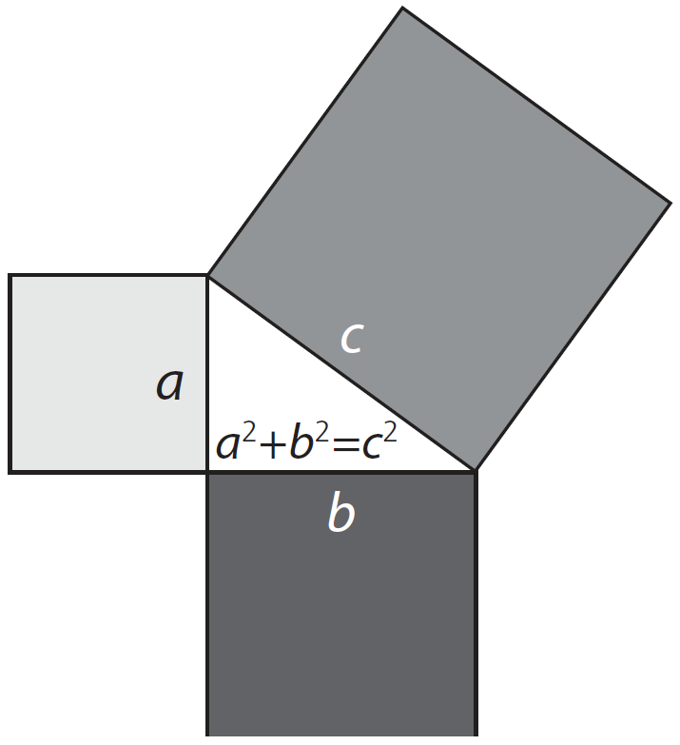
Pythagoras’ theorem
Figure 7.74: Pythagoras’ theorem

Slide 39
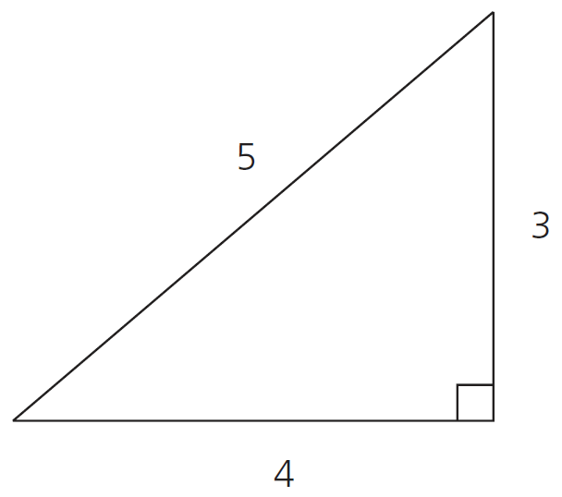
Right-angled triangles with the ratio 5:4:3
Figure 7.81: A right-angled triangle

Slide 40
Complete Assessment activity 7.4 on page 126 of your Student’s Book

Slide 41
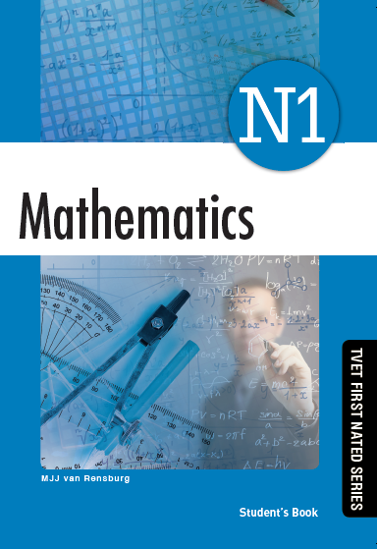
Summative activity
Module 7

Slide 42
Name the following angles:
1. 45°
2. 90°
Acute angle
Right angle
3. 135°
4. 30° and 60°
Obtuse angle
Complementary angles
5. 120° and 60°
Supplementary angles

Slide 43
6.

Slide 44
7.

Slide 45
8.
C
30°
A
B

Slide 46
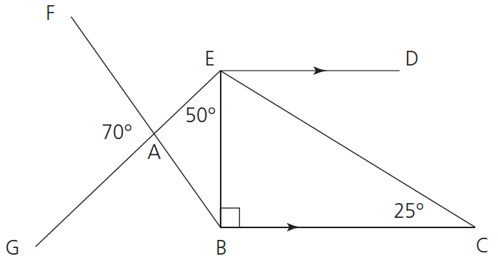
9. Refer to Figure 7.106 and calculate:
Figure 7.106

Slide 47
9. Refer to Figure 7.106 and calculate:
Figure 7.106

Slide 48
9. Refer to Figure 7.106 and calculate:
Figure 7.106

Slide 49
10.
C
The hypotenuse and one side (AC and DC) are equal to the hypotenuse and one side of another [BC and DC]
AC = BC
DC is common
A
B
D

Slide 50
11. When are two triangles congruent? Give three other possibilities, not mentioned in Question 10.
Two triangles are congruent when:
Three sides of one triangle equal three sides of the other triangle
Two angles and one corresponding side are equal
Two sides and the included angles are equal.

Slide 51
12.
a) The length of side AB
C
○
F
8
○
6
A
X
B
D
X
E

Slide 52
12. a) The length of side AB (continued)

Slide 53
12. a) The length of side AB (continued)

Slide 54
12. b) The ratio BC:EF

Slide 55
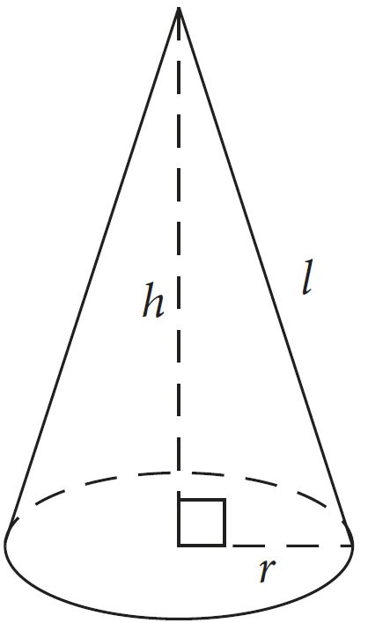
13. Calculate the perpendicular height of a cone if its base diameter is 3 m and the slant height is 7 m.
h
7 m
D = 3 m

Slide 56
14. How long must a ladder be to reach the top of a 3,8 m wall if its bottom end is 1,4 m from the wall?
l
3,8 m
1,4 m

