Slide 1

TERMS AND CONDITIONS
These PowerPoint slides are a tool for lecturers, and as such:
YOU MAY add content to the slides, delete content from the slides, print out the slides, and save the slides onto your computer or server.
YOU MAY NOT resell, reproduce or redistribute the content in any form whatsoever, without prior written permission from the copyright holder.
© Troupant Publishers (Pty) Ltd, 2016
Selected images used under licence from Shutterstock.com

Slide 2
Mathematics
N1

Slide 3
Algebraic graphs
Module 6

Slide 4
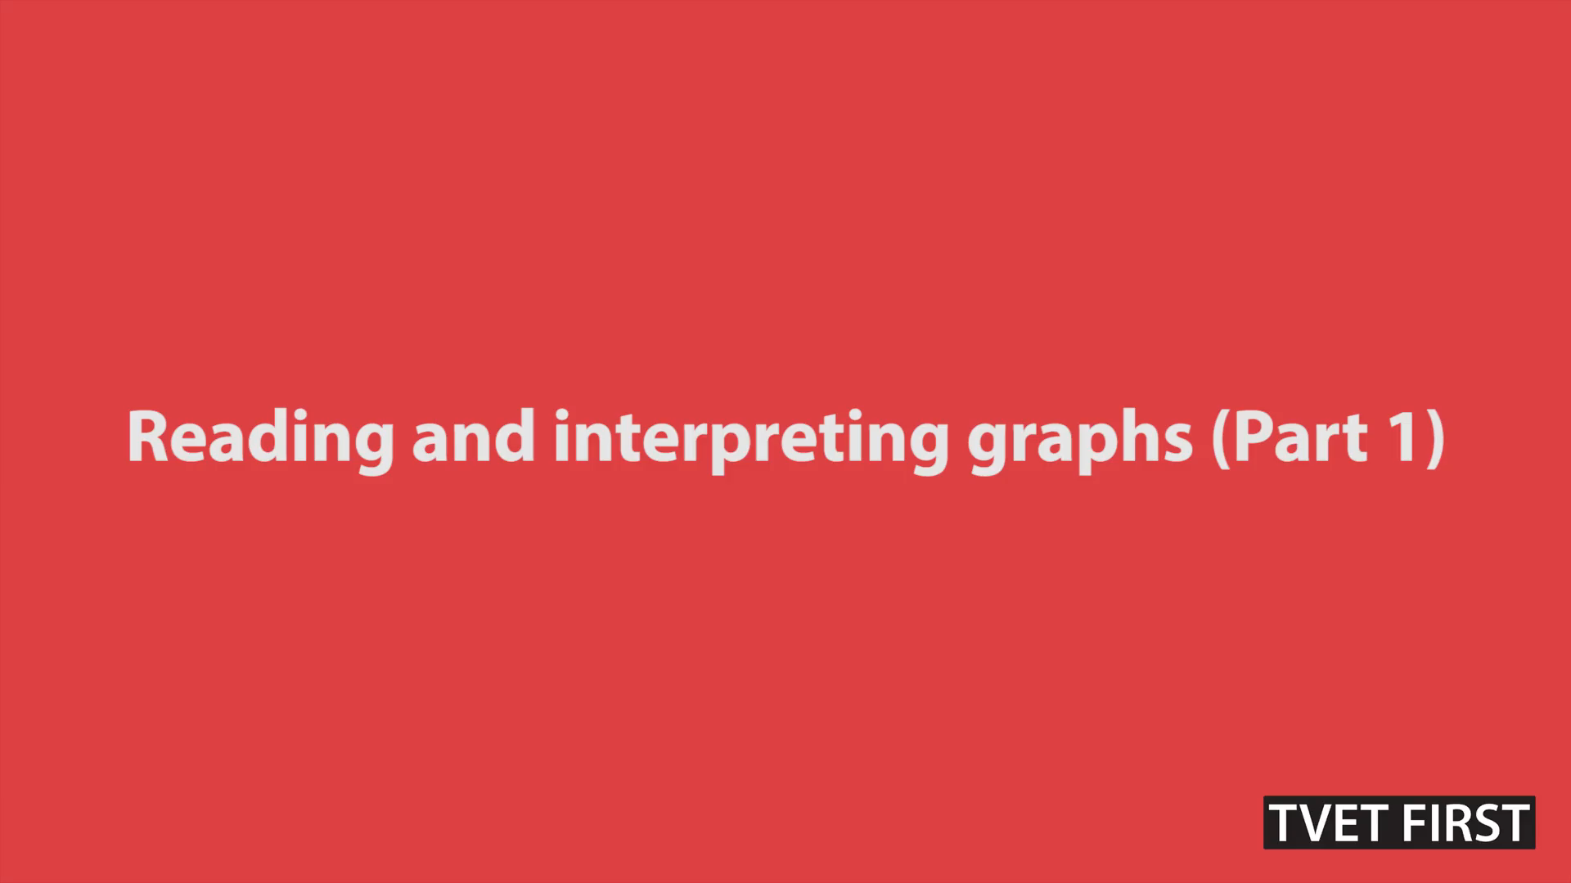
VIDEO: Reading and interpreting graphs (Part 1)

Slide 5

VIDEO: Reading and interpreting graphs (Part 2)

Slide 6

VIDEO: Reading and interpreting graphs (Part 3)

Slide 7
Direct and indirect proportionality
Unit 6.1

Slide 8
Direct proportionality
As one amount increases, the other amount increases at the same rate
The symbol for proportional is

Slide 9
Indirect/inverse proportionality
As one amount increases, the other amount decreases at the same rate

Slide 10
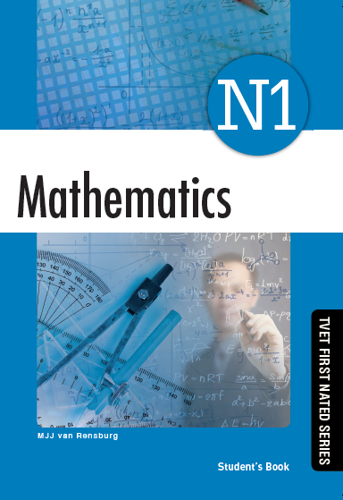
Complete
Assessment Activity 6.1 on
page 85
of your
Student’s Book

Slide 11
Linear graphs
Unit 6.2

Slide 12
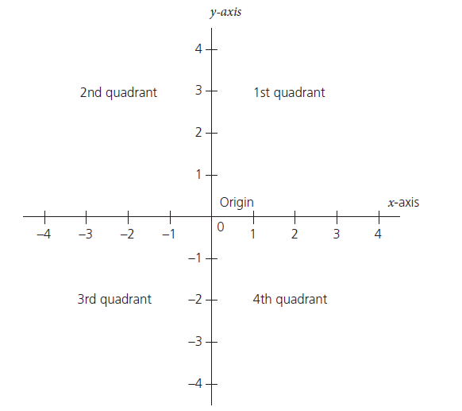
Cartesian system of coordinates
Figure 6.1: A Cartesian plane

Slide 13
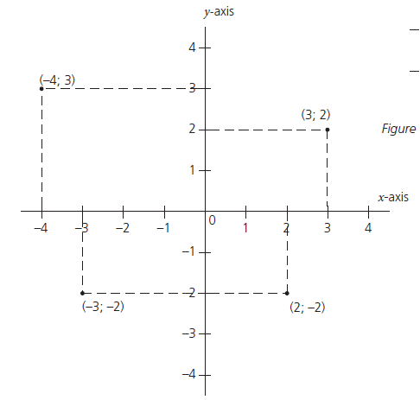
Ordered number pairs
Ordered number pair
(x; y)
Figure 6.5: Number pairs on a Cartesian
plane of coordinates

Slide 14
Linear equations
Where:
m = gradient
c = y-intercept
All equations in this format represent a straight- line graph

Slide 15
Complete
Assessment Activity 6.2 on
page 95
of your
Student’s Book

Slide 16
The rectangular hyperbola
Unit 6.3

Slide 17
Rectangular hyperbolas
The sign of the constant c determines the position of the graph

Slide 18
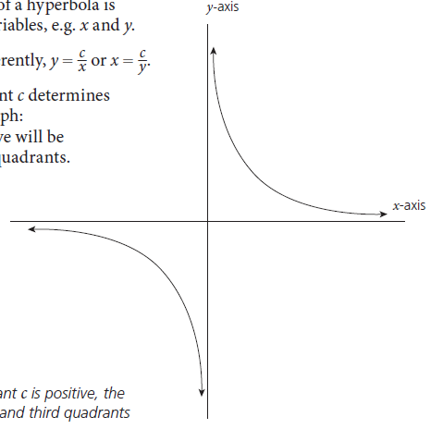
Rectangular hyperbolas
Figure 6.14: If the constant c is positive, the
curve will be in the first and third quadrants

Slide 19
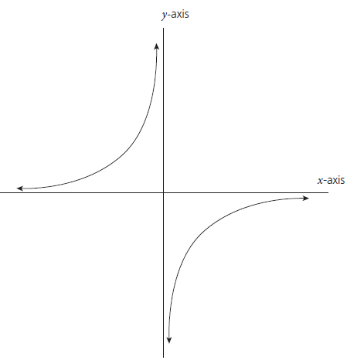
Rectangular hyperbolas
Figure 6.15: If c is negative, the curve will be in
the second and fourth quadrants

Slide 20
Complete
Assessment Activity 6.3 on
page 99
of your
Student’s Book

Slide 21
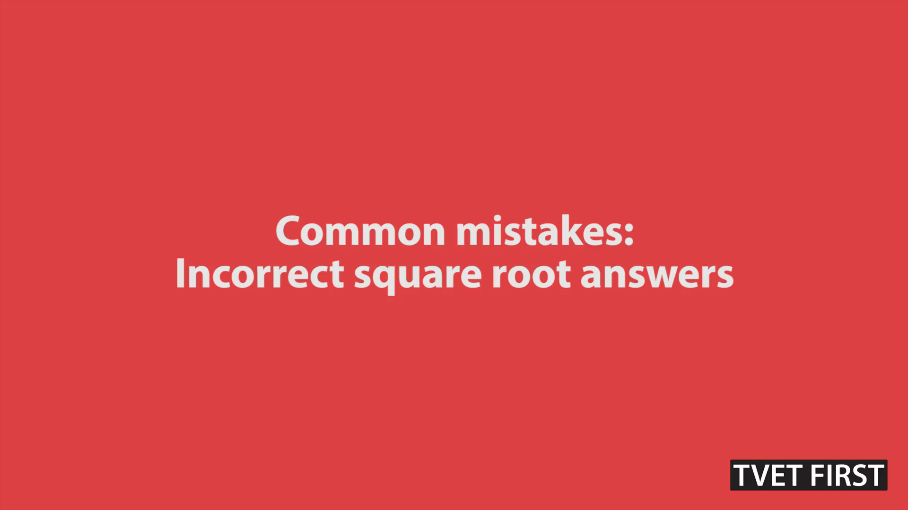
VIDEO: Common mistakes: Incorrect square root answers

Slide 22
Summative activity
Module 6

Slide 23
1. a is directly proportional to b. Calculate the
proportionality constant if a = 6 when b = 12.

Slide 24
2. b is indirectly proportional to c. Write down the
formula for b and c if it is known that b = 9
when c = 3.

Slide 25
2. (continued)

Slide 26
Calculate the gradient and y-intercept of:

Slide 27
Calculate the gradient and y-intercept of:

Slide 28
Calculate the gradient and y-intercept of:

Slide 29
5. (continued)

Slide 30
Calculate the gradient and y-intercept of:

Slide 31
6. (continued)

Slide 32
7. Draw the graphs of the following functions on the same axes and read from your graph the point of intersection:

Slide 33
7. (continued)
Points of intersection:
From A: (1,3; 1,7)

Slide 34
8. Draw the graphs of the following functions on the same axes and read from your graph the point of intersection:

Slide 35
8. (continued)

Slide 36
8. (continued)

Slide 37
8. (continued)
Points of intersection:
From A: (2,3; -2,9)

Slide 38
9. Draw the graphs of the following functions on the same axes and read from your graph the point of intersection:

Slide 39
9. (continued)

Slide 40

9. (continued)

Slide 41
9. (continued)
Points of intersection:
From A: (0,7; 6)
From B: (-2; -2)

Slide 42
10. Draw the graphs of the following functions on the same axes and read from your graph the point of intersection:

Slide 43

10. (continued)

Slide 44
10. (continued)
Points of intersection:
From A: (2,7; -0,7)
From B: (-0,7; 2,7)

Slide 45
11. Draw the graphs of the following functions on the same axes and read from your graph the point of intersection:

Slide 46
11. (continued)

Slide 47

11. (continued)

Slide 48
11. (continued)
Points of intersection:
From A: (4,5; 0,7)
From B: (-1; -3)

Slide 49
12. Draw the graphs of the following functions on the same axes and read from your graph the point of intersection:

Slide 50
12. (continued)

Slide 51

12. (continued)

Slide 52
12. (continued)
Points of intersection:
From A: (2; 6)
From B: (-6; -1)

