Slide 1
TERMS AND CONDITIONS
These PowerPoint slides are a tool for lecturers, and as such:
YOU MAY add content to the slides, delete content from the slides, print out the slides, and save the slides onto your computer or server.
YOU MAY NOT resell, reproduce or redistribute the content in any form whatsoever, without prior written permission from the copyright holder.
© Troupant Publishers (Pty) Ltd, 2016
Selected images used under licence from Shutterstock.com

Slide 2
Mathematics
N1

Slide 3
Exponents (indices) and logarithms
Module 2

Slide 4
VIDEO: Working with big numbers (Part 1)

Slide 5
VIDEO: Working with big numbers (Part 2)

Slide 6
Exponents
Unit 2.1

Slide 7
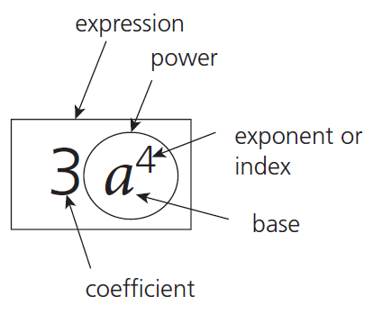
Exponential notation
Figure 2.1: Notation for the term 3a⁴

Slide 8
Exponent laws (laws of indices)

Slide 9
Exponent laws (laws of indices)

Slide 10
Exponent laws (laws of indices)

Slide 11
Exponent laws (laws of indices)

Slide 12
Complete Assessment Activity 2.1 on page 13 of your Student’s Book

Slide 13
Logarithms
Unit 2.2

Slide 14
Logarithms
Logarithms provide another way of writing exponents
Exponential form of 100: 100 = 10²
Logarithmic form of 100: Log₁₀100 = 2

Slide 15
Converting between logarithmic and exponential forms
Definition of a logarithm
If N = b ^{l} then log _{b} N = l
Where:
N = number
b = base
l = logarithm

Slide 16
Complete Assessment Activity 2.2 on page 16 of your Student’s Book

Slide 17
Logarithmic laws
If numbers are multiplied, the logarithms are added.
∴ log_{a}(x × y) = log_{a}x + log_{a}y

Slide 18
Logarithmic laws
If numbers are divided, their logarithms must be subtracted.

Slide 19
Logarithmic laws
If a number is raised to a power, the logarithm of the number is multiplied by the exponent.
∴ log_{a} x^{m} = mlog_{a}x

Slide 20
Complete Assessment Activity 2.3 on page 18 of your Student’s Book

Slide 21
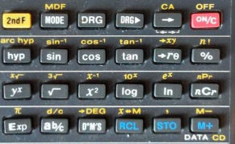
Using the calculator to find logarithms
This is the key for log ₁₀

Slide 22
Complete Assessment Activity 2.4 on page 21 of your Student’s Book

Slide 23
Complete Assessment Activity 2.5 on page 25 of your Student’s Book

Slide 24
VIDEO: Tips and tricks: Show all your workings

Slide 25
Summative activity
Module 2

Slide 26
Simplify without a calculator:
3² × 3³

Slide 27
Simplify without a calculator:

Slide 28
Simplify:

Slide 29
Simplify:

Slide 30
Simplify:

Slide 31
Simplify:

Slide 32
Simplify:

Slide 33
Simplify:

Slide 34
Simplify:

Slide 35
Simplify:

Slide 36
Simplify:

Slide 37
11. (continued)

Slide 38
Write in the logarithmic form:

Slide 39
Write in the logarithmic form:

Slide 40
Write in the logarithmic form:

Slide 41
Write in the exponential form:

Slide 42
Write in the exponential form:

Slide 43
Write in the exponential form:

Slide 44
Solve for x:

Slide 45
Solve for x:

Slide 46
Solve for x:

Slide 47
Solve for x:

Slide 48
Solve for x:

Slide 49
Simplify with the aid of logarithms:

Slide 50
Simplify with the aid of logarithms:

Slide 51
Simplify with the aid of logarithms:

Slide 52
25. (continued)

Slide 53
Simplify with the aid of logarithms:

Slide 54
26. (continued)

Slide 55
Simplify with the aid of logarithms:

Slide 56
27. (continued)

Slide 57
Simplify with the aid of logarithms:

Slide 58
28. (continued)

Slide 59
Simplify with the aid of logarithms:

Slide 60
29. (continued)

