Slide 1
Engineering Science
N2

Slide 2
Electricity
Module 9

Slide 3
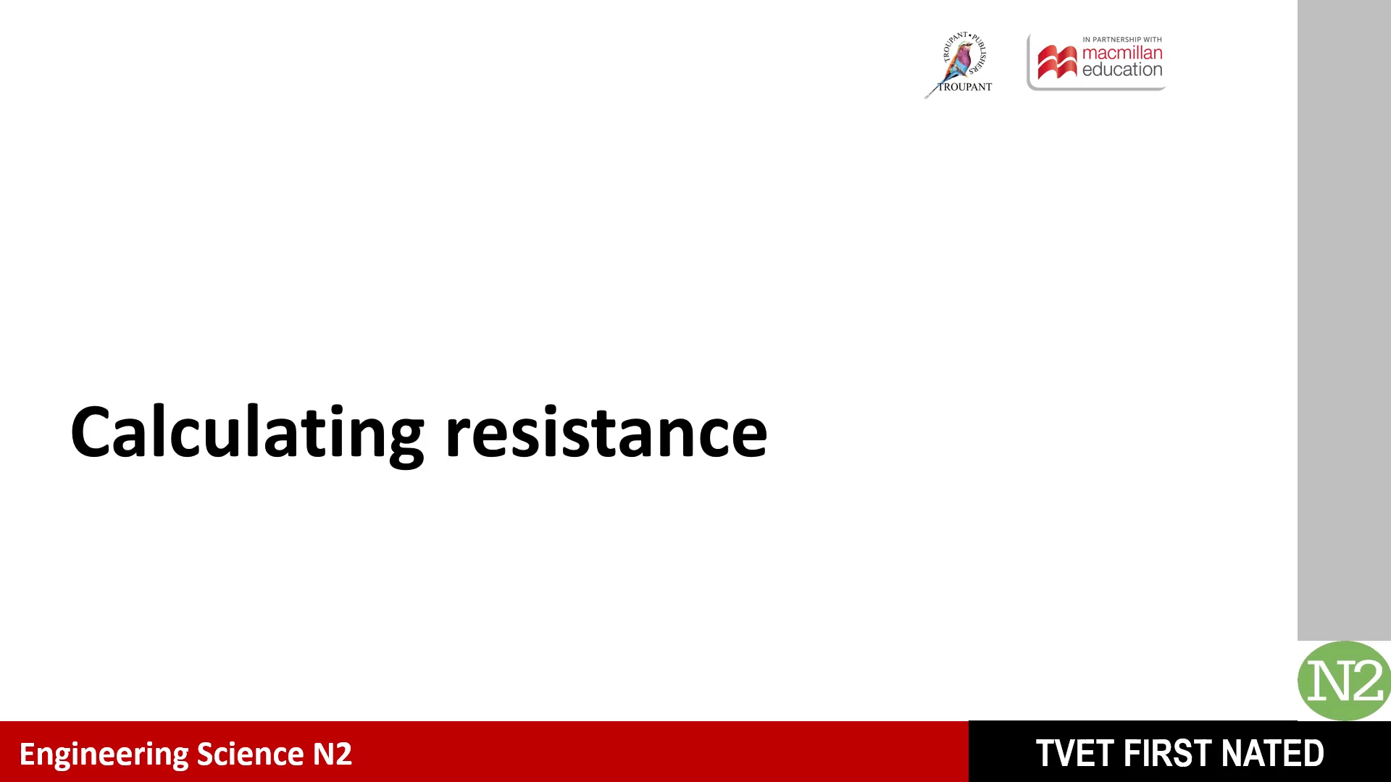


Slide 4
3. Calculate the total resistance of resistors shown in the following circuits:
a)
R₁ = 3 Ω
R₂ = 4 Ω
R₃ = 8 Ω
Figure: Three resistors in parallel

Slide 5
3a) (Continued)

Slide 6
3b)
R₂ = 10 Ω
R₁ = 0.5 Ω
R₄ = 7 Ω
R₃ = 6 Ω
Figure: Resistors in series and in parallel

Slide 7
3b) (Continued)

Slide 8
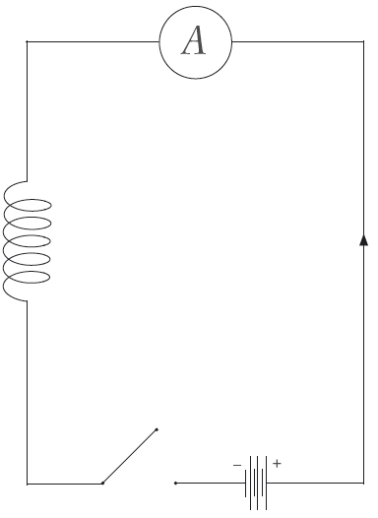
5. Make a neat labelled sketch of the apparatus used to demonstrate self-induction.
Figure: Apparatus to induce self-induction

Slide 9
7. The figure below shows a circuit with three resistors connected in parallel.
R₁ = 12 Ω
R₂ = 6 Ω
R₃ = 9 Ω
Figure: Circuit with three resistors connected in parallel

Slide 10
7. (Continued) Calculate the:
a) Total resistance

Slide 11
7. (Continued) Calculate the:
b) Current through the resistors

Slide 12
7b) (Continued)

Slide 13
7b) (Continued)

Slide 14
8. A circuit consists of two parallel resistors of 4 ohms each, which in turn are connected in series with a resistor of 6 ohms. Calculate the total resistance of the circuit.

Slide 15
8. (Continued)

Slide 16


Slide 17
9. Calculate the resistance of a copper conductor with a cross-sectional area of 2 × 10^{–6} m². The length of the conductor is 105 m. The resistivity of the conductor is 0,02 μΩ.m

Slide 18
10. Calculate the diameter of a 5 km conductor with a resistance of 45 Ω if its resistivity is 0,018 × 10^{–6} Ω.m

Slide 19
10. (Continued)

Slide 20
11. Calculate the resistivity of a conductor with a length of 4 km, resistance of 4 Ω and diameter of 3 mm.

Slide 21
11. (Continued)

Slide 22
Test your knowledge of this module by completing the summative activity on page 225 of your Student’s Book.

