Slide 1
Engineering Science
N2

Slide 2
Friction
Module 6

Slide 3
Inclined plane - worked example

Slide 4
3. An object rests on an incline which makes an angle of 20° with the horizontal. The frictional force when the mass is on the point of moving is 15 N and the component of the weight parallel to the plane is 60 N.

Slide 5
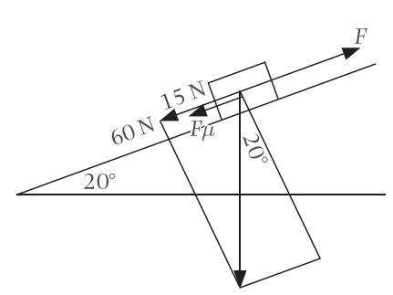
3. (Continued)
Figure: An object on an incline

Slide 6
3. (Continued). Calculate the:
a) Mass of the object

Slide 7
3. (Continued)
b) Force parallel to the plane necessary to pull the object up the incline.
c) Weight component perpendicular to the plane

Slide 8
3. (Continued)
d) Coefficient of friction

Slide 9
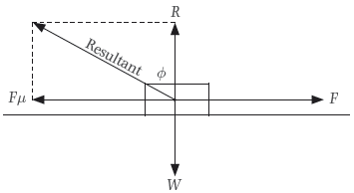
4. Explain, by means of a labelled sketch, the position of the angle of friction of a body that is pulled over a horizontal plane.
Figure: The angle of friction

Slide 11
5. A force of 8 N is necessary to bring a block into motion on a horizontal plane, and a force of 7 N is necessary to keep it in motion. The coefficient of static friction is 0,3.
Figure: Forces acting on an object
Calculate the:

Slide 12
5. (Continued)
a) Static frictional force

Slide 13
5. (Continued)
b) Weight of the block

Slide 14
5. (Continued)
c) Coefficient of kinetic friction

Slide 15
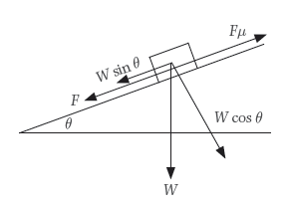
6. An object with a mass of 80 kg rests on an incline of 1:50. A force of 60 N is required to pull the object up the incline.
Figure: An object on an incline

Slide 16
6. (Continued) Calculate:
a) The gravitational weight component
i) Parallel to the plane

Slide 17
6a) (Continued)
ii) Perpendicular to the plane

Slide 18
6. (Continued)
b) The smallest force necessary to pull the object down the incline.

Slide 19
7. A block rests on an incline which makes an angle of 10° with the horizontal. The weight of the block is 50 N and the frictional force is 12 N. Calculate the smallest force necessary to pull the block up the incline.

Slide 20
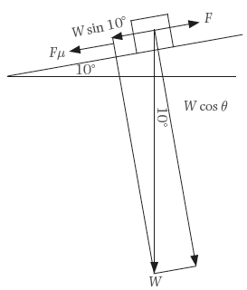
7. (Continued)
Figure: An object on an incline

Slide 21
Test your knowledge of this module by completing the summative activity on page 166 of your Student’s Book.

