Slide 1
Engineering Science
N2

Slide 2
Mechanical drives and lifting machines
Module 5

Slide 3
3. An effort of 40 N is required to lift a load of 140 N. The load distance of the lifting device is 25 m and the effort distance is 115 m.
Calculate the:

Slide 4
3. (Continued)
a) Mechanical advantage

Slide 5
3. (Continued)
b) Velocity ratio

Slide 6
3. (Continued)
b) Efficiency

Slide 8
6. The power transmitted by a belt drive is 3 kW. The effective force in the belt is 220 N and the force in the slack side is 100 N.
Calculate the:

Slide 9
6. (Continued)
a) Belt speed in km/h
[3 kW = 3000 W]

Slide 10
6. (Continued)
b) Force in the tight side of the belt

Slide 11
6. (Continued)
c) Pulling force ratio of the belt

Slide 13
8. In a gear system, gear A rotates at 8 r/s. The number of teeth on gear A is 30 and it meshes with gear B with 90 teeth. Gear B is fixed on an intermediate shaft and gear C is also fixed to this shaft. Gear C drives gear D which rotates at 120 r/min. Gear D has 100 teeth.
First we draw the gears and shafts to visualise how they fit together:

Slide 14
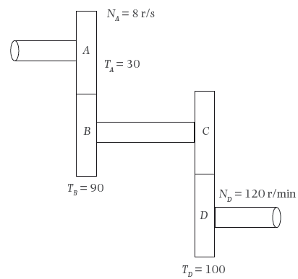
8. (Continued)
Figure: Four gears meshing

Slide 15
8. (Continued). Calculate the:
a) Rotational frequency of gear D in r/s

Slide 16
8. (Continued)
b) Rotational frequency of gear B in r/s

Slide 17
8. (Continued)
c) Rotational frequency of gear C in r/s
d) Number of teeth on gear C

Slide 18
8. (Continued)
e) Velocity ratio of the gear system

Slide 19
10. In a three-speed bicycle the driver gear has 50 teeth and the pedals are fixed to it. Three driven gears are fixed to the rear wheel’s axle. Driven gear 1 has 40 teeth and driven gear 2 has 15 teeth. The average (constant) rotational frequency of the driver gear is 3 r/s and the speed of the bicycle in first gear is 25 km/h.

Slide 20
10. (Continued)

Slide 21
10. (Continued) Calculate the:
a) Rotational frequency of gear 1 when engaged

Slide 22
10. (Continued) Calculate the:
b) Rotational frequency of gear 2 when engaged

Slide 23
10. (Continued) Calculate the:
c) Number of teeth of gear 3 if it rotates at 900 r/min

Slide 24
10c) (Continued)

Slide 25
10. (Continued) Calculate the:
d) Speed of the bicycle in km/h if gear 2 is engaged

Slide 26
10d) (Continued)

Slide 27
10d) (Continued)

Slide 29
11. The diameters of the axles of a differential wheel-and-axle lifting machine are 320 mm and 280 mm. The mechanical advantage of the machine is 9 and the efficiency of the machine is 45%. If a load of 80 kg is hoisted, calculate the following.

Slide 30
11. (Continued)

Slide 31
11. (Continued)
a) Effort required

Slide 32
11. (Continued)
b) Diameter of the wheel

Slide 33
11b) (Continued)

Slide 34
11. (Continued)
c) Load distance after 3 revolutions

Slide 35
11c) (Continued)

Slide 36
11. (Continued)
d) Work done by the load after 3 revolutions of the wheel

Slide 37
12. The big pulley of a Weston differential pulley is 220 mm and the diameter of the smaller pulley is 160 mm. An effort of 50 N is required to hoist a load of 300 N.
Calculate the:

Slide 38
12. (Continued)
a) Velocity ratio

Slide 39
12. (Continued)
b) Efficiency

Slide 40
13. A flat circular plate has a diameter of 80 mm and lies at the bottom of a dam in which the water is 3 m deep.
Calculate the:

Slide 41
13 (Continued)
a) Pressure at the bottom if the density of water is 1 000 kg.m²

Slide 42
13. (Continued)
b) Force of pressure exerted on the plate
[80 mm= 0,08 m]

Slide 43
13. (Continued)
b) Force of pressure exerted on the plate

Slide 44
14. Calculate the absolute pressure if a pressure gauge registers 320 kPa at normal temperature and pressure (NTP)

Slide 45
Test your knowledge of this module by completing the summative activity on page 148 of your Student’s Book.

