Slide 1
Engineering Science
N2

Slide 2
Work, power and efficiency
Module 4

Slide 3
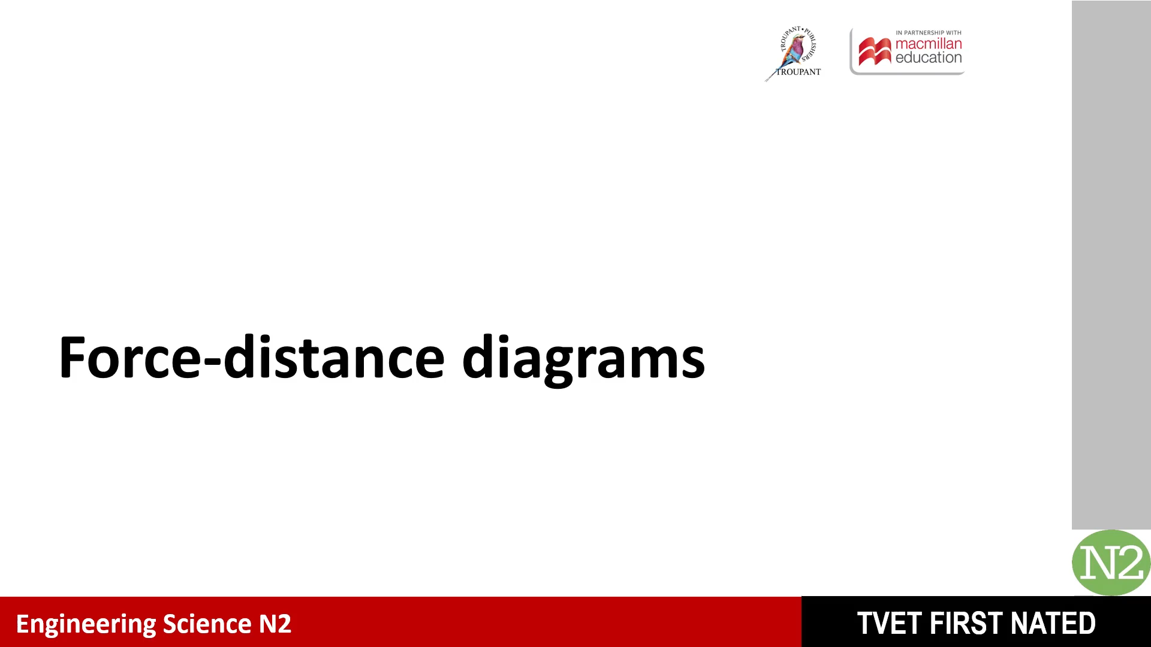


Slide 4
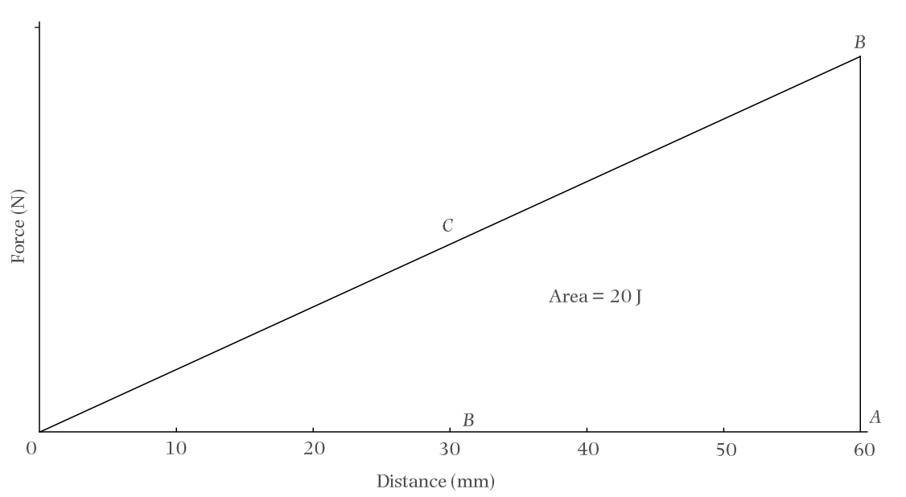
2. The work done to stretch a spring from 0 to 60 mm is 20 J. Draw a force–distance graph.
D
Figure: A force–distance graph

Slide 5
2. (Continued)
a) Calculate the force required to stretch the spring from 0 to 60mm
Reminder: when work is done by an applied force which is not constant, such as on a spring that is compressed or a cable that is lifted, the average force (F_{a}) must be used to calculate work done
[Work done = Average force x distance]
[60mm = 0,06m]

Slide 6
2a) (Continued)

Slide 7
2. (Continued)
a) (alternate solution)

Slide 8
2. (Continued)
b) Calculate the power required if it takes 0.8 s to stretch the spring from 0 to 60 mm

Slide 9
2. (Continued)
c) Calculate the work done to stretch the spring from 0 to 30 mm
[30mm = 0,03m]

Slide 10
2c) (Continued)

Slide 11
3. A cable is 200 m long and its mass per unit length is 2,5 kg/m. The cable is hoisted at a constant speed of 10 m/s and the efficiency of the lifting device is 50%.

Slide 12
3. (Continued)
a) Draw the force–distance graph of the work done to hoist the cable.

Slide 13
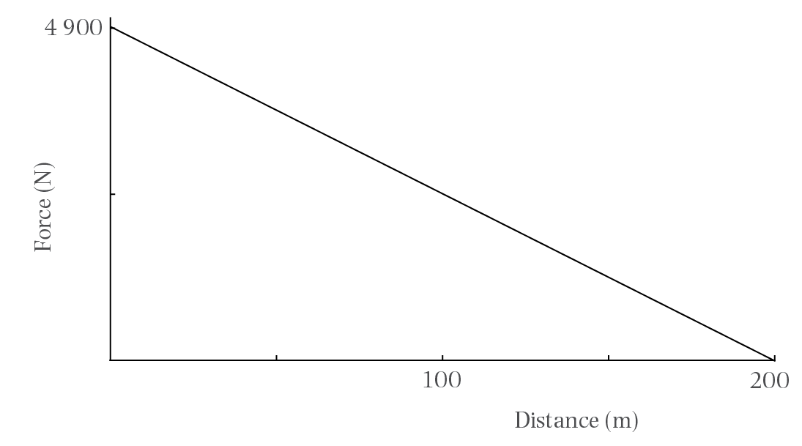
3a) (Continued)
Figure: A force–distance graph

Slide 14
3. (Continued)
b) Calculate the speed in km/h at which the cable is hoisted.

Slide 15
3. (Continued)
c) Calculate the work done to hoist the cable.
[Work done = Average force x distance]

Slide 16
3. (Continued)
d) Calculate the input power of the lifting device.

Slide 17
3d) (Continued)

Slide 18
4. The force–distance graph below represents a cable of 200 m hoisted at a constant speed. The total weight of the cable is 1 200 N and it is hoisted during a period of 4 minutes. The efficiency of this lifting device is 60%.
Figure: A force–distance graph

Slide 19
4. (Continued)
a) Calculate the mass of the cable per unit length

Slide 20
4a) (Continued)

Slide 21
4. (Continued)
b) Calculate the total work done

Slide 22
4. (Continued)
c) Calculate the output power of the lifting device
[4 min = 4x60 seconds]

Slide 23
4. (Continued)
d) Calculate the output power of the motor that drives the device

Slide 24
5. A spiral spring is 100 mm long when it is not stretched out. A force of 8 N is required for stretching it 5 mm. The spring is now stretched from 120 mm to 160 mm. Draw the force–distance graph.

Slide 25
5. (Continued)

Slide 26
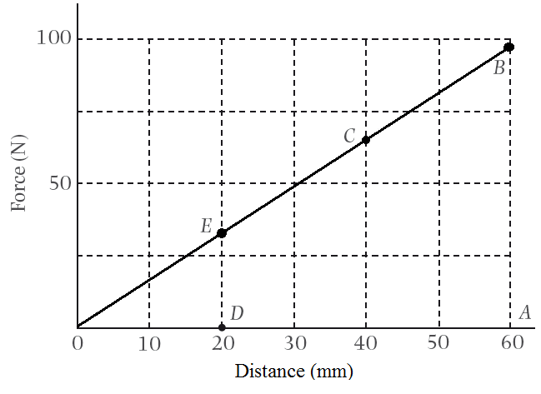
5. (Continued)
Figure: A force–distance graph

Slide 27
5. (Continued)
a) Determine from your graph the work done
[40 mm = 0,04 m]

Slide 28
5. (Continued)
b) Determine from your graph the average force required

Slide 29
6. A mass of 5 000 kg is hoisted though 3 m during a period of 15 s. Calculate the:
a) Work done during 15 s

Slide 30
6. (Continued)
b) Power required to hoist the mass

Slide 31
7. A machine requires a torque of 20 N.m at its shaft. The diameter of the shaft is 0,5 m. The rotational frequency of the shaft is 2 r/s. Calculate the:
a) Magnitude of the load on which the rope around the hoist drum is acting

Slide 32
7a) (Continued)
[2r = d]

Slide 33
7. (Continued)
b) Work done by the machine during 30 s
c) Power delivered

Slide 34
8. A force of 800 N acts on the end of a spanner. The perpendicular distance between the working line of the force and the centre line of the nut is 0,5 m. Calculate the:
a) Torque

Slide 35
8. (Continued)
b) Work done if the torque is kept constant while the nut turns through:
i) 30°

Slide 36
8b) (i) (Continued)

Slide 37
8b) (Continued)
ii) 3 revolutions

Slide 38


Slide 39
9. An object with a mass of 25 kg rests on a slope which makes an angle of 12° with the horizontal. Calculate the:
a) Weight of the object

Slide 40
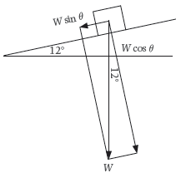
9. (Continued)
b) Component of the weight parallel to the slope
Figure: A mass on an incline

Slide 41
9b) (Continued)

Slide 42
9. (Continued)
c) Work done by the component parallel to the plane if it displaces the mass 2,8 m

Slide 43
9. (Continued)
d) Output power involved if the motion takes place during 8 s

Slide 44
Test your knowledge of this module by completing the summative activity on page 109 of your Student’s Book.

