Slide 1
Engineering Science
N2

Slide 2
Statics
Module 2

Slide 3



Slide 4
3a) Determine the magnitude and direction of the equilibrant graphically:
Figure: Two forces

Slide 5
3a) (Continued)
Space diagram
In a space diagram, any non pulling forces need to be represented as pulling forces – so we transfer the 50N force along the working line
60 N
65°
50 N
Figure: Space diagram

Slide 6
3a) (Continued)
Vector diagram
Note: The following diagram is not to scale, however, students must draw their own diagrams to scale and write the scale next to the diagram.
For example, if drawn to a scale of 1 mm = 1 N, line R should be 93 mm in length on the vector diagram.

Slide 7
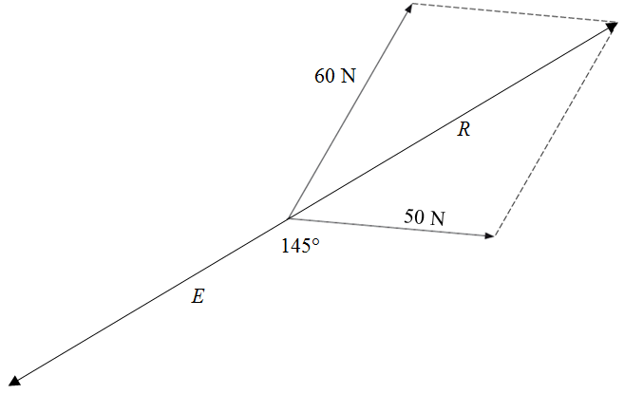
3a) (Continued)
The resultant (R) and the equilibrant (E) of a system of forces have the same magnitude and working line, but act in opposite directions
Vector diagram
Figure: Vector diagram

Slide 8
3b) Determine the magnitude and direction of the equilibrant graphically:
Figure: Two forces

Slide 9
3b) Continued
Vector diagram
Note: The following diagram is not to scale, however, students must draw their own diagrams to scale and write the scale next to the diagram.
For example, if drawn to a scale of 1 mm = 3 N, the 120 N line should be 40 mm in length on the vector diagram

Slide 10
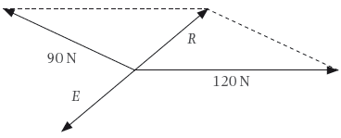
3b) Continued
Vector diagram
Figure: Vector diagram

Slide 11
4a) Determine the horizontal and vertical components of the following force graphically:
Figure: A force

Slide 12
4a) (Continued)
Vector diagram
Note: The following diagram is not to scale, however, students must draw their own diagrams to scale and write the scale next to the diagram.
For example, if drawn to a scale of 1 mm = 3 N, the diagonal line sloping from the corner of HC and VC should be 50 mm in length on the vector diagram

Slide 13
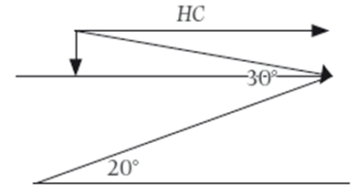
4a) (Continued)
The 150 N force is the resultant, and the horizontal component (HC) and vertical component (VC) will be the adjacent sides of the parallelogram
Vector diagram
VC
150 N
Figure: Forces acting on an incline

Slide 14
4b) Determine the horizontal and vertical components of the following force graphically:
Figure: A force

Slide 15
4b) (Continued)
Vector diagram
Note: The following diagram is not to scale, however, students must draw their own diagrams to scale and write the scale next to the diagram.
For example, if drawn to a scale of 1 mm = 10 N, the diagonal line sloping from the corner of HC and VC should be 60 mm in length on the vector diagram.

Slide 16
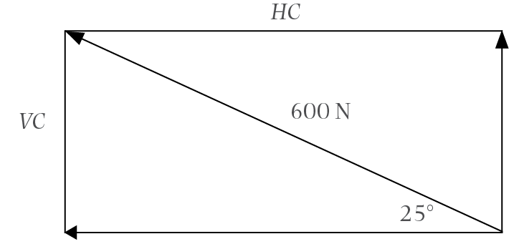
4b) (Continued)
Vector diagram
Figure: Components of a force

Slide 17
5a) Calculate the horizontal and vertical components of the following force:
Figure: A force acting upwards
Here we use the analytical method, rather than the graphical method from the previous questions

Slide 18
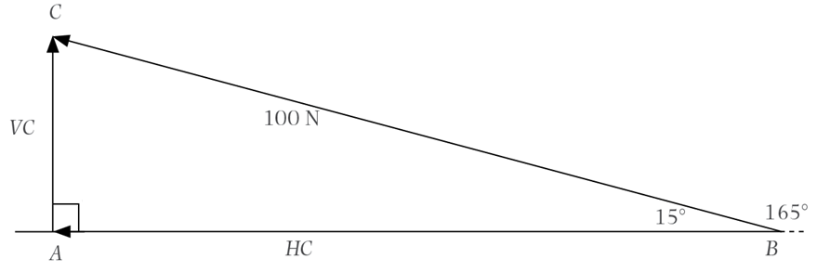
5a) (Continued)
Figure: Components of a force

Slide 19
5a) (Continued)

Slide 20
5b) Calculate the horizontal and vertical components of the following force:
Figure: A force acting downwards

Slide 21
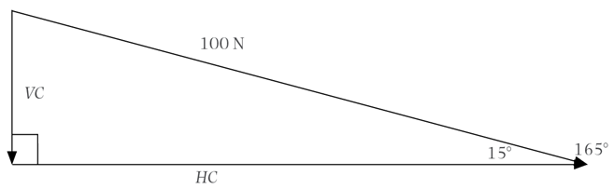
5b) (Continued)
Figure: Components of a force

Slide 22
5b) (Continued)

Slide 23
6a) Calculate the components of the following force parallel and perpendicular to the plane:
Figure: An object on an incline

Slide 24
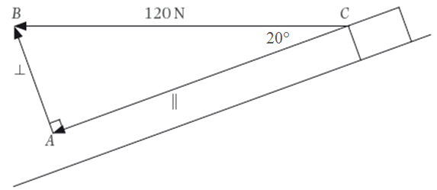
6a) (Continued)
Figure: Forces acting on a mass on an incline

Slide 25
6a) (Continued)

Slide 26
6b) Calculate the components of the following force parallel and perpendicular to the plane:
Figure: An object on an incline

Slide 27
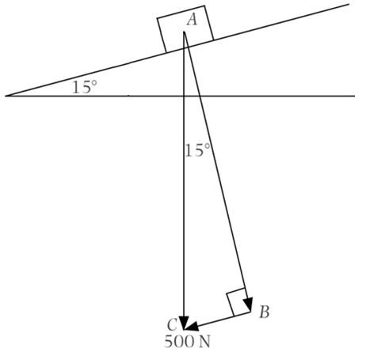
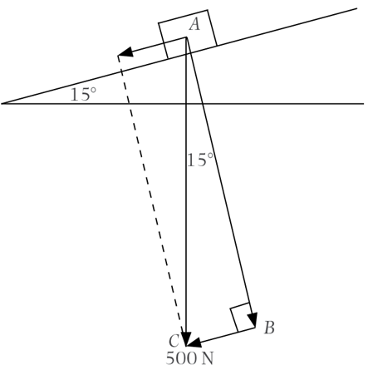
6b) (Continued)
Figure: Forces acting on a mass on an incline

Slide 28
6b) (Continued)

Slide 29
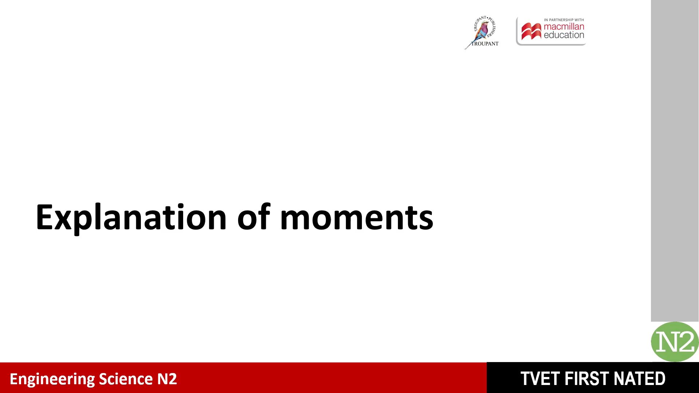

Slide 30
7. A uniform beam with a weight of 800 N, is 8 m long and is supported 1 m from the left end and also at the right end.
It carries concentrated loads, namely 500 N, 3 m from the left end and 680 N, 2 m from the right end.
Calculate the magnitude of the reaction forces and test your answers.

Slide 31
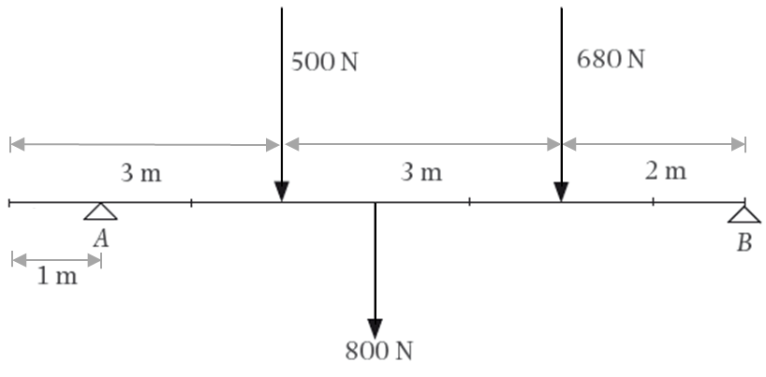
7. (Continued)
Figure: Forces acting on a beam

Slide 32
7. (Continued)
There are 4 moments about A: due to the 500N force, the 800N force, the 680N force, and the unknown force (B). Since the beam is in equilibrium, the law of moments can be applied.
Take moments about A:

Slide 33
7. (Continued)
There are 4 moments about B: due to the 680N force, the 800N force, the 500N force, and the unknown force (A). Since the beam is in equilibrium, the law of moments can be applied.
Take moments about B:

Slide 34
7. (Continued)
As the system is in equilibrium, the sum of the upward forces should equal the sum of the downward forces. We check this by calculating the sum of each.
Test:

Slide 35
8. Calculate the distance from A where the 150 N force must act so that the reaction forces A and B are equal.
Figure: A loaded beam

Slide 36
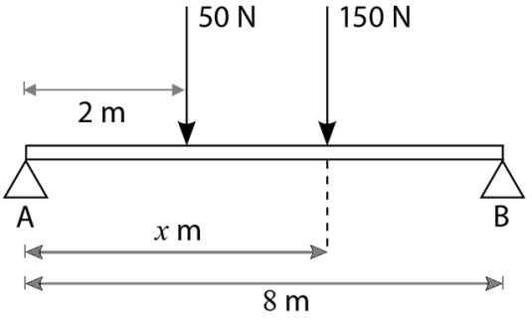
8. (Continued)
Figure: Forces acting on a beam
Let x be the distance between the 150 N and A

Slide 37
8. (Continued)
As the system is in equilibrium, the sum of the upward forces equals the sum of the downward forces.
Given: A = B

Slide 38
8. (Continued)
There are 3 moments about A: due to the 50N force, the 150N force, and the 100N force (B) which we have just calculated. Since the beam is in equilibrium, the law of moments can be applied.
Take moments about A:

Slide 39
9. A light beam is 10 m long and is supported at A and B. A is supported at the left end and B, 2 m from the right end. It also carries concentrated loads of 80 N at the right end and 720 N, 3 m from the left end.
Calculate the magnitude of the reaction forces and test your answer.

Slide 40
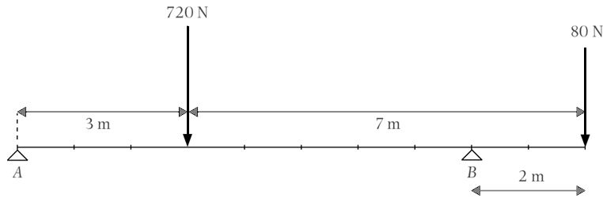
9. (Continued)
Figure: Forces acting on a beam

Slide 41
9. (Continued)
Take moments about A:

Slide 42
9. (Continued)
Take moments about B:

Slide 43
9. (Continued)
Test:

Slide 44
Test your knowledge of this module by completing the summative activity on page 65 of your Student’s Book.

