Slide 1
Engineering Science
N2

Slide 2
Dynamics
Module 1

Slide 3
2. An athlete completes three quarters of a round track with a diameter of 50 m
a) Calculate the distance travelled

Slide 4
2. (Continued)
b) Calculate her displacement if she completes half a revolution

Slide 6
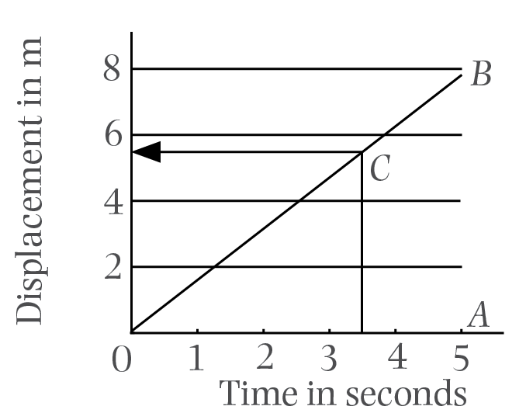
3. Draw a displacement-time graph of the following information:
Time (s) | 1 | 2 | 3 | 4 | 5
Displacement (m) | 1.5 | 3 | 4.5 | 6 | 7.5
Figure: A displacement–time graph

Slide 7
3. (Continued)
Determine from your graph:
a) Velocity:

Slide 8
3. (Continued)
Determine from your graph:
b) Displacement after 3.5 s:

Slide 9
4. Draw the displacement-time graph of a free-falling object which is falling from 80 m.

Slide 10
4. (Continued)
Displacements from 80 m:

Slide 11
4. (Continued)

Slide 12
4. (Continued)

Slide 13
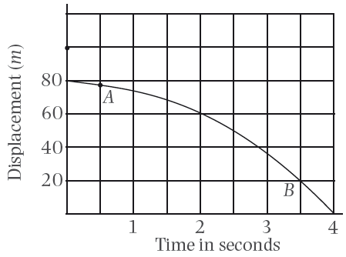
4. (Continued)
Figure: A displacement–time graph

Slide 14
4. (Continued)
Determine from your graph the displacement from 80m after:
a) 0.5 s
b) 3.5 s

Slide 17
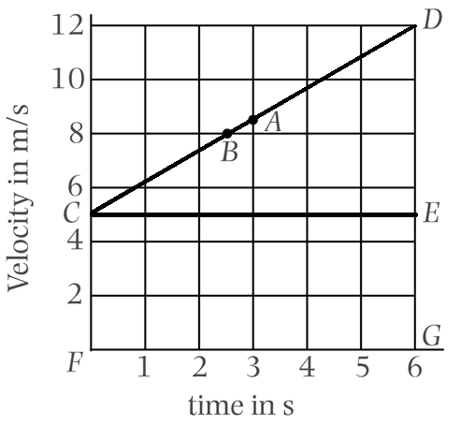
5. An object is accelerated uniformly from 5 m/s to 12 m/s during 6 s. Draw a velocity time graph:
Figure: A velocity–time graph

Slide 18
5. (Continued)
Determine from your graph:
a) Velocity after 3s
b) Time to reach a velocity of 8 m/s

Slide 19
5. (Continued)
c) Acceleration

Slide 20
5. (Continued)
d) Displacement when the object reached a velocity of 12 m/s

Slide 21
6. Calculate the time needed to accelerate and object from rest to 22 m/s at 3 m/s²

Slide 22
7. Calculate the acceleration of an object if it is accelerated from 20 km/h to 90 km/h during a period of 9s

Slide 23
7. (Continued)

Slide 24
8. Calculate the displacement after 25s if an object is accelerated at 6 m/s² from 8 m/s

Slide 25
9. An object is displaced through 360 m while it is accelerated from 10 m/s for 15 s. Calculate the acceleration.

Slide 26
9. (Continued)

Slide 27
10. An object is projected vertically upwards with initial velocity of 80 m/s. Calculate the maximum height the object will reach.

Slide 28
10. (Continued)

Slide 29
Test your knowledge of this module by completing the summative activity on page 30 of your Student’s Book.

