Slide 1
TERMS AND CONDITIONS
These PowerPoint slides are a tool for lecturers, and as such:
YOU MAY add content to the slides, delete content from the slides, print out the slides, and save the slides onto your computer or server.
YOU MAY NOT resell, reproduce or redistribute the content in any form whatsoever, without prior written permission from the copyright holder.
© Troupant Publishers (Pty) Ltd, 2016
Selected images used under licence from Shutterstock.com

Slide 2
Engineering Science N1
Module 6: Particle structure of matter

Slide 3
Unit 6.1: Phases of matter
Figure 6.1: Can you identify the three phases of water in this photograph?

Slide 4
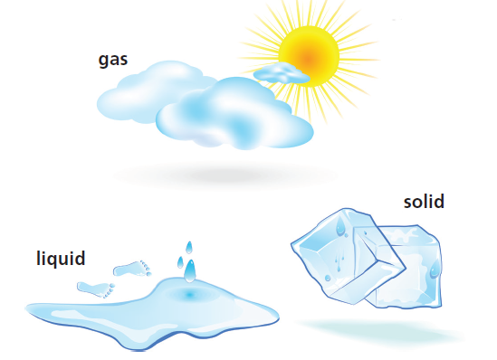
Three phases of matter
Figure 6.3: The three phases of water

Slide 5
Three phases of matter
Solid: definite size/volume and shape
Liquid: definite volume, but takes shape of container
Gas: no definite volume or shape

Slide 6
VIDEO: Kinetic theory of matter

Slide 7
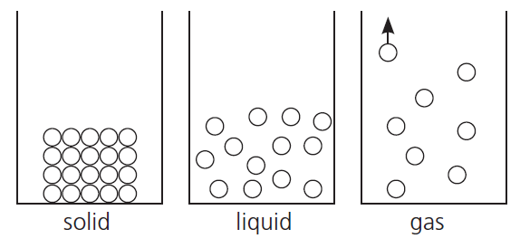
Three phases of matter
Figure 6.4: Arrangement of particles in the three states of matter

Slide 8
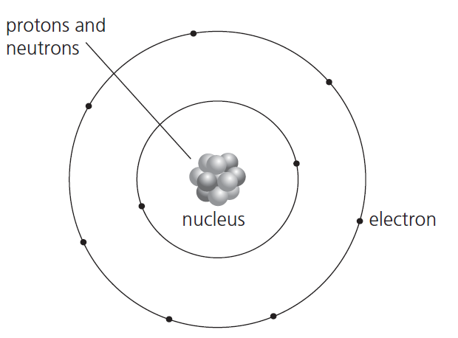
Model and structure of the atom
Figure 6.5: Bohr’s model of an atom

Slide 9
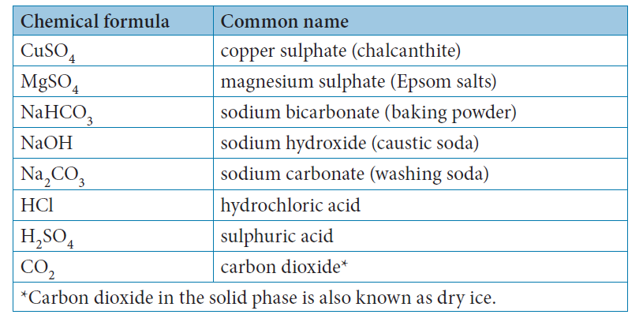
Model and structure of the atom
Table 6.1: Some well-known compounds

Slide 10
Activity 6.1
Test your knowledge of this section by completing Activity 6.1 (page 153 of your Student’s Book)

Slide 11
Summative assessment
Read the module summary on page 153 and then complete the summative activity on page 155

