Slide 1
TERMS AND CONDITIONS
These PowerPoint slides are a tool for lecturers, and as such:
YOU MAY add content to the slides, delete content from the slides, print out the slides, and save the slides onto your computer or server.
YOU MAY NOT resell, reproduce or redistribute the content in any form whatsoever, without prior written permission from the copyright holder.
© Troupant Publishers (Pty) Ltd, 2016
Selected images used under licence from Shutterstock.com

Slide 2
Engineering Science N1
Module 5: Heat

Slide 3
Unit 5.1: Heat and temperature
Figure 5.1: We use a thermometer to measure temperature

Slide 4
VIDEO: Heat and temperature

Slide 5
Temperature
Figure 5.2: It takes more heat energy to boil 1 ℓ of water than 500 ml of water

Slide 6
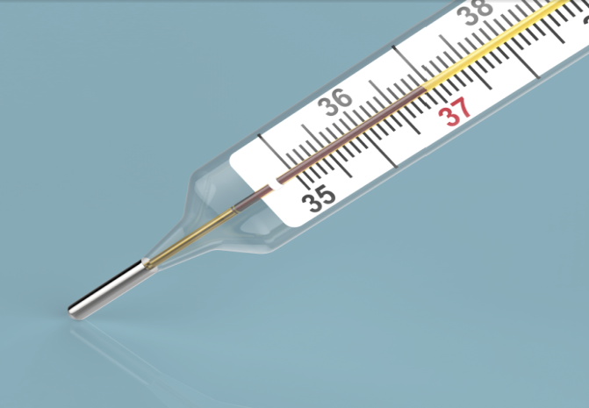
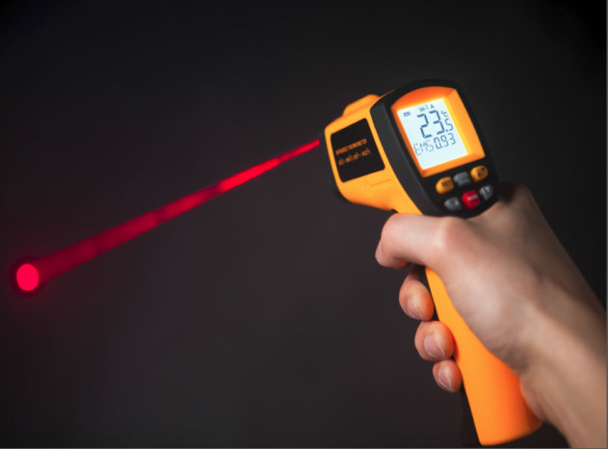
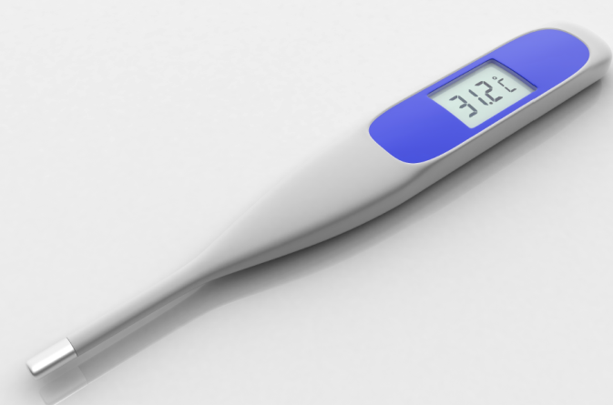
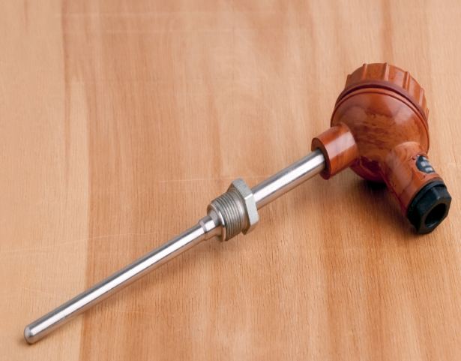
Measuring temperature
TVET FIRST
Different types of thermometers:
Figure 5.3: Liquid-in-glass thermometer
Figure 5.5: Infrared thermometer
Figure 5.4: Digital thermometer
Figure 5.6: Resistance thermometer

Slide 7
Units of measurement
Celsius scale
Water freezes at 0 °C and boils at 100 °C.
Fahrenheit scale
Water freezes at 32 °F and boils at 212 °F.
Conversion formulae
To convert:
Celsius to Fahrenheit: multiply by 9, divide by 5, then add 32.
Fahrenheit to Celsius: subtract 32, multiply by 5, then divide by 9.

Slide 8
Units of measurement
Kelvin scale
0 K – absolute zero point
273 K – freezing point of pure water
373 K – boiling point of pure water
0 K = –273 °C = absolute zero
Conversion formulae
To convert:
Celsius to kelvin: subtract 273.
Kelvin to Celsius: add 273.

Slide 9
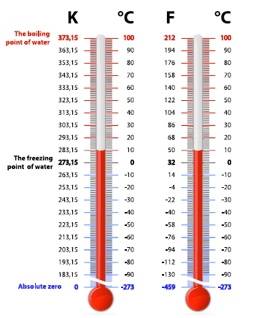
Units of measurement
Figure 5.9: A comparison between the three temperature scales

Slide 10
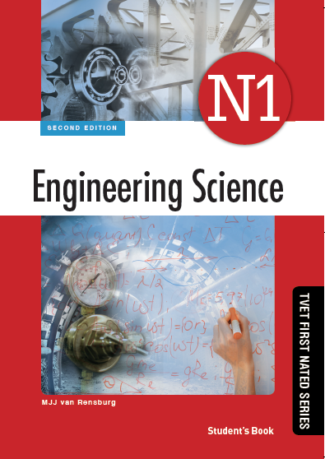
Activity 5.1
Test your knowledge of this section by completing Activity 5.1 (page 125 of your Student’s Book)

Slide 11
Other measuring devices: simple pyrometers
Temperatures of 500 °C and higher are measured with a pyrometer.
Thermocouple pyrometer
Resistance pyrometer
Optical pyrometer

Slide 12
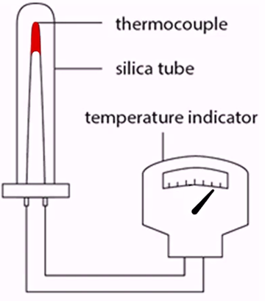
Thermocouple pyrometer
Figure 5.11: A thermocouple pyrometer
Notes:
To play this video, ensure you have QuickTime loaded on your computer – see the installation link in the CD folder.

Slide 13
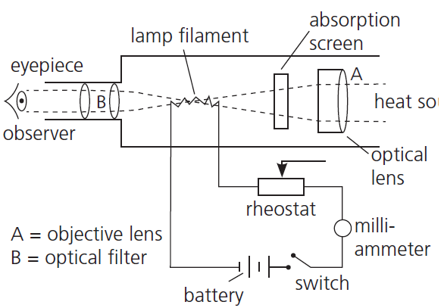
Optical pyrometer
Heat source
Figure 5.13: The working mechanism of an optical pyrometer
Notes:
To play this video, ensure you have QuickTime loaded on your computer – see the installation link in the CD folder.

Slide 14
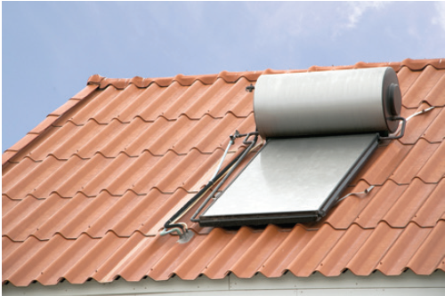
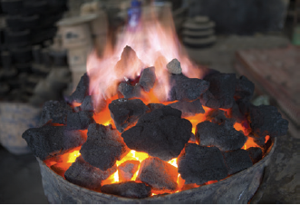
Sources of heat
The sun
Fossil fuels
Figure 5.15: Solar panels capture heat energy from the sun
Figure 5.16: Chemical energy
in the coal is converted to heat energy

Slide 15
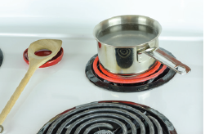
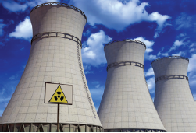
Sources of heat
Electricity
Nuclear energy
Figure 5.17: An electric stove converts electrical energy to heat
Figure 5.18: Nuclear energy is regarded as a solution to the world’s energy crisis

Slide 16
The effect of heat on a substance
Change in dimensions
Figure 5.19: Device to prove expansion of metal rod
Change in temperature

Slide 17
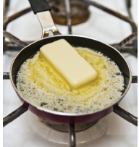
The effect of heat on a substance
Change of phase
Change in composition
Figure 5.20: Many solids melt if enough heat energy is absorbed

Slide 18
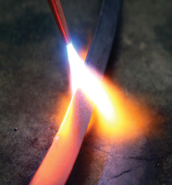
The effect of heat on a substance
Change in colour
Change in resistance
Figure 5.21: When a metal bar is heated, it will start to glow red

Slide 19
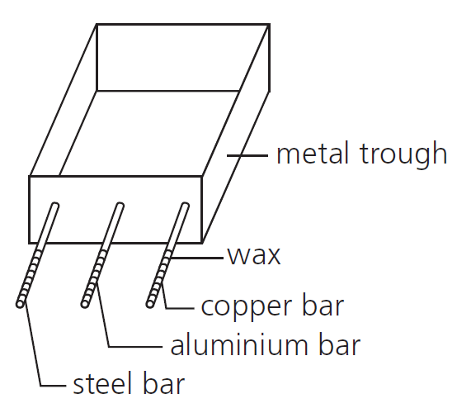
Heat transfer
Conduction
Experimental proof of conductivity of metals
Figure 5.23: A metal trough with three metal bars

Slide 20
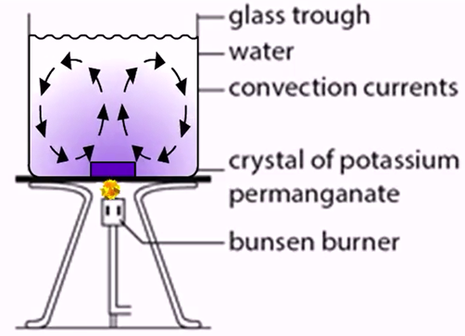
Heat transfer
Convection
Figure 5.24: A glass beaker with water being heated

Slide 21
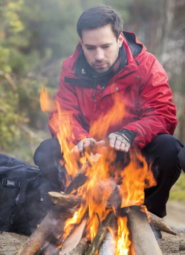
Heat transfer
Radiation
Figure 5.27: The heat reaches the
hiker’s hands through radiation

Slide 22
Activity 5.2
Test your knowledge of this section by completing Activity 5.2 (page 133 of your Student’s Book)

Slide 23
Unit 5.2: Heat capacity and specific heat capacity
Figure 5.29: If water did not have such a high heat capacity, you would not be able to cool off in the pool on a hot day!

Slide 24
Measurable heat
Depends on:
Mass of the substance
Change in temperature
Specific heat capacity of the substance

Slide 25
Specific heat capacity
The specific heat capacity (c) of a substance is the amount of heat energy required to raise the temperature of 1 kg (unit mass) of the substance by 1 K or 1 °C (unit of temperature).

Slide 26
VIDEO: Heat capacity

Slide 27
Calculating the amount of measurable heat

Slide 28
Activity 5.3
Test your knowledge of this section by completing Activity 5.3 (page 138 of your Student’s Book)

Slide 29
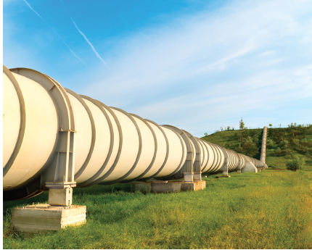
Unit 5.3: Linear expansion
Figure 5.31: Pipelines must allow for expansion and contraction due to temperature changes

Slide 30
VIDEO: Thermal expansion

Slide 31
Thermal expansion
Advantageous in:
Mercury thermometers
Securing of parts
Electric switches and thermostats
Automatic chokes

Slide 32
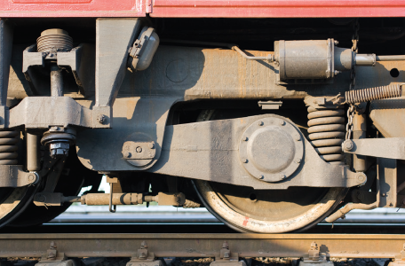
Thermal expansion
Figure 5.32: The principle of thermal expansion is used to fit steel bands to the wheels of railway trucks

Slide 33
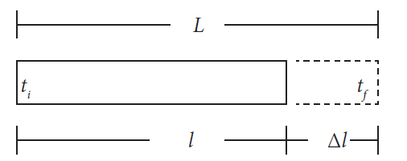
Linear coefficient of expansion
Figure 5.33: Linear expansion of a metal bar

Slide 34
Linear coefficient of expansion
From the definition:

Slide 35
Factors affecting linear expansion
Type of material
Rise in temperature
Original length

Slide 36
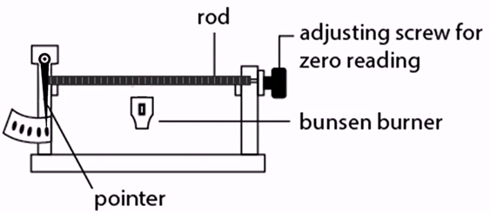
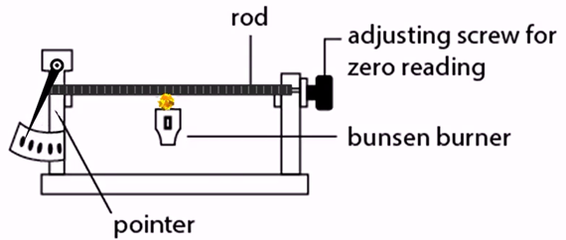
Experimental evidence of expansion
Figure 5.34: Linear expansion of a metal bar

Slide 37
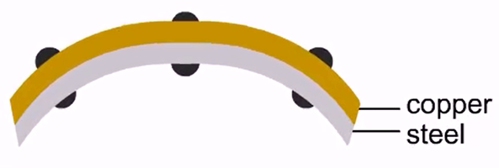
Linear expansion of different metals (bimetallic strip)
Figure 5.36: Copper has a greater coefficient of linear expansion than steel, causing the bimetallic strip to bend

Slide 38
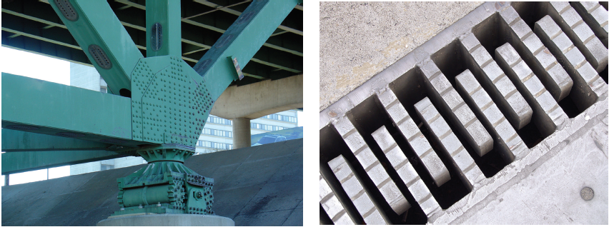
Linear expansion in practice
Figure 5.39: Roller bearings (left) and expansion joint (right) allow for thermal expansion on a bridge

Slide 39
Activity 5.4
Test your knowledge of this section by completing Activity 5.4 (page 144 of your Student’s Book)

Slide 40
Summative assessment
Read the module summary on page 145 and then complete the summative activity on page 148

