Slide 1
TERMS AND CONDITIONS
These PowerPoint slides are a tool for lecturers, and as such:
YOU MAY add content to the slides, delete content from the slides, print out the slides, and save the slides onto your computer or server.
YOU MAY NOT resell, reproduce or redistribute the content in any form whatsoever, without prior written permission from the copyright holder.
© Troupant Publishers (Pty) Ltd, 2016
Selected images used under licence from Shutterstock.com

Slide 2
Engineering Science N1
Module 4: Energy, work and power

Slide 3
Unit 4.1: Energy and conservation of energy
Figure 4.1: What energy conversions take place to enable the pole-vaulter to clear the bar?

Slide 4
Different forms of energy
Kinetic energy Resulting from motion

Slide 5
Different forms of energy
Potential energy Stored in a body or system
(gravitational potential energy)

Slide 6
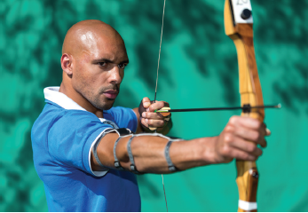
Different forms of energy
Potential energy
Figure 4.2: Elastic potential energy is stored in the drawn bowstring and will be transferred to the arrow when it is released

Slide 7
Different forms of energy
Heat energy Moving / vibrating molecules
Chemical energy Stored in bonds between molecules

Slide 8
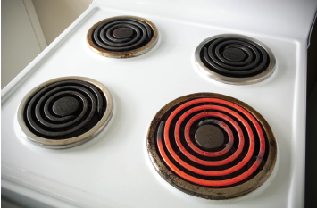
Different forms of energy
Electrical energy Made available by the flow of electric charge through a conductor
Figure 4.4: An electric stove converts electrical energy into heat energy

Slide 9
VIDEO: Work and energy

Slide 10
Conservation of energy
Law of conservation of energy
Energy cannot be created or destroyed; it can only be converted from one form into another or transferred from one object to another.

Slide 11
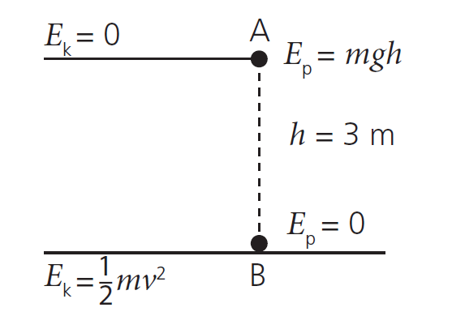
Conservation of energy
Figure 4.5: Potential energy converted to kinetic energy

Slide 12
VIDEO: Energy conservation and conversion

Slide 13
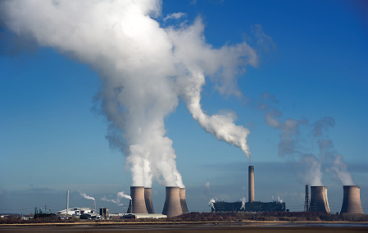
Sources of energy
Figure 4.6: In a coal-burning power station, chemical energy in the coal is ultimately converted into electrical energy

Slide 14
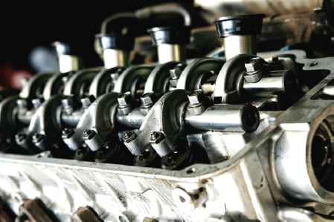
Sources of energy
Figure 4.7: In the internal combustion engine of a motor car, chemical energy is converted to heat energy and then to kinetic energy, which is then transferred from the pistons to the other parts that drive the vehicle

Slide 15
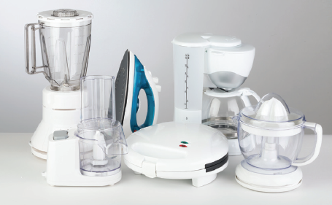
Sources of energy
Figure 4.9: Electrical energy is converted into kinetic energy or heat energy in appliances such as blenders, toasters, irons, fans and electric motors

Slide 16
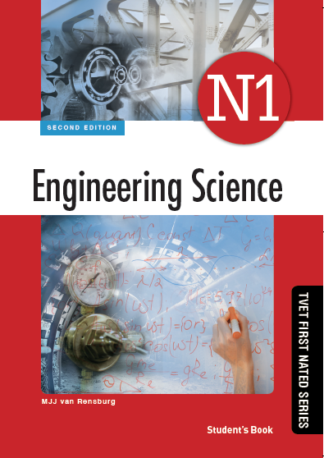
Activity 4.1
Test your knowledge of this section by completing Activity 4.1 (page 106 of your Student’s Book)

Slide 17
Unit 4.2: Work and power
Figure 4.10: Is this athlete doing work when she pushes against the wall with all her strength?

Slide 18
VIDEO: Work and power

Slide 19
Work done

Slide 20
Work done
Figure 4.11: Work is done when a mass is displaced s units horizontally by force F

Slide 21
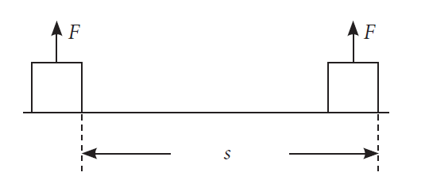
Work done
Figure 4.12: No work is done when two forces act perpendicular to the direction of the displacement

Slide 22
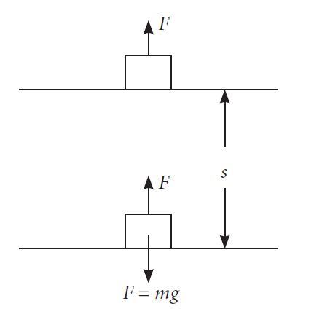
Work done
Figure 4.13: Work is done when a mass is lifted through s units vertically

Slide 23
Work done
When an applied force is not constant:

Slide 24
Power

Slide 25
Power

Slide 26
Force–distance graphs
Figure 4.16: A force–distance graph

Slide 27
Activity 4.2
Test your knowledge of this section by completing Activity 4.2 (page 115 of your Student’s Book)

Slide 28
Summative assessment
Read the module summary on page 117 and then complete the summative activity on page 118

