Slide 1
TERMS AND CONDITIONS
These PowerPoint slides are a tool for lecturers, and as such:
YOU MAY add content to the slides, delete content from the slides, print out the slides, and save the slides onto your computer or server.
YOU MAY NOT resell, reproduce or redistribute the content in any form whatsoever, without prior written permission from the copyright holder.
© Troupant Publishers (Pty) Ltd, 2016
Selected images used under licence from Shutterstock.com

Slide 2
Engineering Science N1
Module 3: Statics

Slide 3
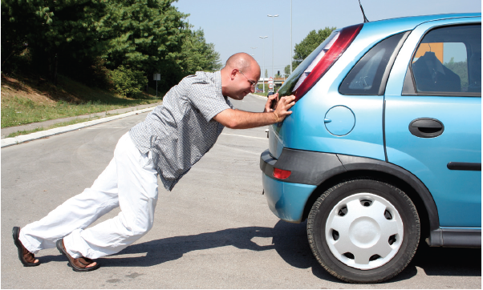
Unit 3.1: Parallelogram of forces, resultant and equilibrant (forces acting on the same point)
Figure 3.1: Even if the car is not moving, there are still forces acting on both the car and the man

Slide 4
Definitions
Resultant That single force that can replace the two or more forces and produce the same effect
Equilibrium Forces that cancel each other out because they have the same magnitude but act in opposite directions

Slide 5
Definitions
Equilibrant The single force that will balance one or more unbalanced forces

Slide 6
Addition of parallel forces
Forces in same direction: Add them
Forces in opposite direction: Subtract them
Subtract this from the others
Add these together
Figure 3.6: Three forces acting on an object

Slide 7
Addition of non-parallel forces
Use a vector diagram to create a parallelogram of forces.
Include scale.
Scale: 0,5 mm = 1 N
Figure 3.16: Parallelogram of forces

Slide 8
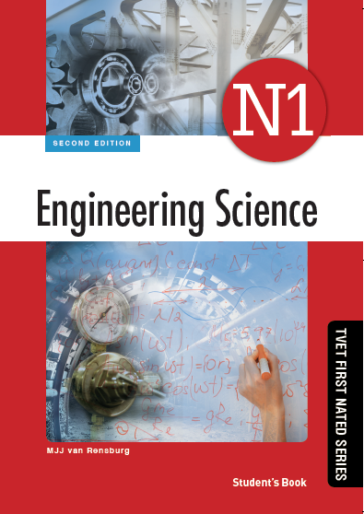
Activity 3.1
Test your knowledge of this section by completing Activity 3.1 (page 52 of your Student’s Book)

Slide 9
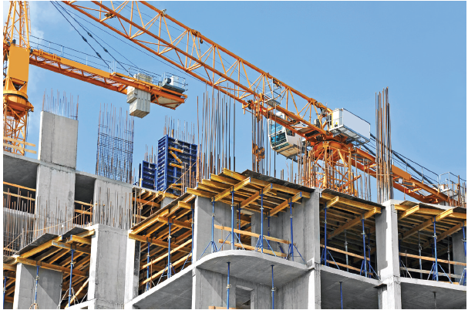
Unit 3.2: Triangle of forces
Figure 3.25: Static equilibrium is a very important principle in engineering and construction

Slide 10
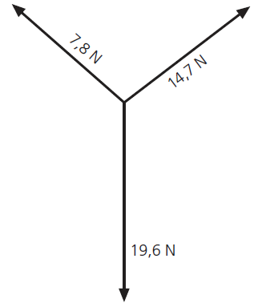
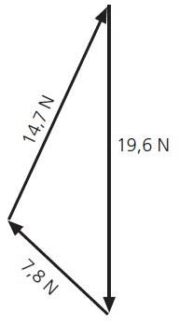
The triangle of forces
If three forces act on a point in equilibrium, they can be represented in sequence as a triangle.
Figure 3.26: Three forces acting on a point
Figure 3.27: A triangle of forces

Slide 11
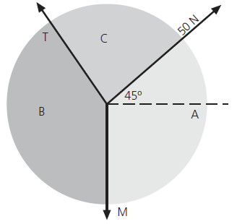
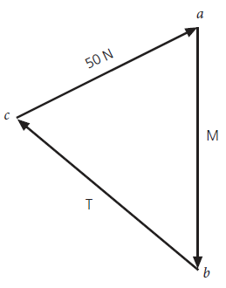
Bow’s notation
Another graphical method used to determine forces in equilibrium.
Figure 3.28: Forces marked in capital
letters on a space diagram
Figure 3.30: The three forces transferred
to the vector diagram

Slide 12
Activity 3.2
Test your knowledge of this section by completing Activity 3.2 (page 63 of your Student’s Book)

Slide 13
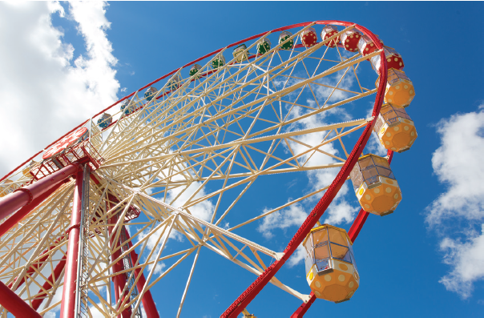
Unit 3.3: Moment of a force
Figure 3.53: We encounter moments everywhere – this Ferris wheel is a good example of how the principle of moments is used

Slide 14
Moment of a force
Moment of a force is the force of rotation around a point transmitted to the point.

Slide 15
Designation of moments
Clockwise moment
↻
(a)
Anticlockwise moment
↺
(b)
Figure 3.58: Clockwise and anticlockwise moments

Slide 16
Torque
Torque is the tendency of a force to cause or change rotational motion of a body.

Slide 17
VIDEO: Torque

Slide 18
VIDEO: Torque – example

Slide 19
The law of moments
A system of forces is in equilibrium when: The sum of the clockwise moments about a point is equal to the sum of the anticlockwise moments about the same point.

Slide 20
Activity 3.3
Test your knowledge of this section by completing Activity 3.3 (page 74 of your Student’s Book)

Slide 21
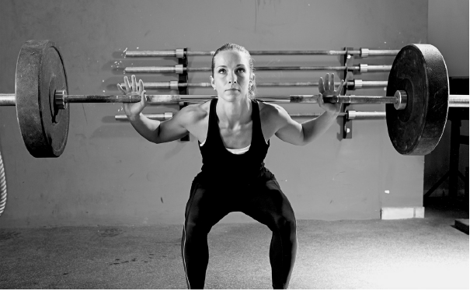
Unit 3.4: Lifting machines
Figure 3.93: This weightlifter uses her arms as a lever to lift the heavy weight

Slide 22
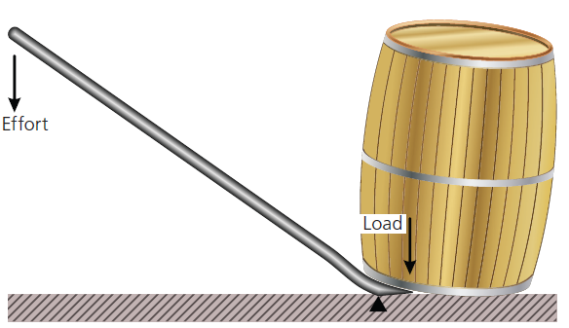
Levers
A lever is an inflexible bar that is free to rotate about a pivot point (the fulcrum).
It lifts the load when effort (force) is applied.
Figure 3.94: A lever is a simple machine

Slide 23
Calculating load
If effort is constant:
Downwards force on leaver = upwards force on load
Substitute and solve:

Slide 24
Mechanical advantage
Mechanical advantage is the ratio between the load lifted and the effort applied.

Slide 25
Velocity ratio
Velocity ratio is the ratio of the distance moved by the effort to the distance moved by the load.

Slide 26
Efficiency
Efficiency (η) of a machine is the ratio of the work delivered (output) to the work applied (input), expressed as a percentage.

Slide 27
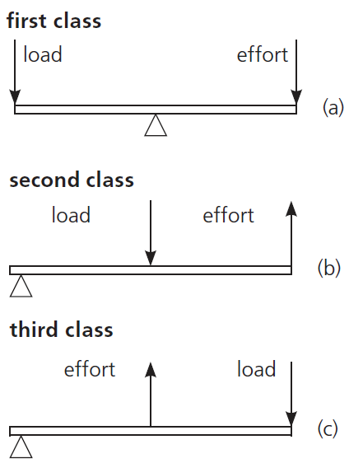
Classification of levers
Figure 3.99: The three classes of levers

Slide 28
Activity 3.4
Test your knowledge of this section by completing Activity 3.4 (page 86 of your Student’s Book)

Slide 29
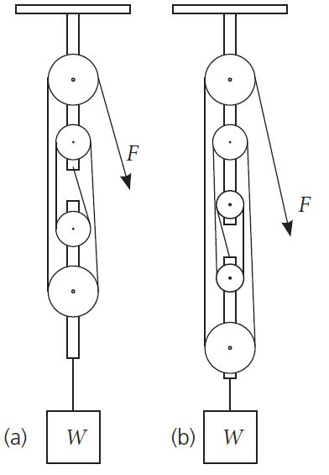
Types of lifting machines
Single-rope pulley system
Figure 3.114: Single-rope
pulley system

Slide 30
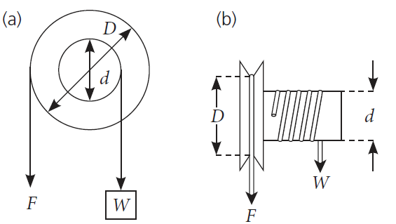
Types of lifting machines (continued)
Wheel-and-axle lifting machine
Figure 3.116: Wheel-and-axle lifting machine

Slide 31
Important formulae
VR for single-rope pulley system = number of pulleys

Slide 32
Activity 3.5
Test your knowledge of this section by completing Activity 3.5 (page 91 of your Student’s Book)

Slide 33
Summative activity
Read the module summary on page 93 and complete the summative activity on page 97

