Slide 1
TERMS AND CONDITIONS
These PowerPoint slides are a tool for lecturers, and as such:
YOU MAY add content to the slides, delete content from the slides, print out the slides, and save the slides onto your computer or server.
YOU MAY NOT resell, reproduce or redistribute the content in any form whatsoever, without prior written permission from the copyright holder.
© Troupant Publishers (Pty) Ltd, 2016
Selected images used under licence from Shutterstock.com

Slide 2
Engineering Science N1
Module 1: Orientation

Slide 3
Unit 1.1: SI units
Figure 1.1: Numbers and symbols form part of the language of
science and mathematics

Slide 4
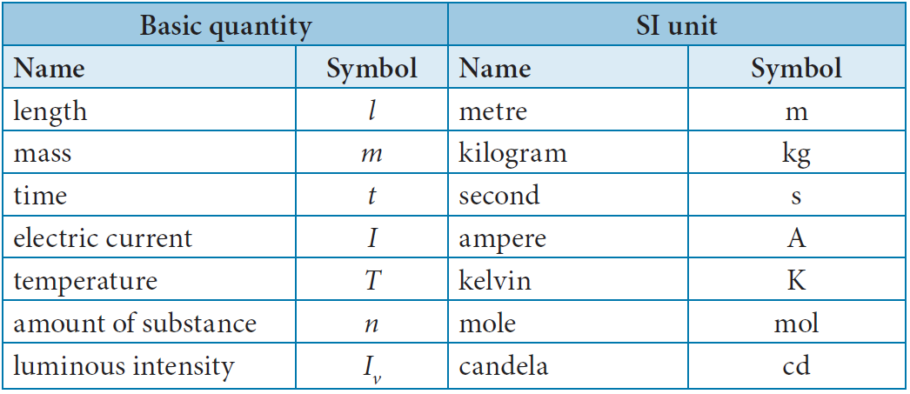
SI quantities and units
Table 1.1: The seven basic SI quantities and units

Slide 5
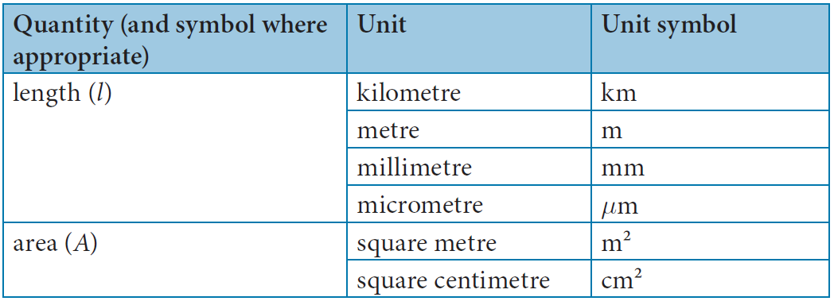
Basic and derived quantities
Table 1.2: Basic and derived quantities, their units and unit symbols

Slide 6
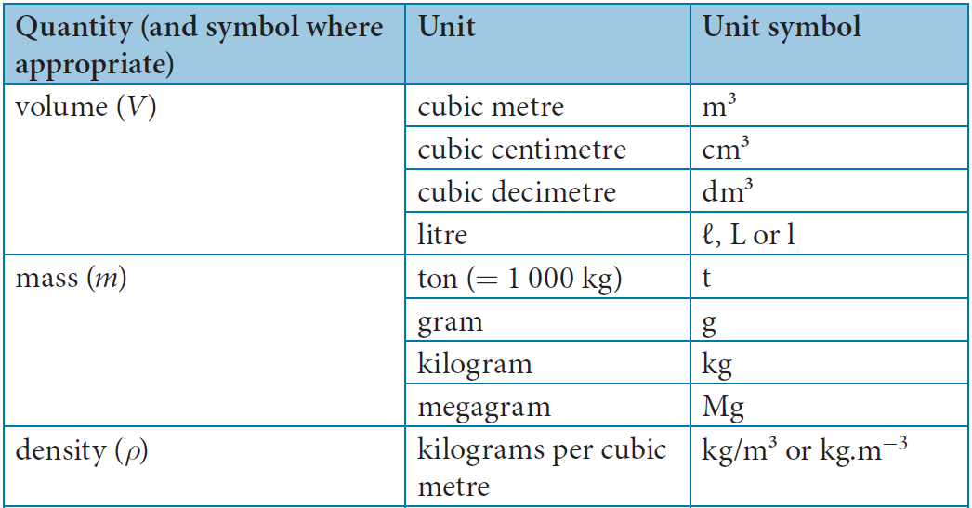
Table 1.2: Basic and derived quantities, their units and unit symbols (continued)

Slide 7
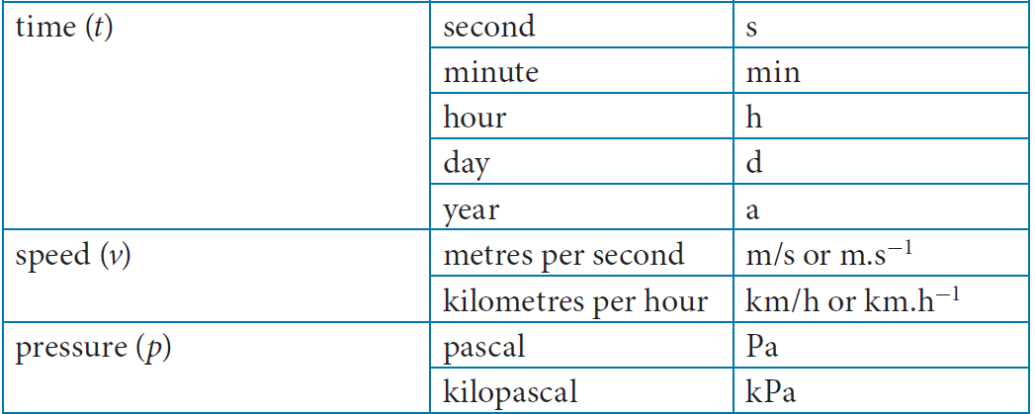
Table 1.2: Basic and derived quantities, their units and unit symbols (continued)

Slide 8
Table 1.2: Basic and derived quantities, their units and unit symbols (continued)

Slide 9
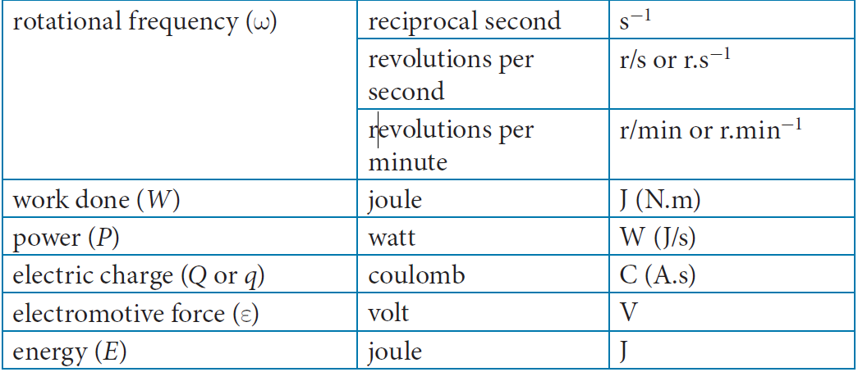
Table 1.2: Basic and derived quantities, their units and unit symbols (continued)

Slide 10
Table 1.2: Basic and derived quantities, their units and unit symbols (continued)

Slide 11
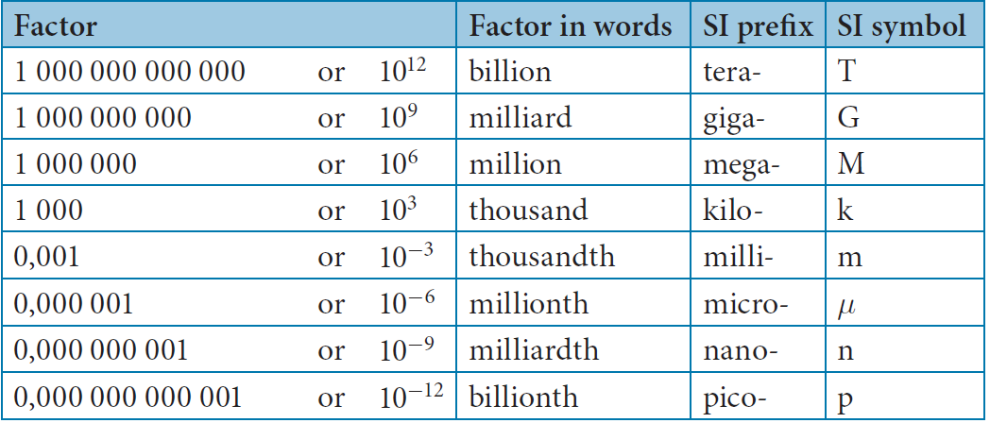
Table 1.3: Preferred SI prefixes
SI prefixes

Slide 12
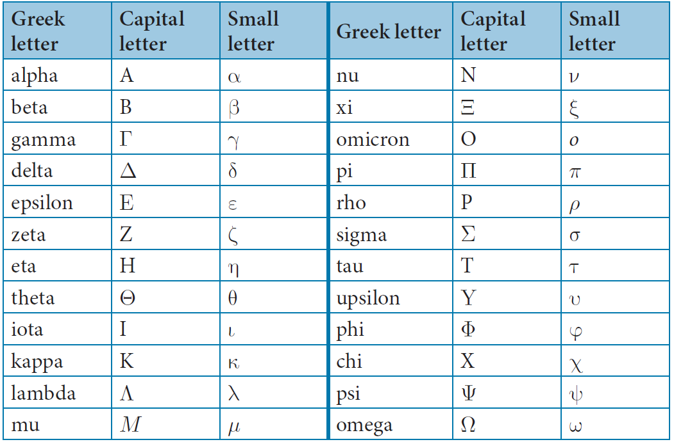
Table 1.4: Greek alphabet

Slide 13
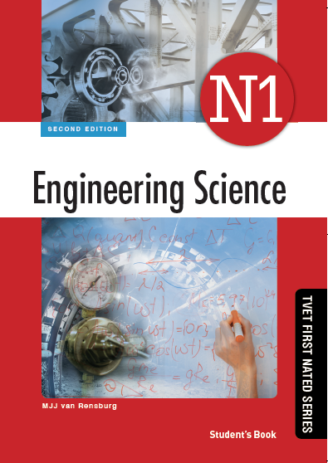
Activity 1.1
Test your knowledge of this section by completing Activity 1.1 (page 5 of your Student’s Book)

Slide 14
Unit 1.2: Calculator
Figure 1.2: Layout of a scientific calculator

Slide 15
Using your scientific calculator
Powers and roots
Memory
Calculations with brackets
The CE or DEL key
The EXP and 10^{x} keys

Slide 16
Unit 1.3: Converting km/h to m/s
hours into seconds: × by 3 600
minutes into seconds: × by 60
kilometres into metres: × by 1 000
seconds into minutes: ÷ 60
metres into kilometres: ÷ 1 000.

Slide 17
Assessment activity
Test your knowledge of this section by completing the Assessment activity (page 11 of your Student’s Book)

