Slide 1
Communication & Management Communication
N4

Slide 2
Business letters
Module 9

Slide 3
Overview
Letters to the press
Business correspondence
Employment letters:
Job application/covering letter and CV
Request for testimonial or reference
Letter to successful applicant
Letter to unsuccessful applicant
Letter of acceptance
Letter declining position
Resignation
Enquiries and replies
Information
Reservations
Business letters
Complaints and adjustments or refusals to adjust
Guest speakers: invitations and replies
Letters of goodwill: congratulatory letters, letters acknowledging
receipt, letters in the absence of the employer

Slide 4
General business correspondence
Unit 9.1

Slide 5

Writing a business letter
Identify the receiver.
Get the facts together.
Decide the relevant facts.
Decide the format and layout.
Draft a rough version.
Think of the audience.
Proofread the letter.
Finalise the letter.
Print the letter on an official letterhead.
Sign and send it.
You represent the company in every letter you send

Slide 6

Enquiries and replies concerning information
Making an enquiry
  Give the relevant account number, etc.
  Use a suitable line opening.
  State what you want to know.
  Specify your requests.
  End with an appropriate closing line.

Slide 7
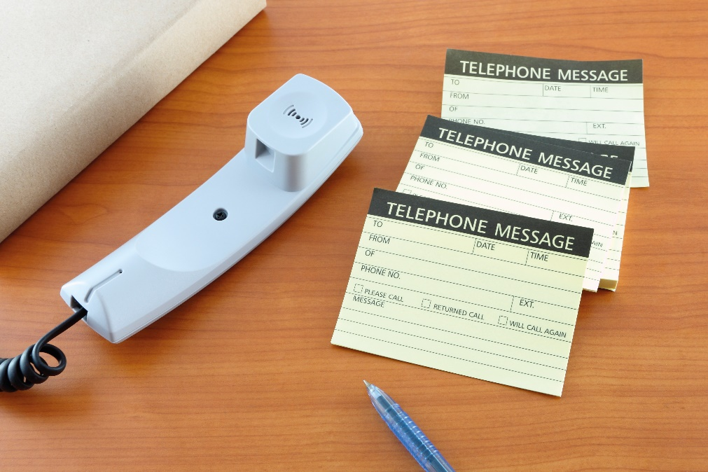
Enquiries and replies concerning information
Replying to an enquiry
  It is important to respond quickly.
  If unable, acknowledge receipt.
  If necessary, offer an explanation.
  End with an appropriate closing line.
Gather as much information as possible

Slide 8
Activity 9.1
Refer to page 175 of your Student’s Book to complete Activity 9.1.

Slide 9
Activity 9.2
Refer to page 177 of your Student’s Book to complete Activity 9.2.

Slide 10
Letters of complaint
Lodging a complaint
  Write an opening line expressing goodwill.
  Give the reference and other details.
  State what caused the present complaint.
  Propose a reasonable solution.
  End with an appropriate closing line.
A rude comment will only annoy the recipient and cause unpleasantness

Slide 11
Letters of complaint
Replying to a complaint
  Check the facts and get both sides of the story.
  Decide on the degree of subjectivity from your side.
  Thank the person bringing the matter to your attention.
  If you or your company is wrong, apologise and offer a solution.
  If the complainant is wrong, explain the matter and provide details.
  End with a closing line of goodwill.

Slide 12
Activity 9.3
Refer to page 180 of your Student’s Book to complete Activity 9.3.

Slide 13
Letters requesting or refusing adjustment
Whether you are asking for, or denying the adjustment, in all cases:
  Give all the necessary details.
  Explain the situation objectively.
  Remain polite and use correct language.
  End with an expression of goodwill.

Slide 14



Slide 15
Activity 9.4
Refer to page 182 of your Student’s Book to complete Activity 9.4.

Slide 16
Invitation and letters to the press
Unit 9.2

Slide 17

Invitations to, and replies from, guest speakers
Inviting a guest speaker
The invitation should contain the:
  Date, time and place
  Reason for the event
  Brief company background
  Proposed programme, etc.
An organisation may want to invite a guest speaker for a formal event

Slide 18
Invitations to, and replies from, guest speakers
Replying to an invitation as a guest speaker
  The person may return a negative or positive reply.
  If accepted, arrangements may be done over the phone.
  Confirm everything in writing, however, to keep records.

Slide 19
Activity 9.5
Refer to page 185 of your Student’s Book to complete Activity 9.5.

Slide 20

Letters to the press
Whether mailed, faxed or emailed, letters to the press should:
  Give your full name and address
  Have “Sir” or “Madam” as a salutation
Don’t abuse any public platform available to you

Slide 21
Activity 9.6
Refer to page 186 of your Student’s Book to complete Activity 9.6.

Slide 22
Employment letters
Unit 9.3

Slide 23
Covering letters for job applications
The covering letter should contain the following:
  Yours and the recipient’s name and address
  The position being advertised
  Where you saw the advertisement
  Your interests and strengths
  Why you are applying
  Your availability for an interview and work
  Attached CV
Even a prescribed application form would benefit from a short covering letter

Slide 24

Job application forms
When filling in a job application form you should:
  Read through it
  Use a pencil to mark information that’s not at hand
  Print clearly
  Reread the form
  Take care to post or email it
Type carefully when completing an online form

Slide 25
Activity 9.7
Refer to page 190 of your Student’s Book to complete Activity 9.7.

Slide 26
Requests for testimonials
A testimonial is a formal letter by your previous employer in which
he or she states:
  How long you worked there (starting date to ending date)
  What position(s) you held and your main duties
  Your best qualities as an employee and as a person
  His or her full name, work address and contact details

Slide 27
Activity 9.8
Refer to page 192 of your Student’s Book to complete Activity 9.8.

Slide 28

Letters of appointment
Confirming a successful application
Details that need to be put in writing include:
  Date of commencing work
  Working hours
  Job title and salary
  Job description, etc.
A successful job applicant

Slide 29

Letters of appointment
Confirming an unsuccessful application
  Contact all other applicants.
  State that they were unsuccessful.
  If you can, give a reason why.
  Thank them for their interest.
  Wish them success in their future employment.
An unsuccessful job applicant

Slide 30
Letters of resignation
When resigning, it’s always best to do it in such a way that you don’t harm any existing relationships.
Think the matter over carefully and weigh up your reasons.
Take time and think straight before resigning

Slide 31
Activity 9.9
Refer to page 196 of your Student’s Book to complete Activity 9.9.

Slide 32
Letters of goodwill
Unit 9.4

Slide 33

Congratulatory letters
Use the correct language and style to convey information:
  Use a formal style if you don’t know the person well.
  With an informal goodwill letter you can be less formal.

Slide 34
Activity 9.10
Refer to page 198 of your Student’s Book to complete Activity 9.10.

Slide 35
Letters acknowledging receipt
Use the company letterhead and state the topic of the sender’s letter. Then:
  Thank the person for sending.
  Explain the next step.
  Say when they can expect to hear from you.
  Give your full contact details.
  If you cannot be of assistance, suggest helpful alternatives.
Tackle a difficult response letter first thing in the morning

Slide 36

Letters in the absence of the employer
In some cases, you will be allowed to answer certain letters while your superior is absent. For instance:
  You can help the customer.
  If you can’t assist, redirect to someone who can.
  The client needs to know if they can be helped when the superior is back.
Always consult a senior colleague if uncertain

Slide 37
Activity 9.11
Refer to page 200 of your Student’s Book to complete Activity 9.11.

Slide 38
Test your knowledge of this module by completing the summative assessment on page 201 of your textbook.

