Slide 1
Communication & Management Communication
N4

Slide 2
Reports
Module 11

Slide 3
Overview
Investigation report
Progress report
Reports
Feedback report
Incident/accident report:
Occupational injury
Theft
Bomb threat

Slide 4
Investigation, feedback and progress reports
Unit 11.1

Slide 5
Investigation report
To compile an investigation report:
Gather information on the subject
Note that it might require teamwork
Identify the relevant details
Examine your findings closely
Present the information clearly
Compile the report in a formal and informal format
Give reasons if you are making a recommendation
An investigative report looks more closely at the incident

Slide 6
Feedback report
For a feedback report it is important to:
Prioritise the information
Organise the details logically
Write clearly

Slide 7
Progress report
A progress report informs the reader on the movement of the work. It could be:
A complete report
An internal memo
A project needs a planned timeline to be effective

Slide 8
Activity 11.1
Refer to page 224 of your Student’s Book to complete Activity 11.1.

Slide 9
Incident and accident reports
Unit 11.2

Slide 10
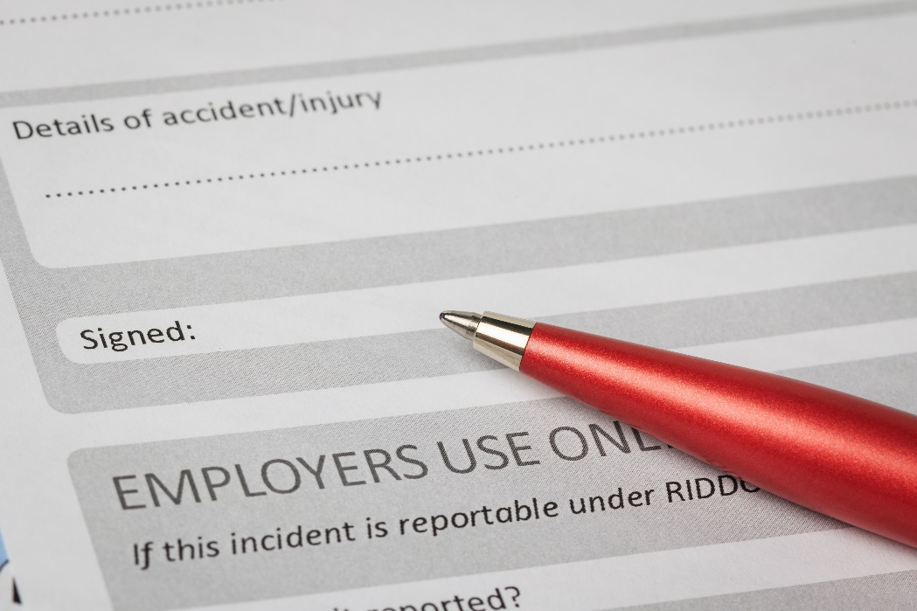
Incident and accident reports
An incident is usually an unplanned occurrence, such as:
An accident causing harm
An argument
Improper or unlawful behaviour
A bomb threat
Some companies have incident report forms

Slide 11
Report form for an occupational injury
This report is used to inform management of an accident.
Details will be required for claims.
The form will also be an important source of information.

Slide 12
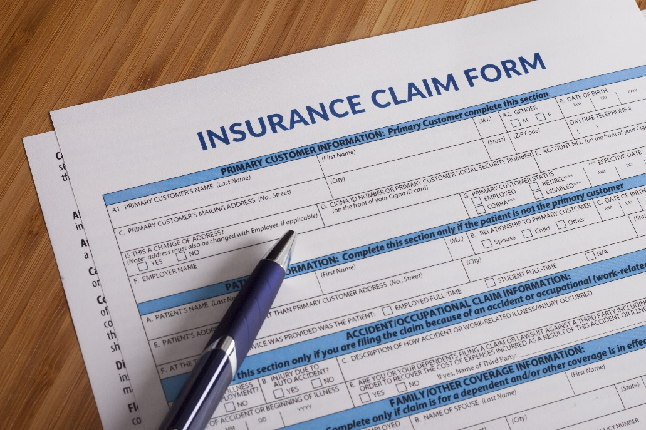
Report form for an incidence of theft
Processes that would benefit from its information are:
Disciplinary hearings
Insurance claims
Police investigations
Court cases

Slide 13
Report form following a bomb threat
This report is used to notify management of the incident.
The information would also be required by the police.
Don’t give speculations

Slide 15
Activity 11.2
Refer to page 227 of your Student’s Book to complete Activity 11.2.

Slide 16
Test your knowledge of this module by completing the summative assessment on page 228 in your textbook.

