Slide 1
Mathematical Literacy
NQF 3

Slide 2
Understanding tariff systems
Module 12

Slide 3
Overview
12.1 Comparing different telephone tariffs
12.2 Considerations when choosing a cell phone and contract
12.3 Comparing different transport costs
12.4 Drawing and interpreting graphs
12.5 Municipal tariffs

Slide 4


Comparing different telephone tariffs
Unit 12.1
Communication is very important for any business.
A reliable phone service is required:
to contact clients and for clients to contact the business
for internet access for emails and internet banking

Slide 5



Comparing different telephone tariffs
Unit 12.1
Two types of cell phone services exist:
Contract services
Prepaid services

Slide 6

Example 12.1 page 227
Unit 12.1
Nomsa runs a home cleaning business. She needs to:
have one business number that can be linked to business cell phones when necessary
stay in touch with each team of cleaners at all times
give each team leader a cell phone so that she can control her business by phone
know that the cell phones will only be used for business calls
receive one invoice for all the
cell phones and for Internet use
She compares the two plans:

Slide 7
Example 12.1 page 227 continued ...
Unit 12.1
Service Provider A:
A virtual landline number. You can divert clients’ calls to a business cell phone.
An email address
One invoice for all business phones
4 business cell phone contracts for work teams at R129 per month for 24 months with:
Monthly allocation of 100 free any-time any-network minutes, 1 Gb of data and 100 SMSs
  Out of bundle calls charged at a flat rate of R0,28 per call
1 business cell phone for Nomsa at R299 per month for 24 months. The contract offers:
  Monthly allocation of 300 free any time any network minutes, 3 Gb of data and 300 SMSs
  Out of bundle calls charged at a flat rate of R0,28 per call
  Out of bundle data charged at 8c per Mb.

Slide 8
Example 12.1 page 227 continued ...
Unit 12.1
Service Provider B:
A virtual landline number. You can divert clients’ calls to a business cell phone.
A call-free zone. Employees can call one another for free, anywhere in the country.
4 business cell phone contracts for work teams at R99 per month for 24 months with:
  Monthly allocation of 1 Gb of data, free SMSs and instant messaging, free itemized billing
  Calls are charged at R0,69 per minute, with per second billing
1 business cell phone for Nomsa at R399 per month for 24 months. The contract offers:
  Monthly allocation of 10 Gb of data, free SMSs and instant messaging, free itemised billing
  Out of bundle calls are charged at R0,69 per minutes, with per second billing
  Out of bundle data charged at 29c per Mb.

Slide 9
Example 12.1 page 227 continued ...
Unit 12.1
Case study questions – try to answer these questions in your group, before looking at the solution.
What is the advantage of having one cell phone number for all the cell phones in the business?
Do both plans suit Nomsa’s needs? Explain fully.

Slide 10

Example 12.1 page 227 continued ...
Unit 12.1
The advantage is that clients’ calls can be diverted to Nomsa’s cell phone when she is not in her office. When she is unavailable, calls can be diverted to one of her team members. Therefore, clients’ calls will always be answered.
Yes, each service provider allows Nomsa to divert calls to other business phones. She can control her business by phone and would receive one invoice for all the business phones.

Slide 11
Example 12.1 page 227 continued ...
Unit 12.1
This is Nomsa’s business’s average phone usage for a month:
Each of the 4 teams makes 40 calls to Nomsa. The average length of a call is 50 seconds.
Each of the 4 teams makes 17 calls to clients. The average length of a call is 1 minute 8 seconds
Nomsa makes 160 calls to her work teams. The average length of a call is 1 minute 15 seconds. These are calls to the same service provider.
Nomsa makes 110 calls to clients from her phone. The average length of a call is 2 minutes. Assume that these are calls to different service providers.
The business uses 18,5 Gb of data per month.

Slide 12
Example 12.1 page 227 continued ...
Unit 12.1
  Calculate the cost of calls for one work team for
    Service Provider A
    Service Provider B
  Calculate the cost of Nomsa’s calls for
    Service Provider A
    Service Provider B
  Calculate the cost of data for the business for
    Service Provider A
    Service Provider B

Slide 13
Example 12.1 page 227 continued ...
Unit 12.1
Use your calculations to complete the table below.
Which service provider would you recommend to Nomsa? Give a reason for your answer
 | SERVICE PROVIDER A | SERVICE PROVIDER B
Monthly contract costs
Total cost for 4 work team calls to Nomsa and clients
Nomsa’s calls to work teams
Nomsa’s calls to clients
Business data costs
TOTAL COST

Slide 14



Example 12.1 page 227 continued ...
Unit 12.1
3. a)
  Calls to Nomsa + calls to clients
  = (40 calls × 50 secs) + (17 calls × 1 min 8 secs)
= 2 000 seconds + (17 x 68 secs)
= 2 000 + 1 156 secs = 3 156 secs
Number of call minutes = = 52,6 minutes
The contract provides 100 free minutes. There is no charge for phone calls.
Calls to Nomsa are free.
Calls to clients = 17 calls × 1 min 8 secs
= 1 156 seconds = = 19 minutes 16 seconds
Cost of calls to clients
= (19 × 0,69) + ( × 0,69)
= R13,11 + R0,18 = R13,29
$$\frac{3156}{60}$$
$$\frac{1156}{60}$$
$$\frac{16}{60}$$

Slide 15
Example 12.1 page 227 continued ...
Unit 12.1
b)
Nomsa gets 300 free minutes.
Calls to work teams = 1 min 15 secs = 1,25 minutes
1,25 mins × 160 = 200 minutes
There is no charge.
Calls to clients. Nomsa has 100 free minutes left.
Calls are 2 minutes long.
100 mins ÷ 2 minute calls = 50 calls at no charge.
She pays for 60 calls @ R0,28 per call
60 × R0,28 = R16,80

Slide 16
Example 12.1 page 227 continued ...
Unit 12.1
Call free zone for employees. There is no charge for calls to work teams.
110 calls × 2 mins × R0,69
= 220 mins × R0,69
= R151,80
c)
Nomsa gets 3 Gb of free data, but she uses 18,5 Gb. Therefore she pays for 15,5 Gb of data
15,5 Gb × 1 000 = 15 500 Mb
15 500 × R0,08 = R1 240,00
Nomsa gets 10 Gb of free data.
Therefore she pays for 8,5 Gb of data
8,5 Gb × 1000 = 8 500 Mb
8 500 × R0,29 = R2 465,00

Slide 17
Example 12.1 page 227 continued ...
Unit 12.1
Service provider A. The cost of calls and data for service provider B are higher.
 | SERVICE PROVIDER A | SERVICE PROVIDER B
Monthly contract costs | (4 × R129) + (1 × 299) = R516 + R299 = R815,00 | (4 × R99) + (1 × R399) = R396 + R399 = R795,00
Total cost for 4 work team calls to Nomsa and clients | R0,00 | R13,29
Nomsa’s calls to work teams | R0,00 | R0,00
Nomsa’s calls to clients | R16,80 | R151,80
Business data costs | R1 240,00 | R2 465,00
TOTAL COST | R2 071,80 | R3 425,09

Slide 18
Exercise 12.1
Unit 12.1
Complete Exercise 12.1 on page 231 of your Student’s Book

Slide 19

Considerations when choosing a cell phone and a contract
Unit 12.2
Not all purchases are based upon financial reasons.
The non-financial factors that influence our choices:
1
Brand loyalty
2
Functionality
3
Network coverage
4
Range of other products offered by the provider

Slide 20
Exercise 12.2
Unit 12.2
Complete Exercise 12.2 on page 233 of your Student’s Book

Slide 21
Comparing different transport cost
Unit 12.3
Transport in the business environment is usually very expensive.
Before the choice is made a detailed comparison needs to be made.

Slide 22
Example 12.2 page 233
Unit 12.3
Mpho has to travel from Durban to Johannesburg for a job interview process. The interview and assessment is scheduled for 10:00 – 14:00.
She needs to land in Johannesburg by 08:30.
The earliest she can get to the airport in Johannesburg after the meeting is 15:30.
On her way back, she must be at the airport one hour before departure.
She looks at flights on an Internet website.

Slide 23
Example 12.2 page 233 continued ...
Unit 12.3
All flights are 1h05m non-stop economy
Kul Air | DUR 06:00–07:05 JNB | R572 | SA Air | JNB 15:10–16:15 DUR | R1 353
Kul Air | DUR 06:15–07:20 JNB | R572 | SA Air | JNB 15:55–16:00 DUR | R1 284
Mardi | DUR 06:15–07:20 JNB | R699 | Mardi | JNB 16:00–17:10 DUR | R704
SA Air | DUR 06:15–07:20 JNB | R1 377 | BritAir | JNB 15:10–16:15 DUR | R834
Brit Air | DUR 06:30–07:35 JNB | R566 | BritAir | JNB 16:15–17:20 DUR | R834
SA Air | DUR 06:30–07:35 JNB | R651 | SA Air | JNB 16:45–17:50 DUR | R1 353
SA Air | DUR 07:00–08:05 JNB | R822 | KulAir | JNB 16:55–18:00 DUR | R572
SA Air | DUR 07:40–08:45 JNB | R651 | Mardi | JNB 17:15–18:20 DUR | R704

Slide 24
Example 12.2 page 233 continued ...
Unit 12.3
What is the cheapest combination of flights that would
suit Mpho?
Another option is for Mpho to travel by bus.
Bus schedule 1:
1. Depart Durban, Thursday, May 3 2018 to Johannesburg
Route: Dbn – Ladysmith – Jhb – Pta
Depart 11:30 Duration 8 hours, 50 minutes Arrive 20:20
Available Seats: 28; from R250,00 OR
2. Depart Durban, Thursday May 3 2018 to Johannesburg
Route: Durban – Newcastle – Jhb – Pta
Depart 21:00 Duration 9 hours, 15 mins Arrive 06:15
Available Seats: 22, from R320,00 OR
3. Depart Durban, Friday May 4 2018 to Johannesburg
Route Durban – Howick – Jhb – Pta
Depart 08:00 Duration 7 hours, 50 minutes Arrive 15:50
Available Seats 16, from R360,00
https://www.greyhound.co.za/booking-process-continued/#

Slide 25
Example 12.2 page 233 continued ...
Unit 12.3
Bus schedule 2:
1. Return Johannesburg, Saturday, May 5 2018 to Durban
Route Pta - Jhb – Howick - Dbn
Depart 11:10 Duration 8 hours, 0 minutes Arrive 19:10
Available Seats: 20, from R 240.00
2. Return Johannesburg, Saturday, May 5 2018 to Durban
Route Pta - Jhb – Vereeniging - Durban
Depart 08:30 Duration 7 hours, 55 minutes Arrive 16:25
Available Seats: 29, from R 385.00
3. Return Johannesburg, Friday, May 4 2018 to Durban
Route Pta - Jhb – Bloemfontein - Durban
Depart 16:20 Duration 13 hours, 20 minutes Arrive 05:40
Available Seats: 27 from R 325.00
https://www.greyhound.co.za/booking-process-continued/#

Slide 26
Example 12.2 page 233 continued ...
Unit 12.3
2.
Which would be the most suitable bus to take to Johannesburg? Give a reason for your answer.
Which would be the most suitable bus to take back to Durban? Give a reason for your answer.
How much would Mpho pay for the return journey?
How should Mpho travel to Johannesburg for her interview? Give a reason for your answer.

Slide 27
Example 12.2 page 233 continued ...
Unit 12.3
The BritAir flight DUR 06:30 – 07:35 JNB at R566 is the cheapest flight to Johannesburg. Mpho will have enough time to get to the meeting.
She can only get to the airport at 15:30, so the earliest flight she can take to Durban is 16:30. The Kul-air flight JNB 16:55 – 18:00 DUR at R572 will suit her needs.
Mpho would pay R1 138 for the return trip.

Slide 28
Example 12.2 page 233 continued ...
Unit 12.3
a) Your answer could be different. As long as you provide a sensible reason, your answer would also be acceptable.
If she wanted to save money on accommodation, she could choose Route Durban - Jhb/Pta Via Swb **. She would travel overnight and arrive on the morning of the interview.
If she wanted to look fresh and relaxed for the interview, she should choose Route Pta/ Jhb - Durban - Jhb/ Pta (Via Howick)***. She would arrive in Johannesburg on the day before the interview.
I think she should choose Route Pta/ Jhb - Durban - Jhb/ Pta (Via Howick)*** and sleep in Johannesburg before the interview.

Slide 29
Example 12.2 page 233 continued ...
Unit 12.3
b) Route Pta/ Jhb - Durban - Jhb/ Pta (Via Howick)*** and Route Pta/ Jnb - Dbn - Jnb/ Pta Via Pnt * would both suit her. She would arrive home on the same afternoon. Route Pta/ Jnb - Dbn - Jnb/ Pta Via Pnt * is cheaper.
c) R360 + R250 = R610,00
She should go by plane. If she chose to go by bus, she would have a longer journey and would have to pay for accommodation in Johannesburg. This would increase the cost of the journey.
Some tariff tables group the prices for travelling in zones.
The more zones you travel through, the more you pay.

Slide 30
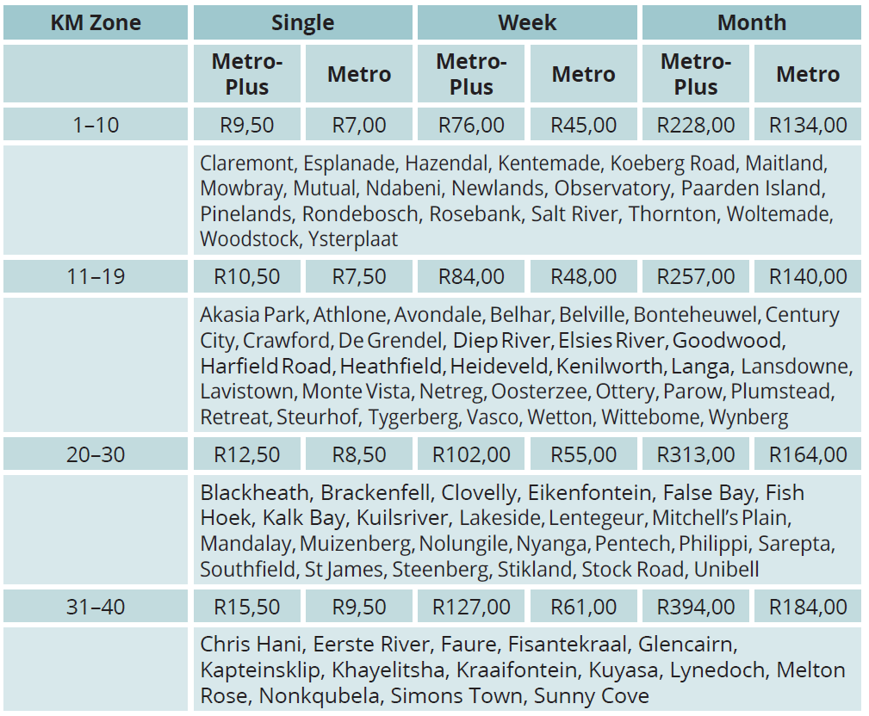
Travel tariff tables
Unit 12.3
On this tariff table, zoning is based on distance from Cape Town station.
http://www.metrorail.co.za/Communication/fares/Western-Cape-Flyer.png

Slide 31
Travel tariff tables
Unit 12.3
Refer to the tariff table:
Stations in the 1–10 zone are all 1–10 km from Cape Town station.
You pay the same price to a station 12 km away from Cape Town or a station 19 km away, because they are both in the zone 11–19.
It would cost R17,00 for a return trip from Nolungile to Cape Town in the Metro coach of the train.
It would cost R25 for the same journey if the person travelled in the MetroPlus coach.

Slide 32
Exercise 12.3
Unit 12.3
Complete Exercise 12.3 on page 236 of your Student’s Book

Slide 33
Drawing and interpreting graphs
Unit 12.4
We can compare two different situations using two graphs on the same set of axes.
At the point of intersection of two graphs their values are equal.

Slide 34
Example 12.3 page 239
Unit 12.4
The graph compares income and expenditure using two straight line graphs on the same set of axes.

Slide 35
Example 12.3 page 239
Unit 12.4
The expenditure graph shows how the business expenditure increased as more units were produced.

Slide 36
Example 12.3 page 239
Unit 12.4
The sales graph shows how the business income increased as more units were sold.

Slide 37
Example 12.3 page 239
Unit 12.4
The expenditure graph cuts the vertical axis at approximately (0; 1 750).
The company spent R1 750 before any units were produced.
The sales graph cuts the vertical axis at (0; 0). This means that there is no income when no units are sold.

Slide 38
Example 12.3 page 239
Unit 12.4
The point of intersection marks the point at which the company earned exactly the amount it had spent on production.
This is called the break-even point. At the break-even point, the business does not make a profit, but it does cover all costs.

Slide 39
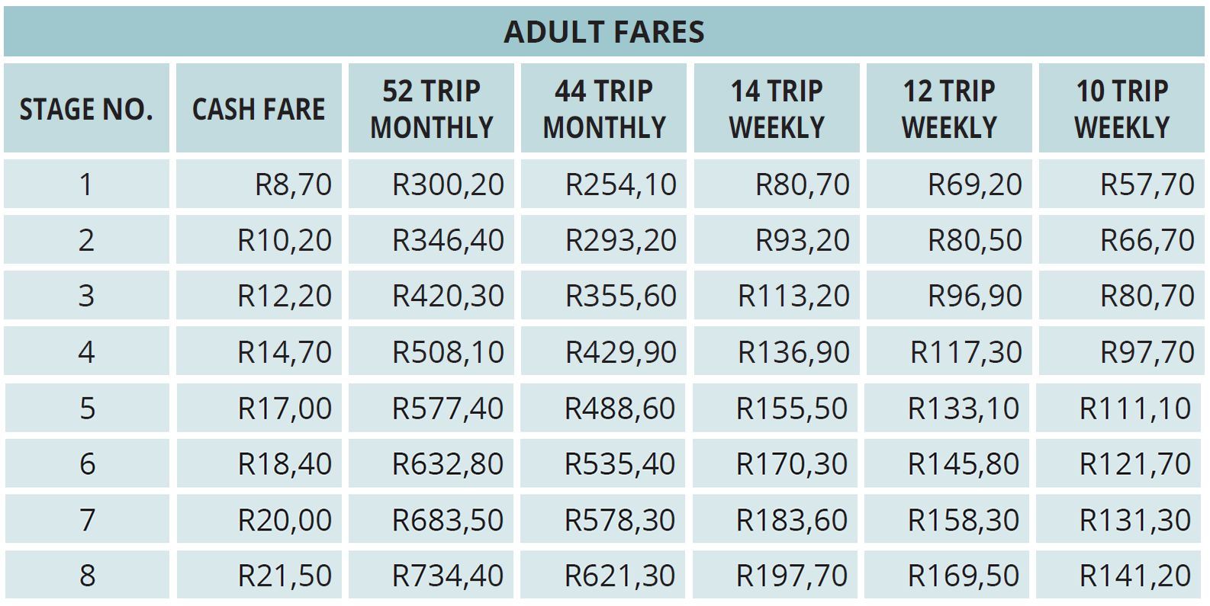
Example 12.4 page 239
Unit 12.4
We can use graphs to compare tariff-based costs. The table shows different tariffs for travelling by bus in a city:

Slide 40
Example 12.4 page 239
Unit 12.4
How much does it cost for a return fare, paid in cash, to a destination in Stage 1?
Calculate the cost of a return trip to the same destination 6 days of the week if you pay the cash fare every time.
What would you pay for a 12-trip weekly card?
On the same set of axes, draw the graph showing the two scenarios for 6 days.

Slide 41
Example 12.4 page 239
Unit 12.4
Use your graph to answer the following questions:
  Show by calculation that it costs R69,60 for 4 return trips.
  Explain why your graph showing cash fare, is a dotted line.
  Which is the cheaper option if you do two return trips?
  After how many days does it become cheaper to buy a 12-trip weekly? Explain.
  What feature on the graph indicates this?
  Why is the 12-trip weekly graph horizontal?

Slide 42
Example 12.4 page 239
Unit 12.4
R8,70 × 2 = R17,40
R17,40 × 6 = R104,40
R69,20
4.

Slide 43
Example 12.4 page 239
Unit 12.4
5.
R17,40 × 4 = R69,60
Each value is discrete. There is no fare between two points.
The cash fare
After 3 days. The total cost for a 12-trip weekly card is equal to or less than the cash fare on day 4 or more.
The point of intersection lies before the 4 day mark.
There is one cost that covers all 12 trips.

Slide 44
Exercise 12.4
Unit 12.4
Complete Exercise 12.4 on page 241 of your Student’s Book

Slide 45
Municipal tariffs
Unit 12.5
Municipalities use a tariff based costing system.
One price or tariff covers each band or range of usage.
Electricity is priced within bands. The unit of measurement is kilowatt hour (kWh).
The more electricity you use, the more you are charged per kWh.
Water is also priced within bands. Water is measured in kilolitres (kℓ).

Slide 46
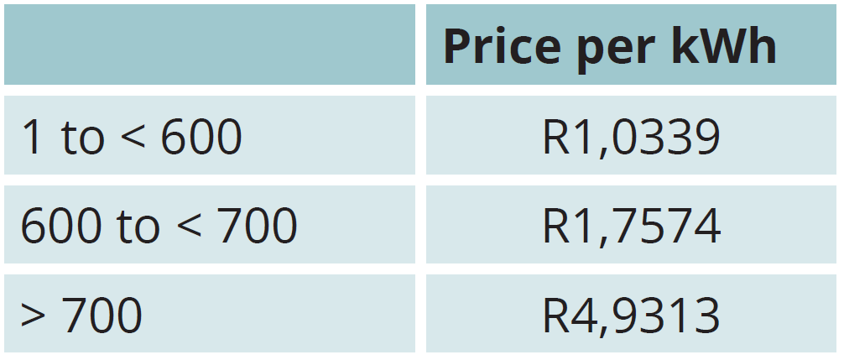
Example 12.5 page 242
Unit 12.5
Study this example of electricity tariff bands:
  How much would you pay per kWh if you used 540 kWh of electricity?
  Calculate the cost of 540 kWh of electricity. Round off your answer to the nearest cent.
Show that if you used 650 kWh of electricity, you would pay approximately R700.
Calculate the cost of using 800 kWh of electricity.

Slide 47
Example 12.5 page 242 continued ...
Unit 12.5
a) You would pay R1,0339 per kWh.
  b) 540 kWh × R1,0339 = RR558,31.
Cost for first 599 kWh: 599 kWh × R1,0339 = R619,3061
Cost for (650 – 599) kWh: 51 kWh × R1,7574 = R89,6274
Total cost = R619,3061 + R89,6274
= R708,9335 ≈ R708,93
(599 kWh × R1,0339) + (100 kWh × R1,7574)
+ (101 kWh × R4,9313)
= R619,3061 + R175,74 + R498,0613
= R1 293,1074 ≈ R1 293,11

Slide 48
Exercise 12.5
Unit 12.5
Complete Exercise 12.5 on page 243 of your Student’s Book

Slide 49
Module assessment
Module 12
Complete Module assessment on page 246 of your Student’s Book

