Slide 1
Life Orientation: Life Skills
NQF 4

Slide 2
Describe the voting procedure
Module 13

Slide 3

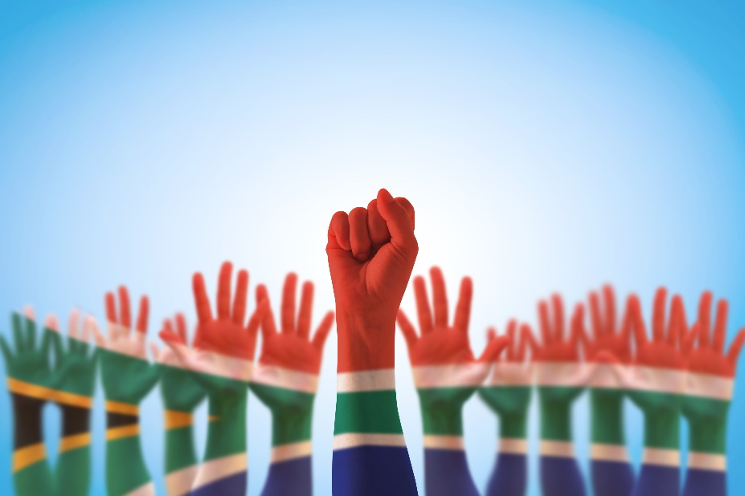
Think about it…
Does your one small vote matter?
What is the role of the IEC in elections?
What does ‘democracy’ really mean?

Slide 4
The importance of voting in an election
Unit 13.1

Slide 5
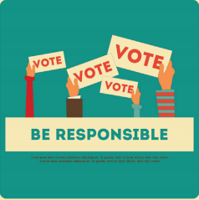
What is voting?
Formal process to choose between two or more candidates to fill a position.
You can vote:
    By a show of hands
    On a ballot paper
    Electronically.
The candidate with the most votes wins.

Slide 6
Different kinds of elections
Refer to Table 13.1 in your Student’s Book for the characteristics of different kinds of elections.

Slide 7
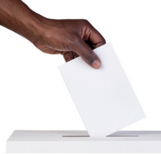
The importance of voting
Become informed.
Exercise your rights.
Exert a positive influence.
Figure 13.2: The outcome of an election will affect your own circumstances in several ways

Slide 8

The importance of voting
See the true state of the nation.
Make every vote count.
Voting is taking action.
Have a say in matters.

Slide 9

The importance of voting
Support honest policymakers, hard workers & visionaries.
Keep a check on responsibilities.
Help shape the future.
Consider the alternatives.

Slide 10
Learning activity 13.1
Module 13
Test your knowledge of this unit – and think about why voting matters to you – by completing Learning activity 13.1 in your Student’s Book.

Slide 11
The voting
& election process
Unit 13.2

Slide 12
Who can vote in an election?
Refer to Table 13.2 in your Student’s Book for more information about the characteristics of eligible voters.

Slide 13
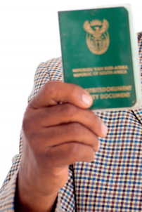
Documents required to vote
Green bar-coded ID book or smart ID
Temporary Identification Certificate (TIC) if your ID has been lost, stolen or damaged.
Figure 13.7: The green, bar-coded ID books are being phased out by smart ID cards, but you can use either to vote

Slide 14

How do you register as a voter?
Normal votes:
    Register in the voting district where you live most of the time
    Need to be at least 16 years old to register (can only vote from age 18)
    Check that you are on the voters’ roll.

Slide 15

How do you register as a voter?
Special votes:
  In some cases, registered voters can apply for special votes
  For people who will be away on voting day
  For people who are disabled, pregnant, elderly, or too ill to vote on election day.

Slide 16
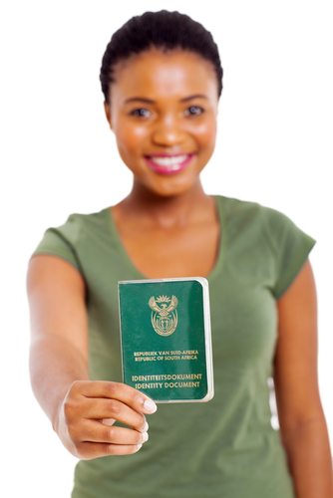
Procedure at election stations
Queue at your voting station
Show your ID to the voting officer:
    If your name isn’t on the voters’ roll, show proof of registration
    If your name is on the roll, a line will be drawn through your name, your ID stamped & your thumbnail marked.

Slide 17
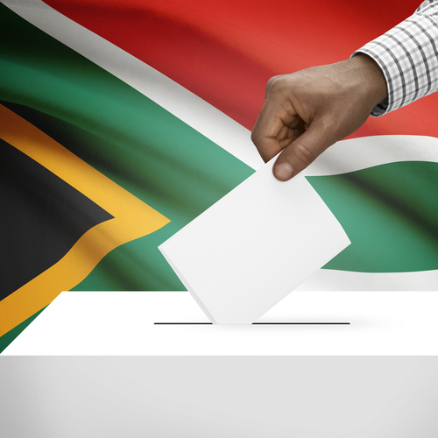
Procedure at election stations
You will be given ballot paper(s).
Go to a private ballot booth & mark one choice with an ‘x’.
Fold your ballot paper(s).
Place ballot(s) in the correct box(es).

Slide 18

How the votes are used
Sealed ballot boxes are taken to counting stations
Ballot papers are unfolded & sorted, then counted, checked & bundled
Counting officer signs off numbers & takes election materials to nearest election office.

Slide 19
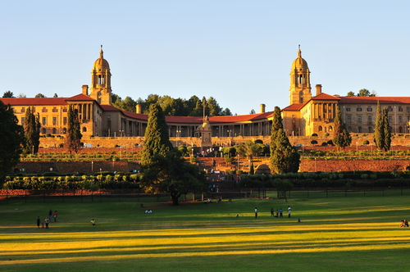
How the votes are used
In SA, voters vote for a party not for an individual.
Each party is allocated seats in parliament proportional to the number of votes the party received.
National Assembly is
formed & the president
is chosen.

Slide 20
Learning activity 13.2
Module 13
Test your knowledge of this unit by completing Learning activity 13.2 in your Student’s Book.

Slide 21
The role of the
IEC in elections
Unit 13.3

Slide 22
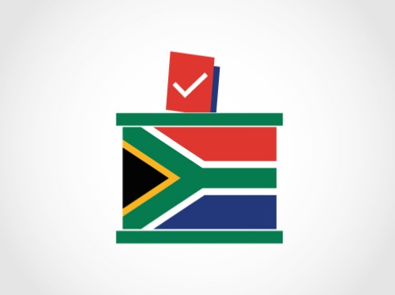
What is the IEC?
IEC = Independent Electoral Commission
Manages SA’s national, provincial & municipal elections
Financed by public funds, but is an independent body
Aims:
    Excellent running of elections
    Strengthening democracy
    Cooperation with political parties.

Slide 23
What is the role of the IEC?
Section 190 (1) of the Constitution states that the IEC must:
“(a) manage elections of national, provincial and municipal legislative bodies in accordance with national legislation;
(b) ensure that those elections are free and fair; and
(c) declare the results of those elections within a period that must be prescribed by national legislation and that is as short as reasonably possible.”

Slide 24

Critical analysis of the IEC
Is media used well to communicate with voters?
Do people know what to expect from an election?
Do people know where to vote?
How does the IEC communicate with the media?

Slide 25
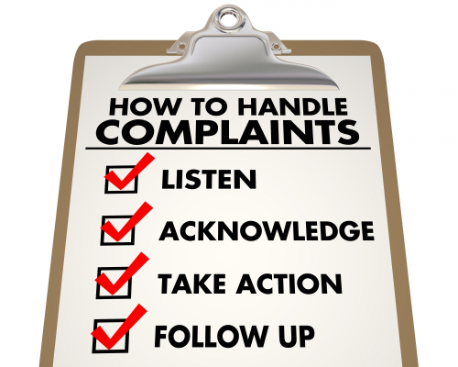
Critical analysis of the IEC
Is the IEC open about its work?
Does the IEC make the voting process easier for voters?
How does the IEC handle complaints?

Slide 26
Learning activity 13.3
Module 13
Test your knowledge of this unit by completing Learning activity 13.3 in your Student’s Book.

Slide 27
Good voter behaviour
Unit 13.4

Slide 28
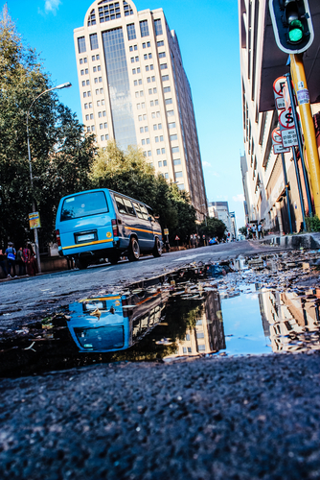
Good voter behaviour before the election
Check that you are registered.
Know where you are voting & how you’ll get there.
Research different candidates & what they stand for.

Slide 29
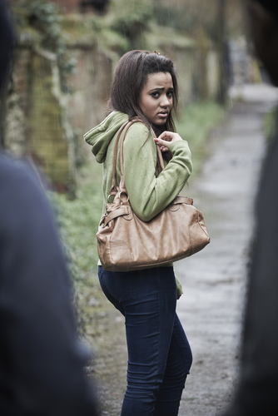
Good voter behaviour during the election
Respect those in authority.
Respect other voters & public property.
Do not intimidate.
Vote wisely.
Don’t spoil your ballot paper.

Slide 30
Good voter behaviour after the election
Report any irregularities.
Complete a form if you see:
    Anyone being intimidated or bribed.
    Anyone receiving too many ballot papers.
Don’t tamper with any voting boxes.
Don’t be a sore loser if your candidate doesn’t win.

Slide 31
Learning activity 13.4
Module 13
Test your knowledge of this unit – and start preparing for your project – by completing Learning activity 13.4 in your Student’s Book.

Slide 32
Portfolio task 5
Complete Portfolio task 5 in your Student’s Book. This is a formal assessment.

