Slide 1
Life Orientation: Life Skills
NQF 3

Slide 2
Participate in a community or national campaign or project
Module 13

Slide 3

Think about it…
What motivates people to help others whom they don’t even know?
How can you identify a good cause?
When is the best time to do good to others?

Slide 4
Community projects
& national campaigns
Unit 13.1

Slide 5
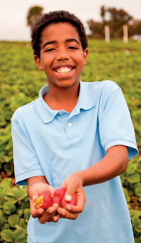
Community projects
Aim to assist, uplift, inform, inspire & empower
Need different types of aid, e.g. material, developmental, informational, physical.
Figure 13.1: Creating food gardens in a community empowers residents
to grow their own food

Slide 6
Types of community projects
Can be started by:
Person or organisation interested in the community
Individuals or group in the community.
Need volunteers (who aren’t paid or forced to help & want to make a difference)
Need groups of people (teams) working to achieve a goal.

Slide 7
Types of community projects
Refer to Table 13.1 in your Student’s Book to see examples of community projects & their main beneficiaries.

Slide 8
Examples of national campaigns
Can be held by:
    Local or national governments
    Local or international non-profit organisations (NPOs).
Usually advertised in the media (e.g. TV, radio, social media & newspapers).
May coincide with local or international days.

Slide 9
Example of a national campaign
Anti-violence
The 16 Days of Activism for No Violence Against Women and Children campaign (25 November to 10 December)
Volunteers can:
    Raise awareness
    Work with places that help victims of abuse
    Participate in activities.

Slide 10

Example of a national campaign
Healthcare
Examples:
    1 December: World Aids Day
    Campaign: Polio & Measles Immunisation.
Volunteers can:
    Raise awareness
    Give talks
    Organise transport to clinics.

Slide 11

Example of a national campaign
Savings
The National Savings Awareness campaign (every July)
Volunteers can:
  Promote a culture of saving
  Educate about dangers of debt
  Offer financial literacy classes.

Slide 12

Example of a national campaign
Anti-substance abuse
The National Anti-Substance Abuse campaign
Volunteers can:
  Participate in events
  Learn more & inform others
  Spread the news about the campaign.

Slide 13

Example of a national campaign
Environment
Examples:
Every March: National Water Week
2 February: World Wetlands Day
22 April: UN International Mother Earth Day
Volunteers can:
  Participate in events
  Learn more & inform others.

Slide 14

Example of a national campaign
Ubuntu
Examples:
The Proudly South African National Buy Local campaign (ongoing)
18 July: Nelson Mandela Day
Organ donation awareness.

Slide 15
Learning activity 13.1
Module 13
Test your knowledge of this unit – and carry out an activity to assist a community project – by completing Learning activity 13.1 in your Student’s Book.

Slide 16
Participation in projects & campaigns
Unit 13.2

Slide 17

Why take part in national campaigns?
Shows that you agree with a cause
Shows that you care & are willing to be counted
Allows you to assist in practical ways.
Figure 13.10: It helps to wear a T-shirt or badge that identifies you with the group or activity

Slide 18

Best ways to participate in events
Commit:
    Choose activities you’re passionate about.
    Be honest about your abilities.
    Notify a leader if you cannot attend or need to be excused.

Slide 19

Best ways to participate in events
Behave in a professional manner:
    Uphold the reputation of the group or organisation
    Take pride in your work
    Don’t abuse your position
    Respect privacy & be discreet.

Slide 20

Best ways to participate in events
  Have team spirit:
    Respect the rules
    Offer suggestions respectfully
    Stay modest
    Cooperate & be reliable.

Slide 21

Best ways to participate in events
  Leaders need to:
  Consult the community & ensure they approve the project
  Be honest about work involved
  Give clear instructions
  Train team members
  Advise where necessary.

Slide 22

Best ways to participate in events
  Leaders need to:
  Take responsibility for actions
  Motivate & inspire
  Listen to suggestions & feedback
  Show respect
  Be sensitive to differences.

Slide 23
Learning activity 13.2
Module 13
Test your knowledge of this section by completing Learning activity 13.2 in your Student’s Book.

Slide 24

Reporting on a project or campaign
Need to:
  Report back to organisers
  Account to sponsors for money spent
  Give feedback to public
  Provide statistics for media
  Give lessons learnt for future projects.

Slide 25

Content of the report
Be honest
Edit your draft
Don’t exaggerate
Give enough detail
Content must be accurate
Only take credit for what you did
Tell all sides of the story objectively.

Slide 26
Basic structure of a feedback report
Table 13.2: Basic components of a report
Components | Description
Cover page | Give a creative, catchy title, followed by a subtitle that states the name and date of the event. Your name should also appear on the cover page.
Background | Give background information to the event (such as who organised it and why, and where it took place).
Introduction | State your role in the event and why you decided to participate.
Description | Describe the event chronologically, giving sufficient detail.
Highlights/Best practices | Describe interesting incidents or conversations in more detail, and place these in boxes that are separate from the main body of text.

Slide 27
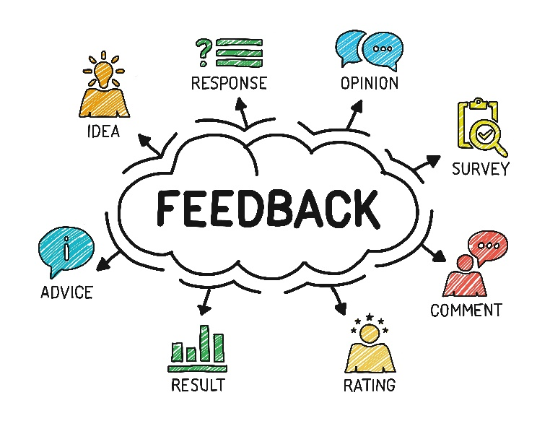
Basic structure of a feedback report
Table 13.2: Basic components of a report
Components | Description
Findings | State what you discovered about the issue, yourself, the public’s views, and any mistakes that were made.
Conclusions | Identify the main lessons and impressions you are taking with you.
References | List any sources you used and your full contact details.

Slide 28
Learning activity 13.3
Module 13
Test your knowledge of this section by completing Learning activity 13.3 in your Student’s Book.

Slide 29
Portfolio task 5
Complete Portfolio task 5 in your Student’s Book. This is a formal project.

